Slide 2
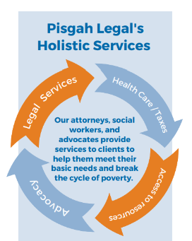
MORE JUSTICE, LESS POVERTY.
Established in 1978, Pisgah Legal Services is a nonprofit providing free civil legal aid, anti-poverty advocacy, and access to health care to people with low incomes in Western North Carolina.

Slide 3
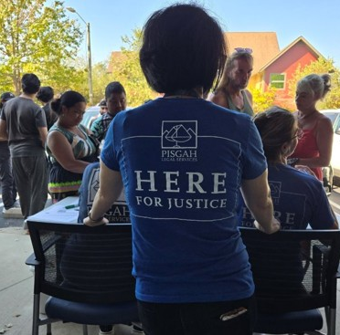
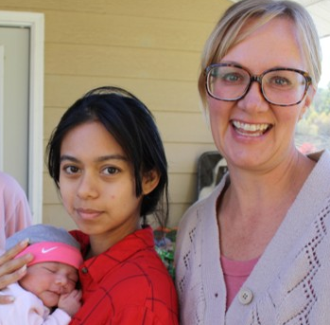
MISSION AND VISION
Our Mission
Pisgah Legal Services seeks to pursue justice by providing legal assistance and advocacy to help low-income people in Western North Carolina meet their basic needs and improve their lives.
Our Vision
Pisgah Legal Services envisions a community where all people have access to civil legal assistance when they need it to protect their basic rights and secure essentials, such as housing, health care, income, and safety from abuse. We envision a community with policies and services in place that reduce poverty and ease the burdens of poverty on our neighbors.

Slide 4
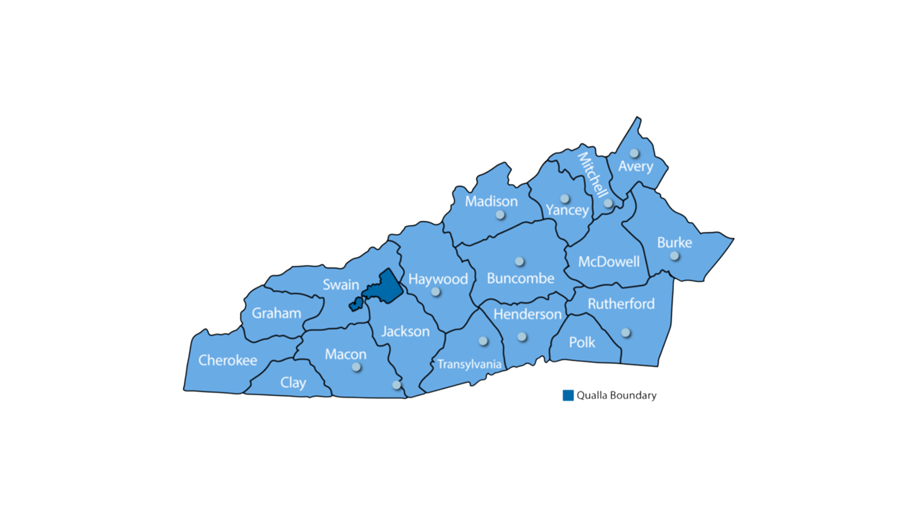
WHERE WE SERVE
Pisgah Legal Services works in the 18-county WNC region and the Qualla Boundary. Program offerings vary by county depending on the availability and scope of funding.
Pisgah Legal has offices in Asheville, Brevard, Burnsville, Franklin, Hendersonville, Highlands, Cashiers, Marshall, Newland, Rutherfordton, Spruce Pine and Waynesville.

Slide 5




PRIORITY AREAS
SAFETY
HOUSING
HEALTH
INCOME
Safety from and prevention of violence and abuse including domestic violence, sexual assault, child abuse and maltreatment, and hate crimes
Affordable, safe, and stable housing
Access to quality, meaningful health care coverage and services
Stable income sources, protection of essential income and resources, and supportive services for families

Slide 6
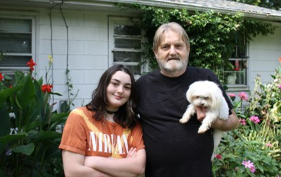
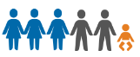
WHO WE HELP
The most vulnerable people in WNC: children, single parents, seniors, people with mental and physical disabilities, the working poor.
Very low-income: at or below 125% of the federal poverty line ($33,313 for a family of three)
Average income of PLS clients: $17,600
75% of our clients are women
Most clients
living below
125%
25,000
+
of the federal
POVERTY LINE
People helped
in 2024

Slide 7
PROGRAMS AND INITIATIVES
Children’s Law
Client & Community Resource Team
Community Economic Development
Consumer Law
Domestic and Sexual Violence Prevention
Elder Law
Expunction and Driver’s License Restoration
Homelessness Prevention
Health Care and Income Security
Justice for All
Low Income Taxpayer Clinic
Medical-Legal Partnerships
Mountain Area Volunteer Lawyer
NC Medicaid Ombudsman
Veterans Law
WNC Health and Economic Opportunity Program
Disaster Recovery

Slide 8




STRATEGIES – HOW WE DO THIS WORK
DIRECT SERVICE
COMMUNITY ENGAGEMENT & COLLABORATION
POLICY ADVOCACY
ADDRESSING THE SOCIAL DETERMINANTS OF HEALTH

Slide 9




PISGAH LEGAL IMPACT
HOUSING
58 people helped to stabilize housing and prevent homelessness
SAFETY
298 people helped to escape domestic abuse and rebuild their lives
HEALTH
87 people assisted to increase their access to health care, including ACA health insurance
INCOME
130 people helped to increase their basic income, including free tax aid

Slide 10

CHALLENGES FACED BY PEOPLE IN POVERTY
$15,080 – full-time at minimum wage
Housing crisis – less than 1% vacancy
5+ years wait for public/subsidized housing
An estimated 1 in 5 children live in poverty in WNC
More barriers in accessing food assistance, health care coverage, housing subsidies, and other assistance

Slide 11
WHY LEGAL AID MATTERS
80% of low-income people face wrenching legal wrongs or challenges
Legal system not set up for lay people to represent themselves
Without an attorney, most people will not have a positive outcome in court
Only 1 legal aid attorney is available for every 8,000 North Carolinians eligible for legal services

Slide 12
THE FINANCIAL PICTURE
2026 Budget of $14.4 Million
Diverse funding base
Excellent steward of resources

