Slide 1
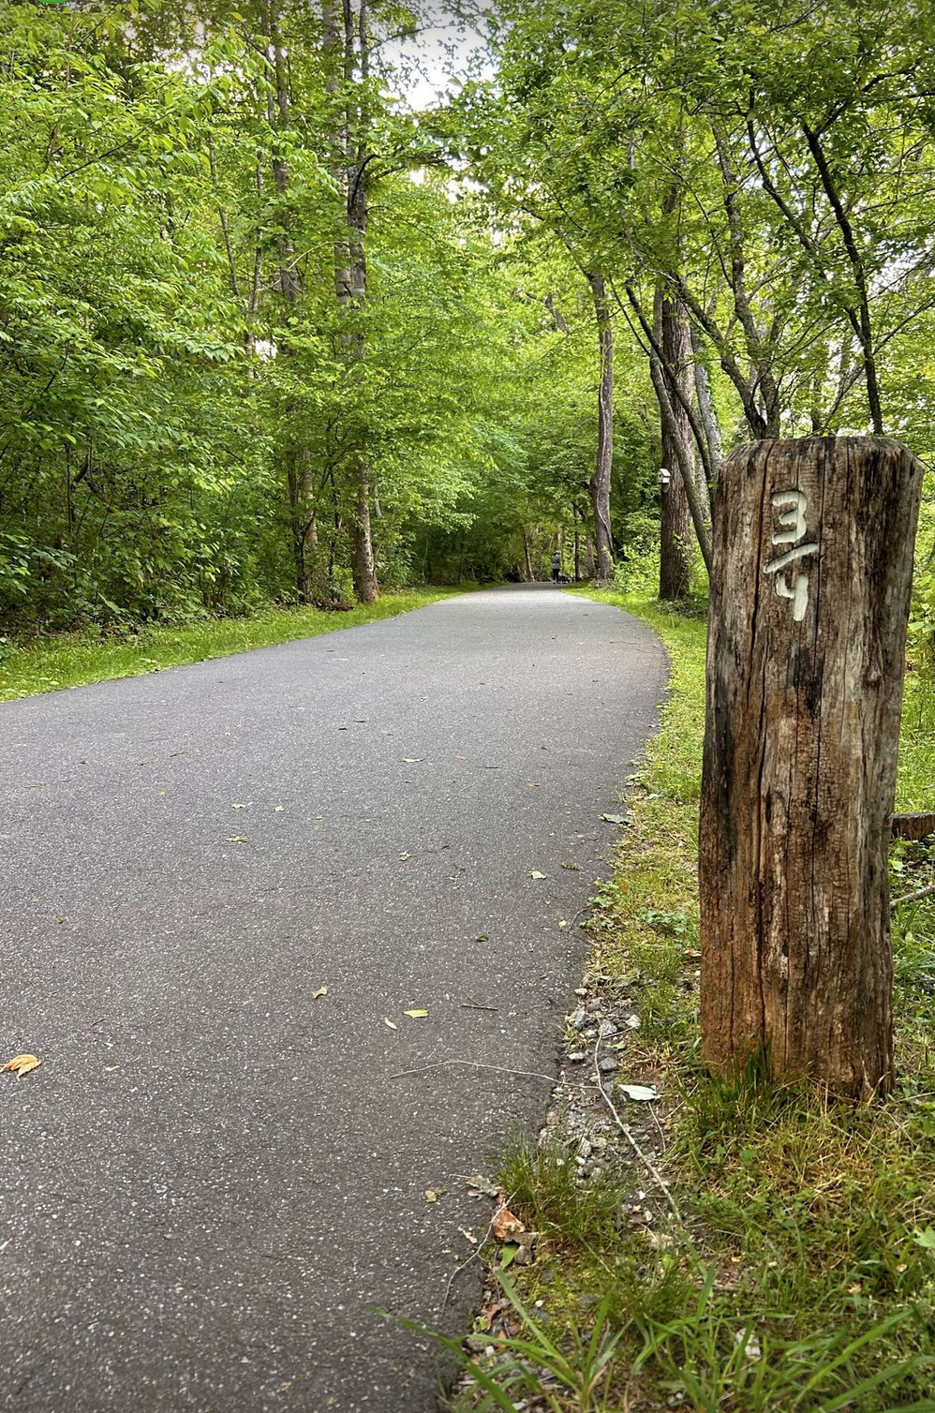
Friends of the Jackson County Greenways
Partnering with Jackson County Parks & Recreation

Slide 2
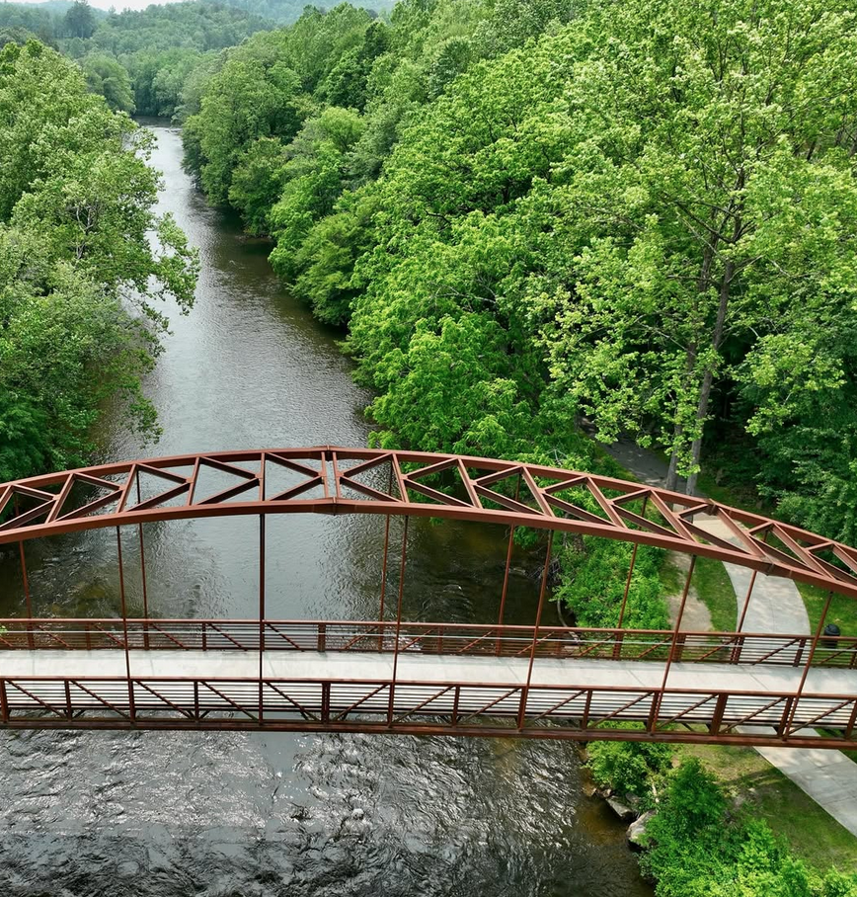
Thank You,
Commissioners
Your leadership has helped to build a thriving public asset.
• Improved health
• Stronger community connection
• Enhanced quality of life

Slide 3
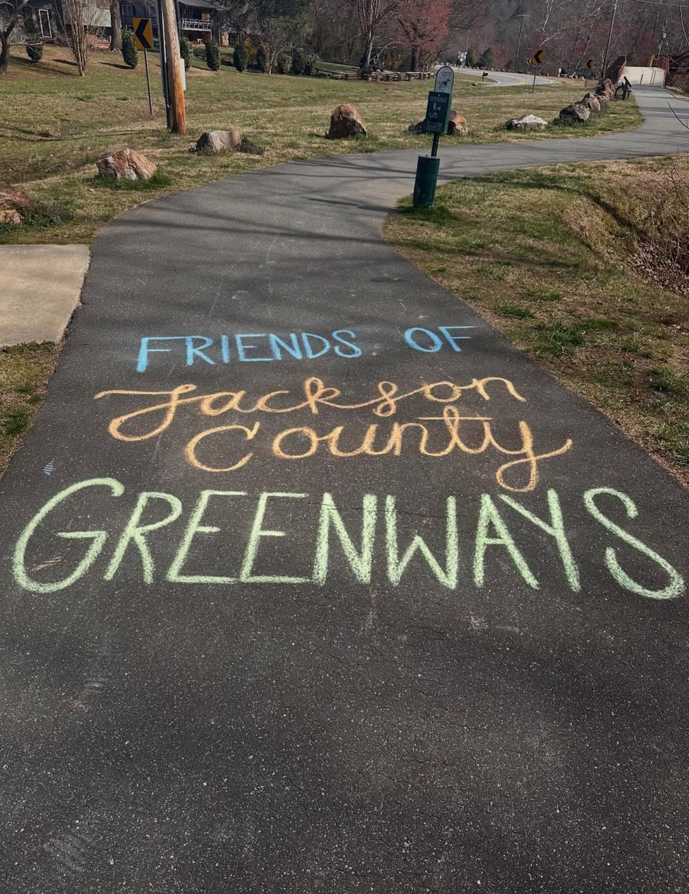
Who We Are
Friends of the Jackson County Greenways provides:
• Volunteer labor
• Educational programming
• Grant-writing capacity
• Private fundraising support
➤ Extending county resources beyond
public budgets.

Slide 4
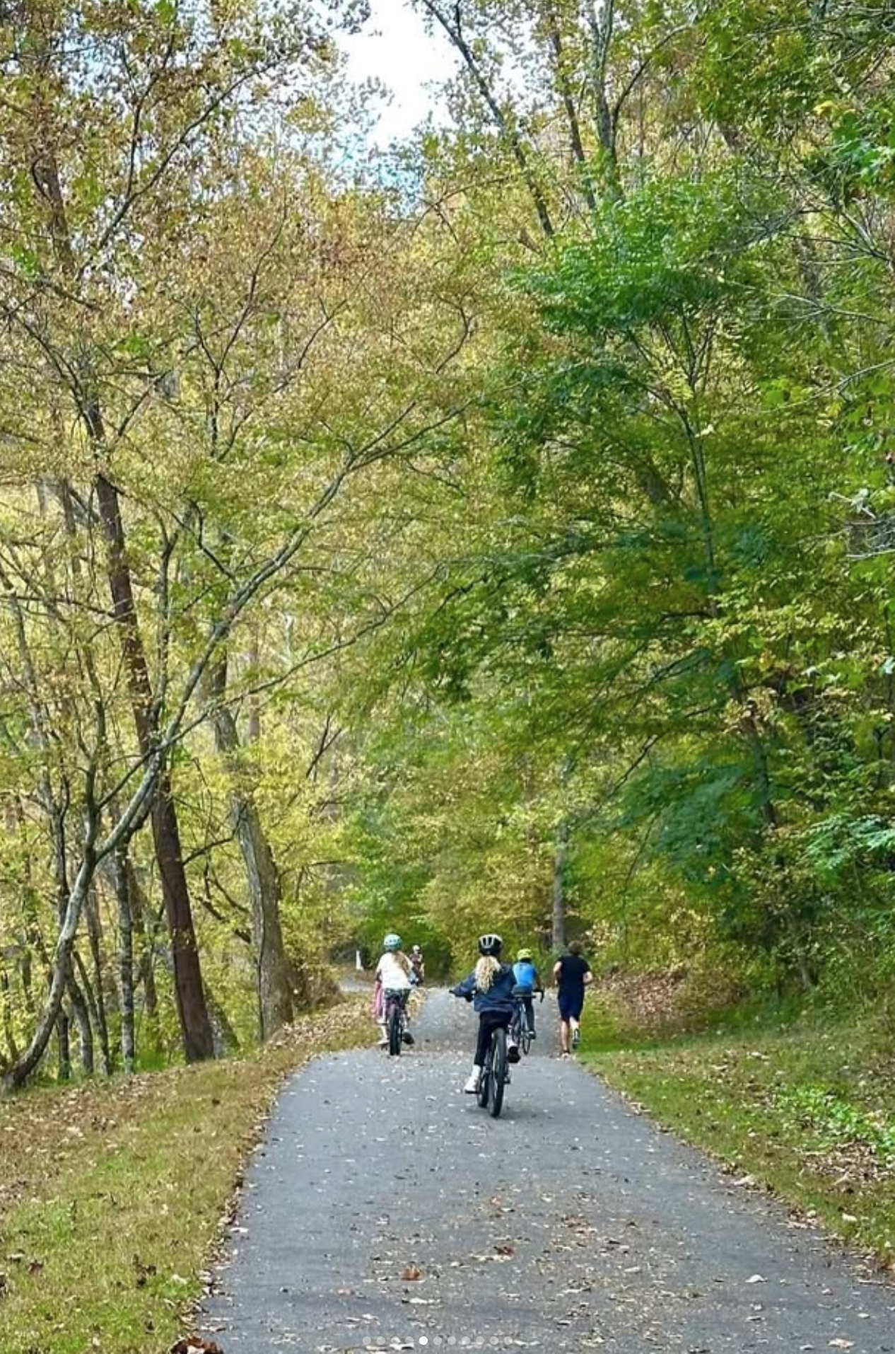
The Jackson County Greenway:
A Smart Public Asset
150,000 Visits this year *
Most users visit 2-6 times per week **
✔ Free
✔ Accessible
✔ Multigenerational
✔ Paved & relatively flat
➤ Not an Amenity. Infrastructure.
* Trail counter data from Jackson County Parks & Recreation, 2025-2026.
** Survey results collected from 687 greenway users. Friends of the Jackson County Greenways, 2024-2025.

Slide 5
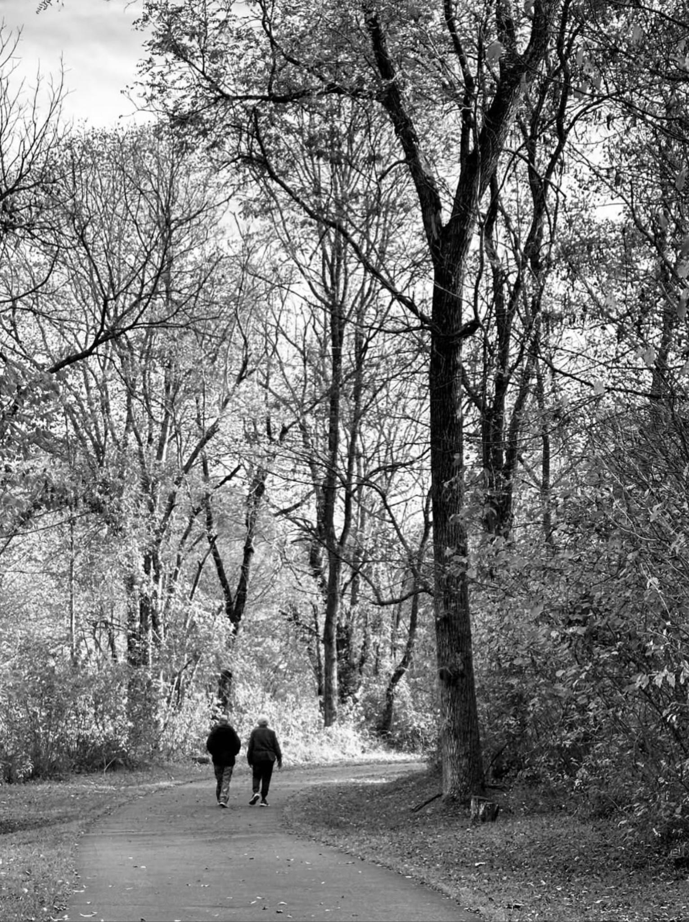
The Jackson County Greenway:
A Strong Return on Investment
• $1 invested in greenways → $3 - $4 returned
(health + economic benefits) *
• Greenways are a top homebuyer priority **
• Greenways attract families, retirees, and visitors
• Increased foot traffic supports local business
➤ Greenways provide economic and
community health benefits.
*American Journal of Preventive Medicine, “Parks, Trails, and Greenways for Physical Activity,” J Reynolds et.al. (2024).
**Journal of Park and Recreation Administration. “The Impact of Greenways and Trails on Proximate Property Values,”
G Lindsey et.al.

Slide 6
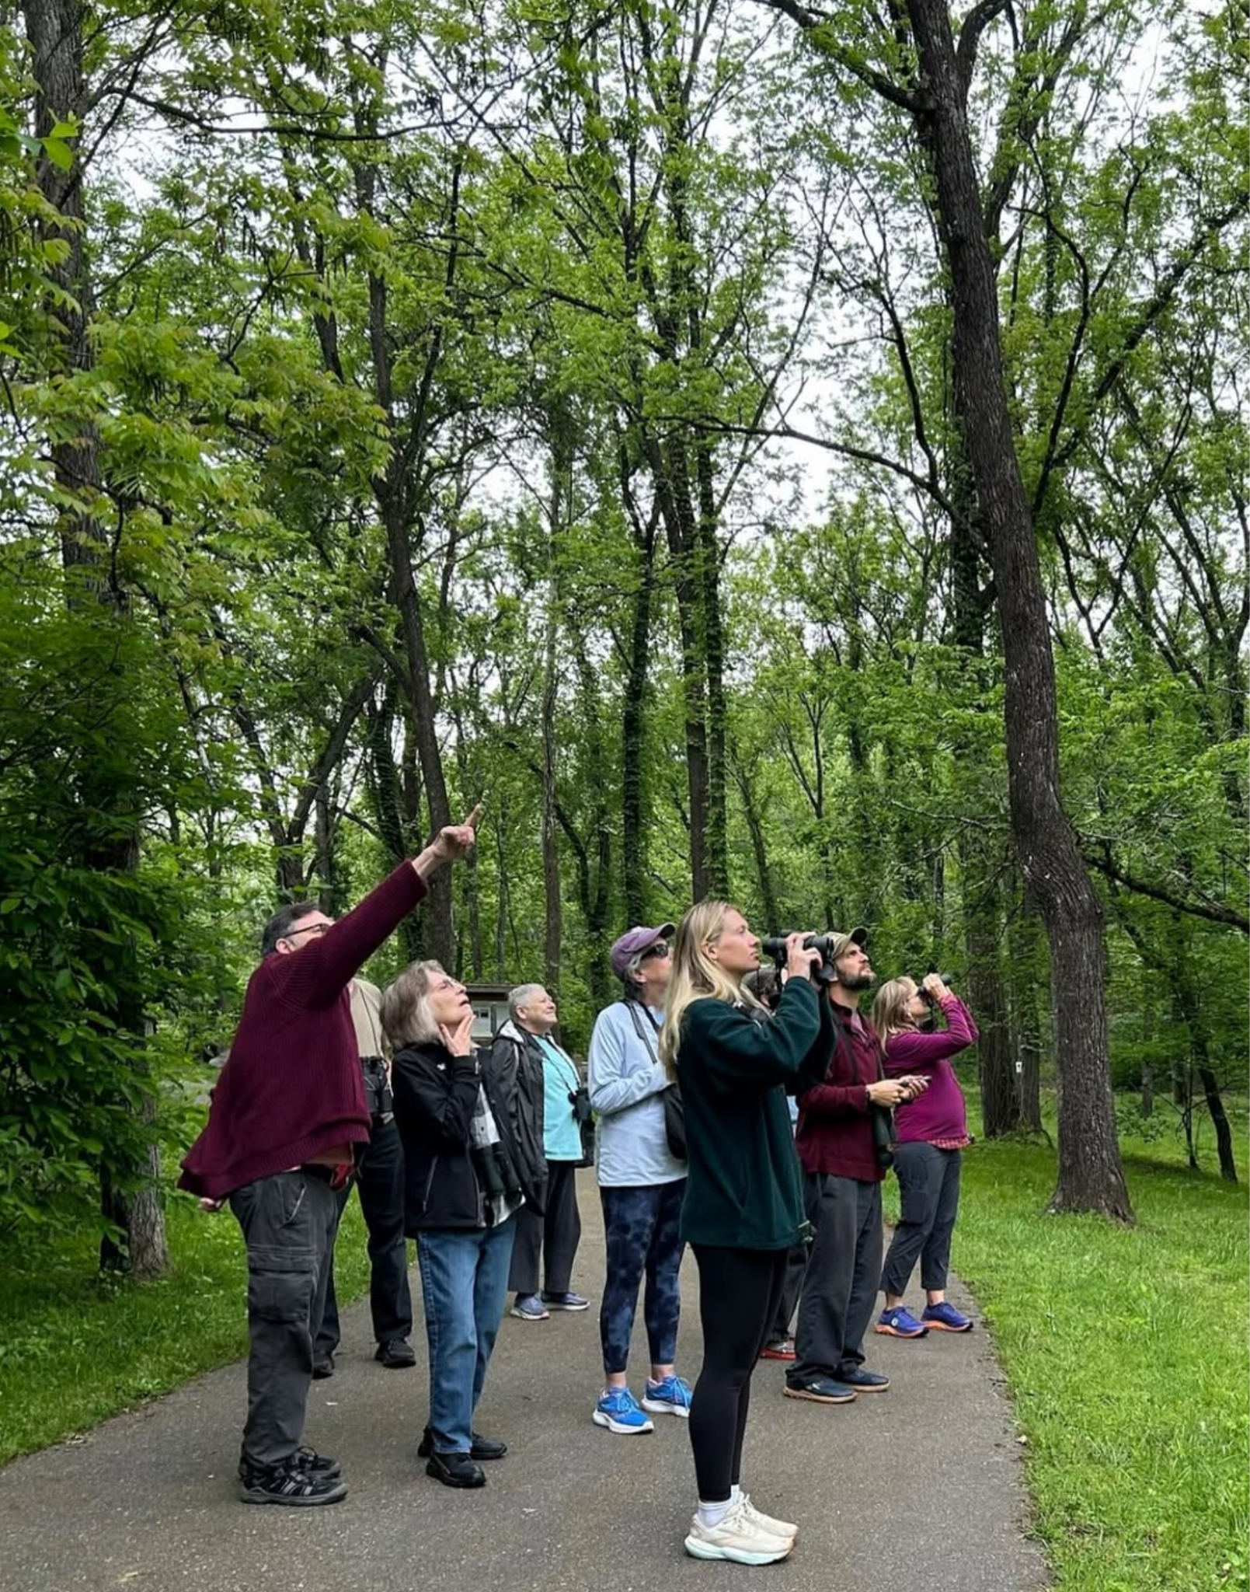
The Jackson County Greenway:
2025-2026 Momentum
• 1.6-mile expansion launching this spring
• First All-Accessible Certified Forest Therapy
Trail in the United States
• Expanded educational engagement

Slide 7
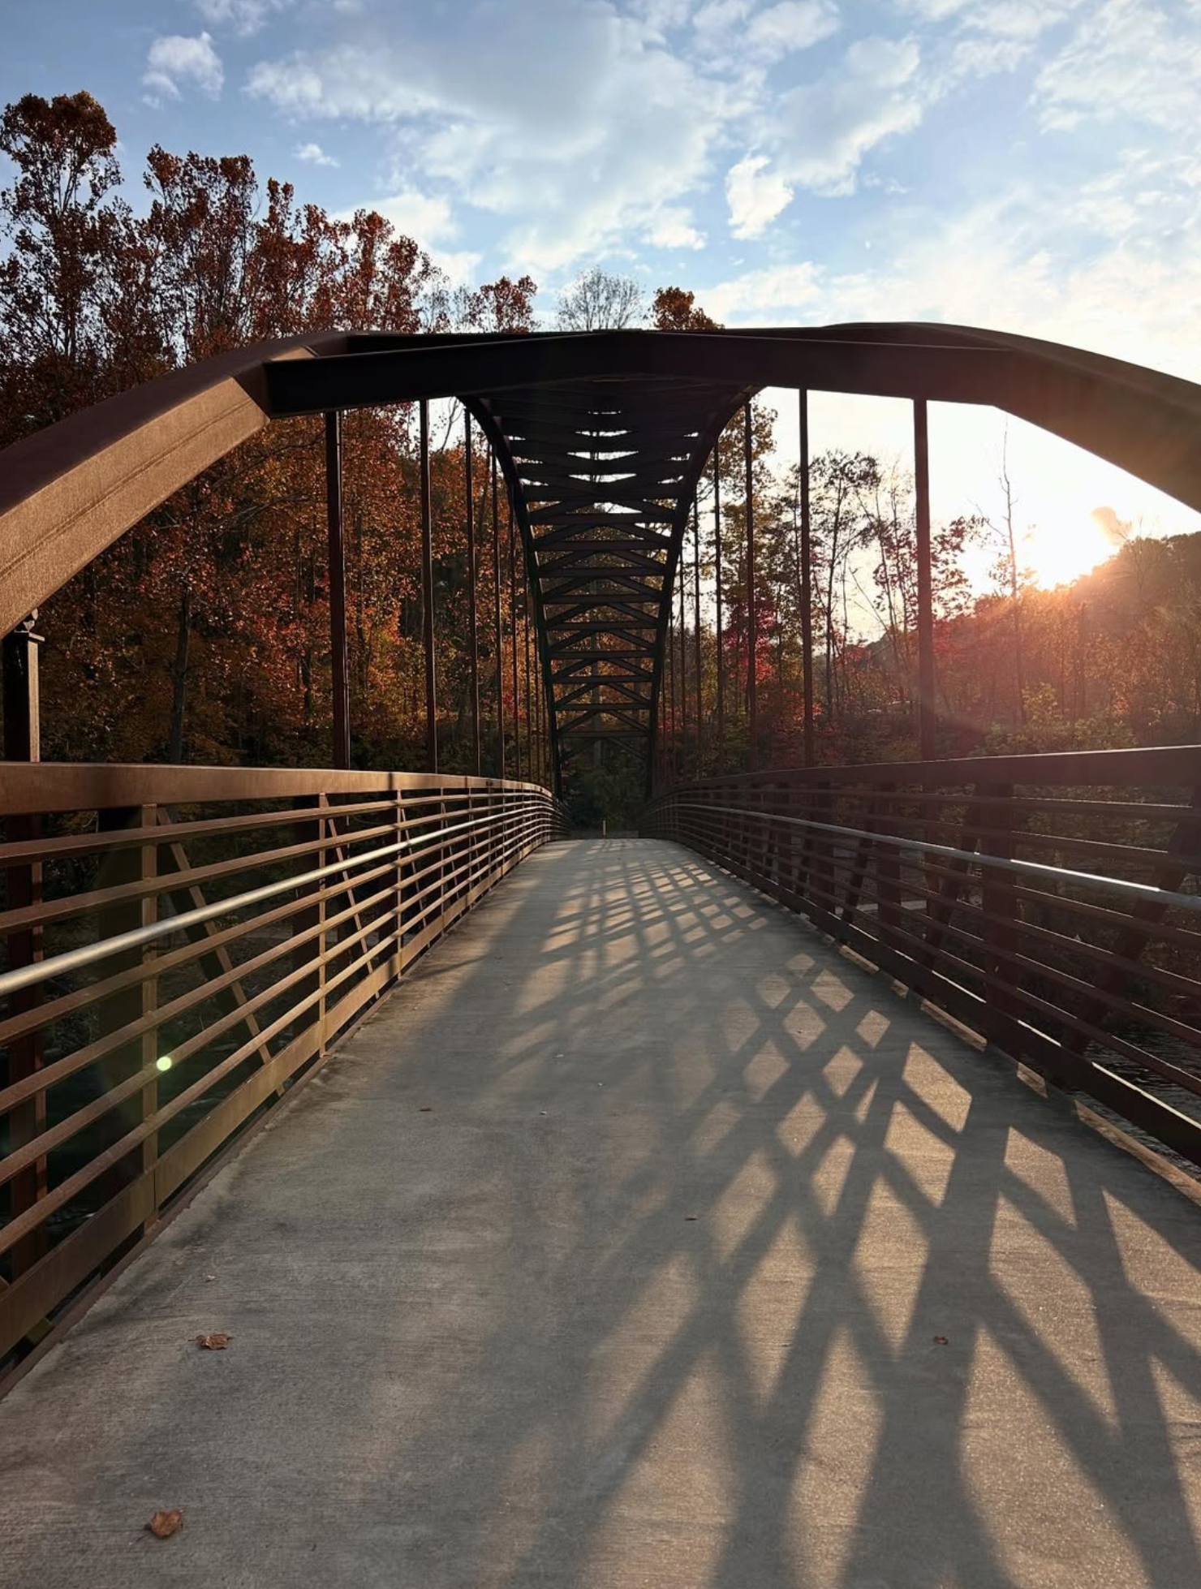
The Jackson County Greenway:
Why Continued Investment Matters
The Jackson County Greenway is an asset
already delivering results:
✔ Strong public support
✔ Competitive for matching grant funding
✔ Proven usage
✔ Preventive health impact

Slide 8
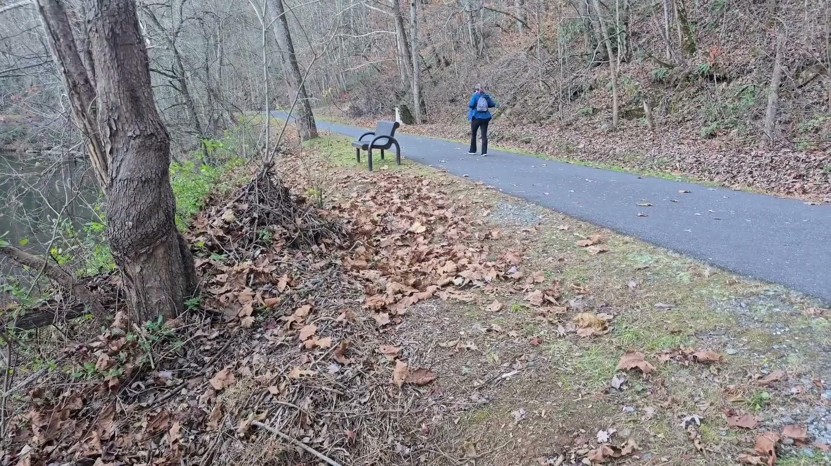

Slide 9
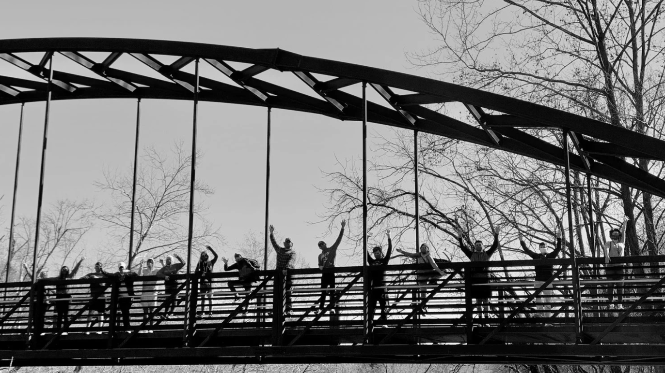
THANK YOU

