Slide 1

Community Table Update
March 2026

Slide 2
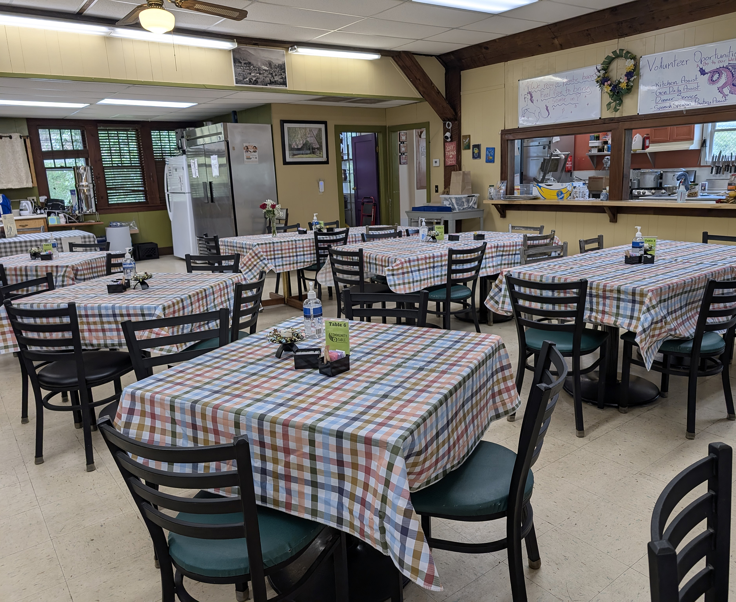
Background
Founded 1999 as Meal Program
501©(3) status 2001
2008 Added Food Pantry
Volunteer Board of Directors
Staff:
(2) Full Time
(2) Part Time
Volunteers:
45 core
Several Hundred Rotating

Slide 3
Partnerships (1)
Food Partnerships
• MANNA Foodbank
• Franklin Farm Hub
• ASAP
• Carringer Farms
• WNC From the Ground Up
• K&B Meats
• Haywood Christian Ministries
• United Christian Ministries
• Fishes & Loaves
• Restoration House
• Living Waters
• Grace Place
• Cullowhee Community Garden
• Sylva Community Garden
• Local Restaurants (City Lights, B&Als, etc)
• Dozens of local individuals
Foundations
• Great Smokies Health Foundation
• Foundation of Healthy Carolinas
• NC Community Foundation
• Jackson County Community Foundation
• Balsam Preserve Gift Fund
• WNC Bridge Foundation
• Highland Cashiers Health Foundation
• Nantahala Health Foundation
• FoodLion Feeds Foundation
• Dogwood Health Foundation

Slide 4
Partnerships (2)
Other Partners in Community Assistance
• Jackson County Department on Aging
• Jackson County Health Department
• Jackson County Emergency Services
• Jackson County Public School
• Town of Sylva
• Church of the Good Shepherd
• Vecinos
• Cornbread & Roses Community Counseling
• WCU Band of Brothers
• WCU Service Learning
• WCU Honor COllege
• Southwestern Community College
• Westbridge Vocational
• NC Works
• Sylva Warehouse
• Sylva Support Stop
• Blue Ridge Health/Mental Health Services
• Disability Partners
• HERE in Jackson County
• The Center of Domestic Peace
• Uncomplicated Kitchen
• St. David’s Episcopal Church
• 1st Baptist Church of Sylva
• Sylva United Methodist Church
• Shepherd of the Hills Lutheran Church
• Cullowhee Valley Baptist Church
• Unidxs
• Catholic Charities
• St David’s Episcopal Church

Slide 5
Partnerships (3)
Local Business Support
City Lights Bookstore
City Lights Café
Baxley’s Chocolates
Innovation Brewing
Dillsboro Chocolate Factory
WNC Pottery Festival
Harold’s Supermarket
Harrah’s Cherokee Casino
State/ Federal Programs and Partners
USDA-> NCDA-> TEFAP SKP (The Emergency Food Assistance Program – Soup Kitchen Program)
USDA-> NCDA-> MANNA Foodbank-> TEFAP Pantry (The Emergency Food Assistance Program – Soup Kitchen Program)
Western Carolina University CCESL (Center for Community Engagement and Service Learning)

Slide 6
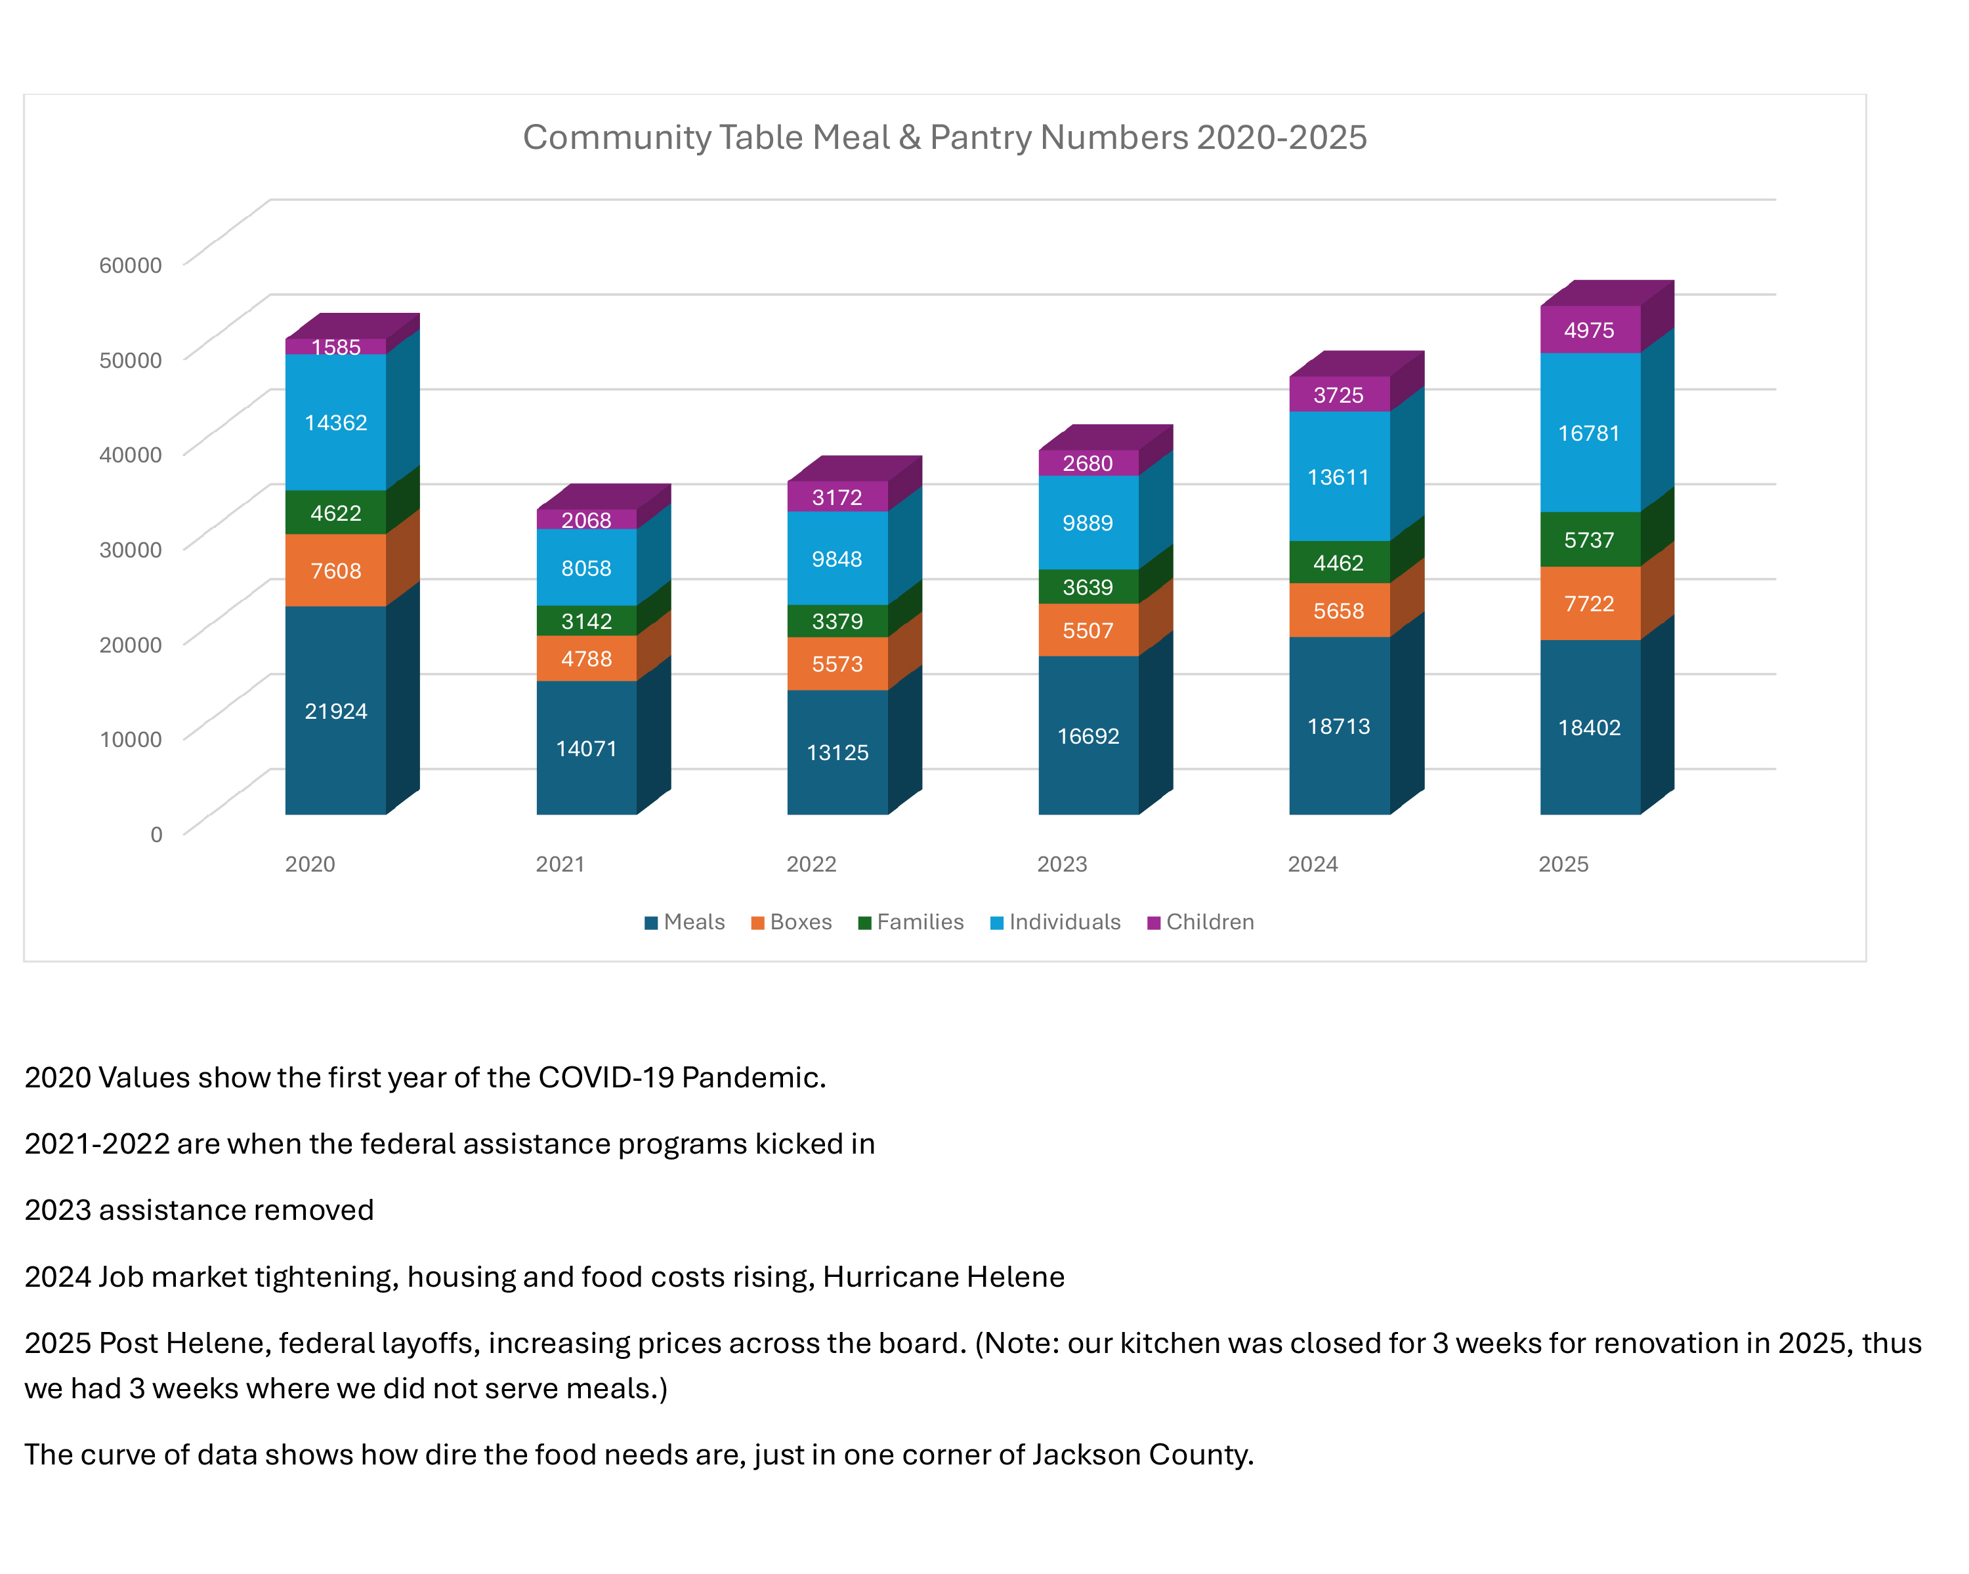
2020 -
2025

