Slide 1

Request: $25,000
Small Business Growth & Workforce Development

Slide 2
Why This Matters in Southern Jackson County
• ~400 member businesses
• Majority are small employers
• No municipal government structure
• Tourism-driven local economy

Slide 3
Stakeholder Input
Strategic Planning
17 stakeholders surveyed
14 organizations responded
18 total responses
Business & Community Leaders represented
Clear Emerging Theme:
“Strengthen support & promotion of local small businesses.”
• More skill-building opportunities • Practical leadership tools • Workforce development focus • Intentional promotions

Slide 4
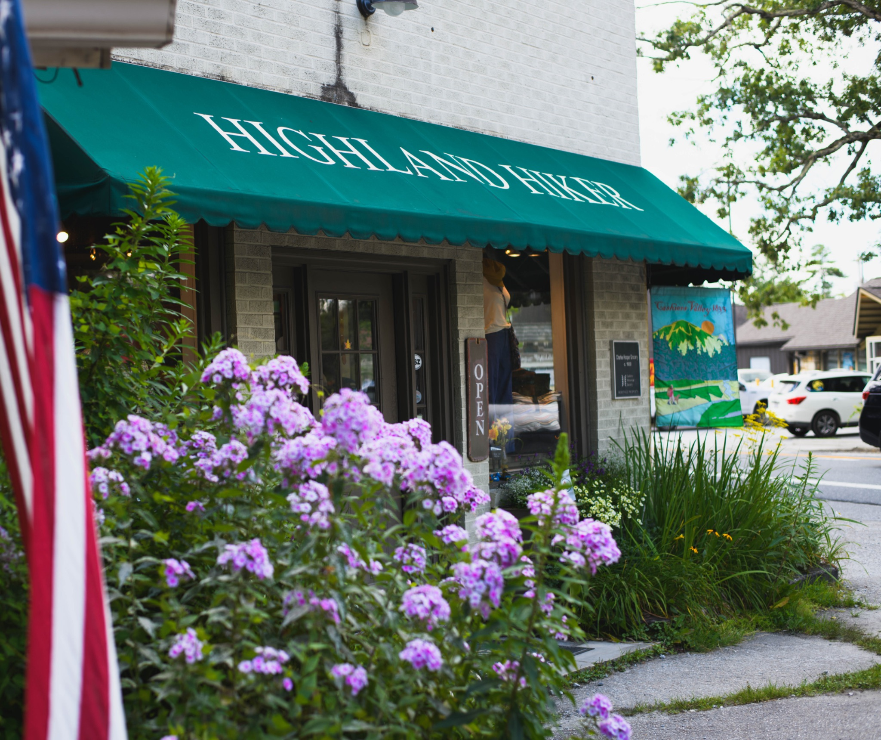
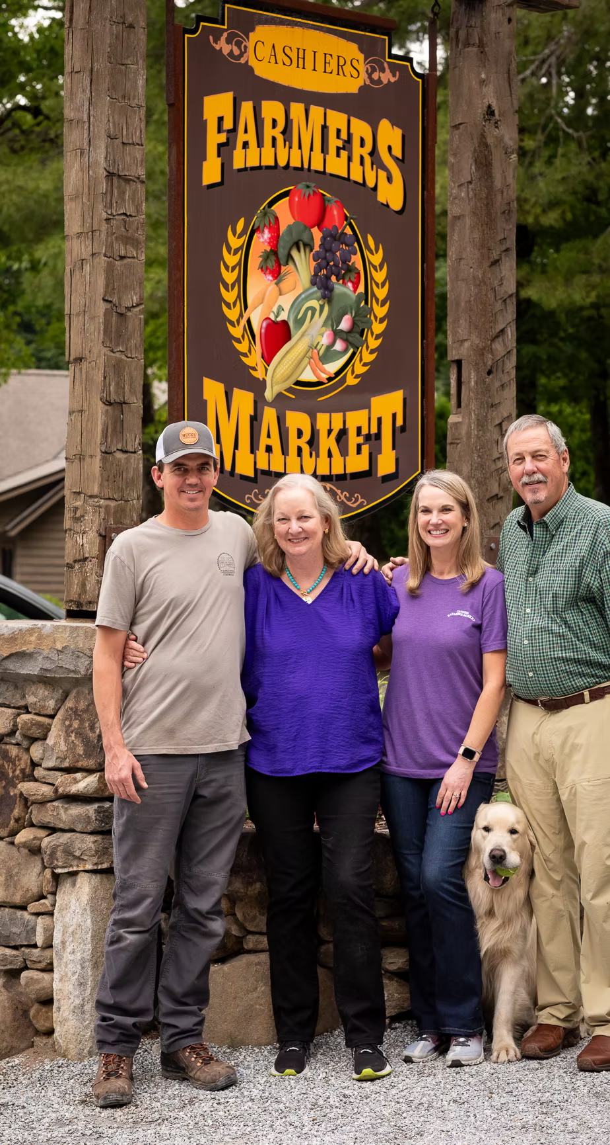
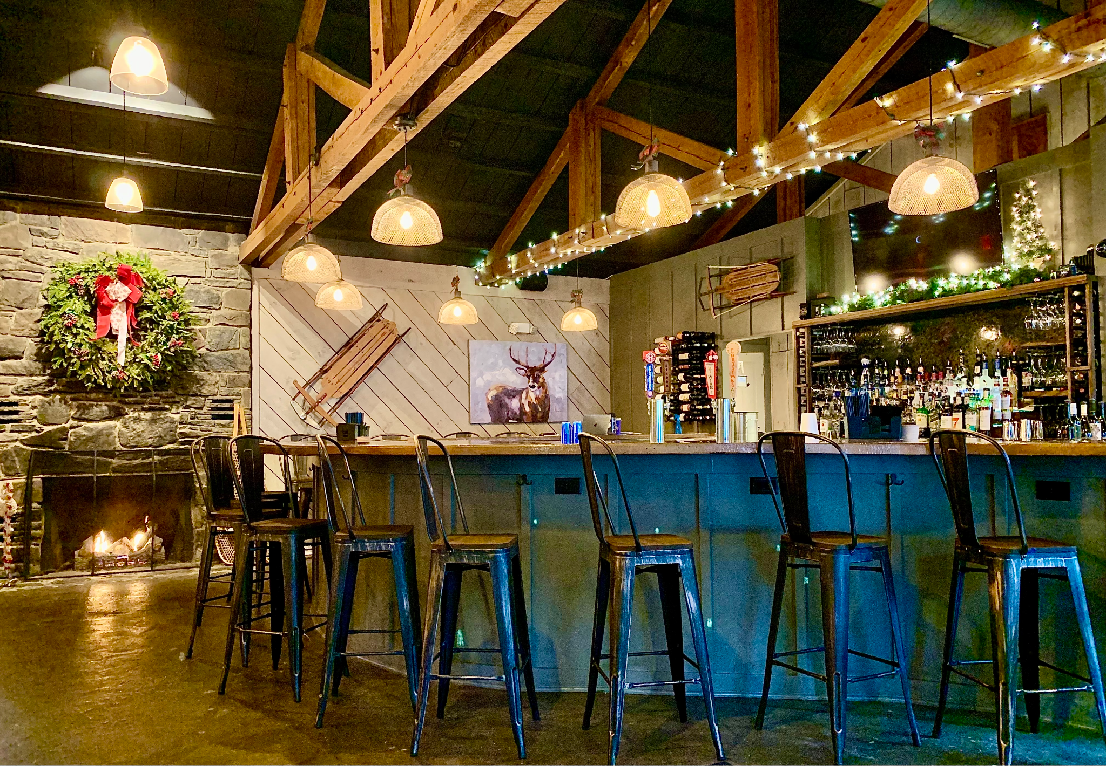
Southern Jackson County Small Businesses
Small businesses power our local economy.
Most employ fewer than 10 people.

Slide 5

Focus Areas May Include:
• Hiring & retention
• HR Solutions
• Disaster planning for Southern Jackson County
• Tracking Overtime under the "One Big Beautiful Bill Act" (OBBBA)
• Financial fundamentals
• Digital visibility
• Health Insurance Landscape
• Bilingual workplace communication
Rise & Refine
Lunch & Learn
Hybrid in-person & video conference
Retail Roundtable
Equipping Local Enterprises with Vision, Action & Targeted Education

Slide 6
Rural Workforce - Internship Expansion
Not simply a summer program for the Chamber but a long-term workforce pipeline strategy for our members.
• Expand placements in Southern Jackson County
• Connect with UNC system to advocate for WNC program
Business HIRE (High-Impact Rural Experiences)
Gain internship experience while making a difference in a rural community.
NC State Poole College of Management

Slide 7
County Investment Allocation – $25,000
• Workshop curriculum & facilitators
• Hybrid technical capability
• Internship coordination
• Materials & reporting

Slide 8
Defined Outcomes & Measurable Impact
6 – 8 sessions annually
15 – 20 participants per session
90 – 160 engagements
Year-end reporting
Structured investment. Measurable return. Stronger local economy.

Slide 9
Alignment with Jackson County Priorities
• Strengthens local economic development efforts
• Supports small business stability and growth
• Expands workforce development opportunities
• Responds to documented stakeholders
• Delivers measurable and reportable outcomes

Slide 10
Strengthening the Foundation of Southern Jackson County
Targeted investment in small business leadership and
rural workforce development.

