Slide 1
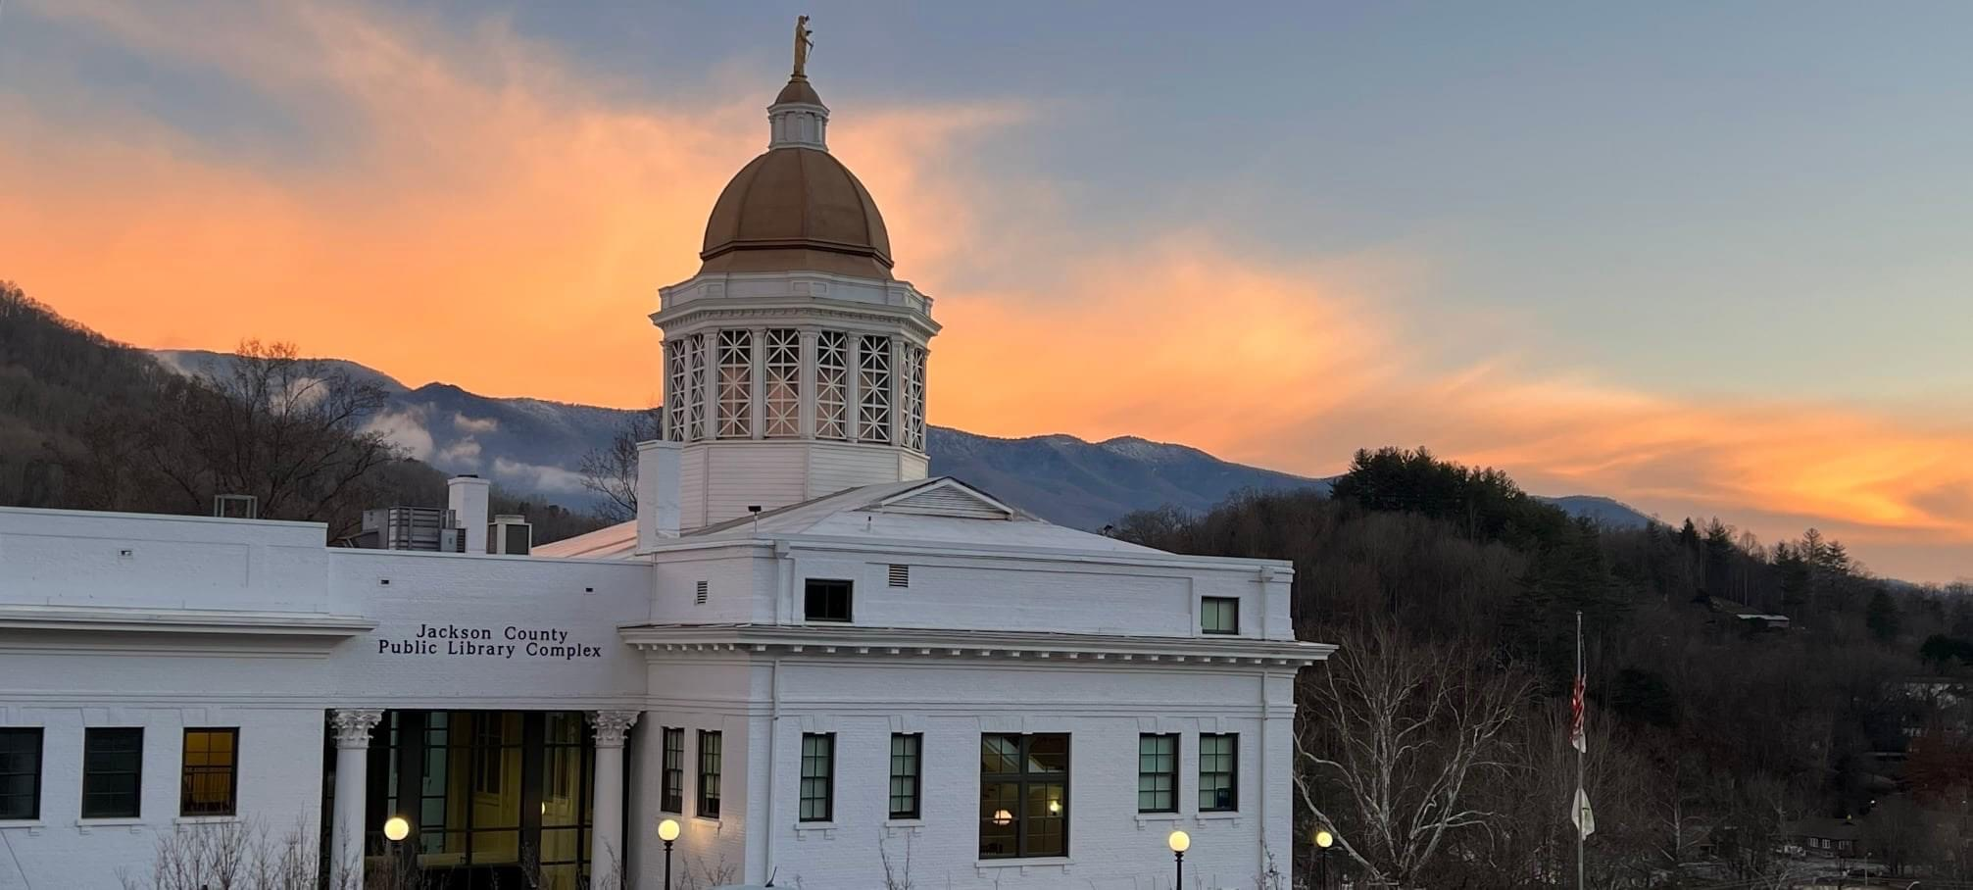
Jackson County Public Library Complex

Slide 2
Historic Jackson County Courthouse & the Jackson County Public Library
1983 – JC’s 6400 sq ft library built in 1970 had outgrown its space
1988 - historic courthouse was condemned
2003 - Southwestern Community College proposed building a combined library.
2004 - joint JC & Sylva committee formed to evaluate potential JCPL sites
2007 - JC Commissioners hired architectural firm to look at the courthouse & see if it would make a good library site.
2007 - Library Needs Assessment was commissioned

Slide 3
Dubberly Garcia Associates Needs Assessment May 28, 2007
Top Four Service Priorities
Satisfies Curiosity: Lifelong Learning
Create Young Readers: Early Literacy
Visit a Comfortable Place: Physical and Virtual Spaces
Stimulate Imagination: Reading, Viewing, and Listening for Pleasure

Slide 4
Dubberly Garcia Associates Needs Assessment May 28, 2007
New Library Complex Highlights
Large Community Room, Conference, Study & Tutor Rooms
Expanded Children’s Area
Dedicated Teen Area
Increased Internet/Wireless Access
Extensive Increase in Collections
Exhibit, Gallery & Performance Space

Slide 5
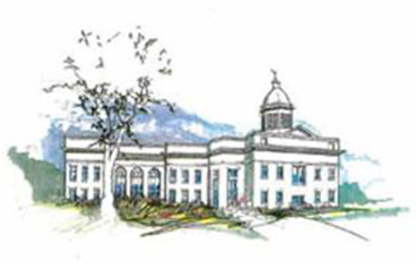
The Library Breathed New Life into the Courthouse
October 2007 - The JC Commissioners voted to restore the historic courthouse and incorporate it into the new Jackson County Public Library Complex. The Courthouse would become an integral part of our community again as an anchor for the much-needed new library.

Slide 6
Fundraising Feasibility Study – Sims & Steele Consulting April 2008
The Friends had raised over $140,000 over the past decade for a new library
79 individuals across Jackson County were interviewed
81% Awareness & Passion for the Project
91% Strong Case for Support
93% Will Make a Financial Gift
Caution was advised as citizen attitudes should not be overestimated. It will take a lot of work to make this project a financial priority
“The issue of ‘the economy’ is repeatedly mentioned as a cause for concern.” US stock market had just lost 50% of its value.
$1.5 million is feasible

Slide 7
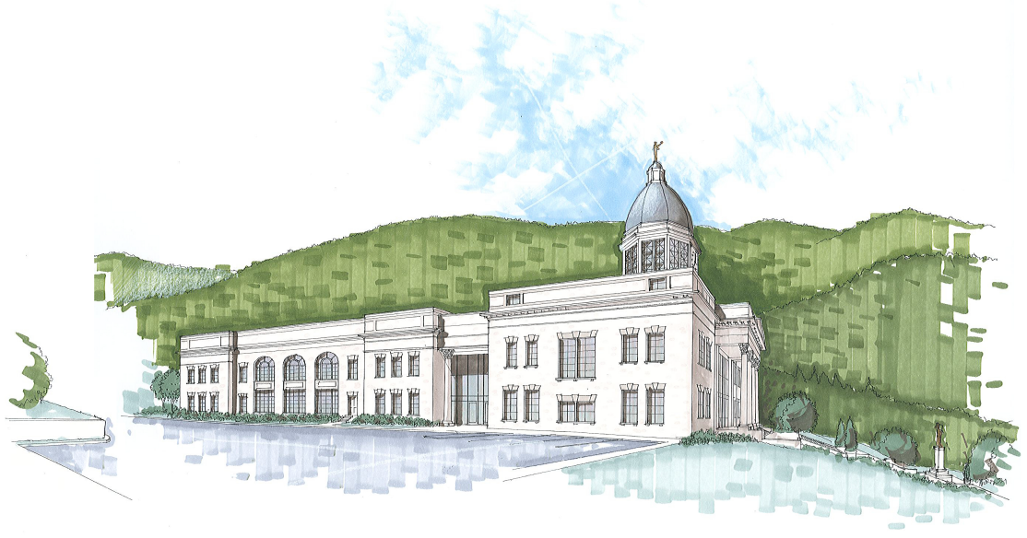
Jackson County Public Library Complex
Incorporating the historic courthouse into a new library complex allowed us to honor one of the most recognized symbols of Jackson County by making it a part of one of the most important institutions of our county – the public library.

Slide 8
Jackson County Public Library Complex
“It’s a way to help preserve one of the county’s best landmarks; it’s a way to create a library that is uniquely ours; it’s a way to celebrate the history of our community while looking to the future; and it’s a site that will inspire people for generations.” Joyce Moore, owner of City Lights Bookstore in Sylva
“Such opportunities are rare in one’s lifetime to assist with the preservation of history while simultaneously meeting the needs for our future.” Tom Massie Jackson County Commissioner

Slide 9
Jackson County Public Library Complex Fundraising
To make this new library complex a reality -
Jackson County Commissioners committed over $8 million
The Capital Campaign lead by the Friends, & supported by the Genealogy Society, Historical Association and the Arts Council developed a plan to raise the $1.5 million
With a goal of raising at least $1 million by the official groundbreaking.

Slide 10
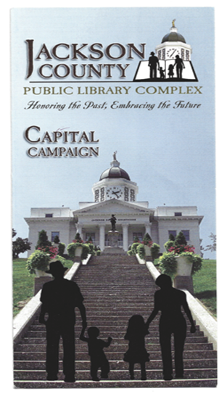
Jackson County Public Library Complex Fundraising
Over $1.8 million was raised
1000+ donors contributed from 21 states across the country
Gifts ranged from piggy banks filled with coins to $250,000 given by the SECU Foundation
Jackson County was the largest provider of funds at over $8 million

Slide 11
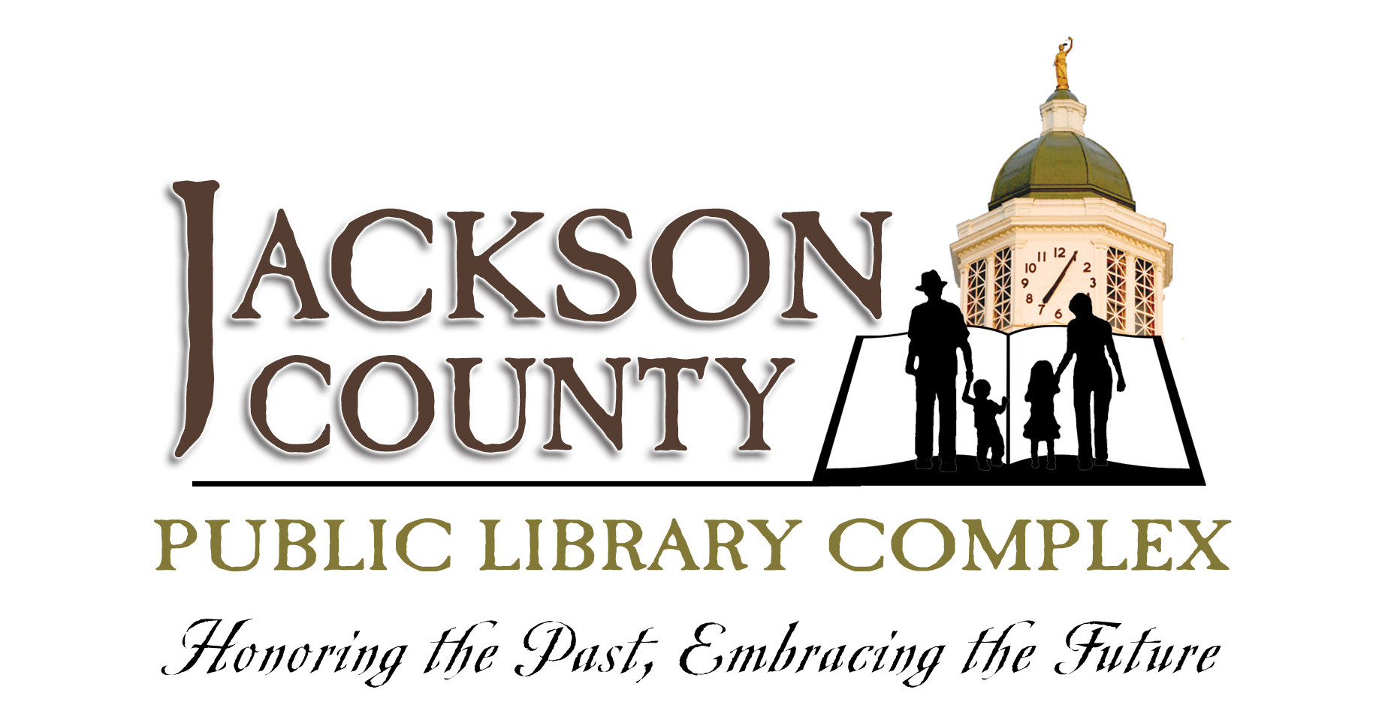
We ask that Jackson County renew the lease related to the Jackson County Public Library Complex to continue to meet the community’s needs and expectations.

