Slide 1



Slide 2
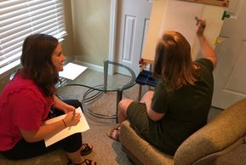
Forensic Interviewing
At AWAKE, trained forensic interviewers conduct child-friendly interviews
Forensic Interviews limit the number of times a child must talk about their abuse

Slide 3
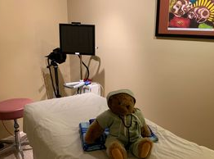
Child Medical Evaluation
A contracted AWAKE healthcare provider performs child medical exams in the privacy of the Center
These exams are a head-to-toe examination to ensure the health and well being of every child
AWAKE’s nurse practitioner is rostered with the NC Child Medical Evaluation Program and is a certified Sexual Assault Nurse Examiner

Slide 4

Case Management/Victim Advocacy
Our case managers guide families through entire the process
They help provide resources from the Center or find outside resources and connect with the families regularly until services are no longer needed
AWAKE’s Victim Advocates are also bilingual!

Slide 5
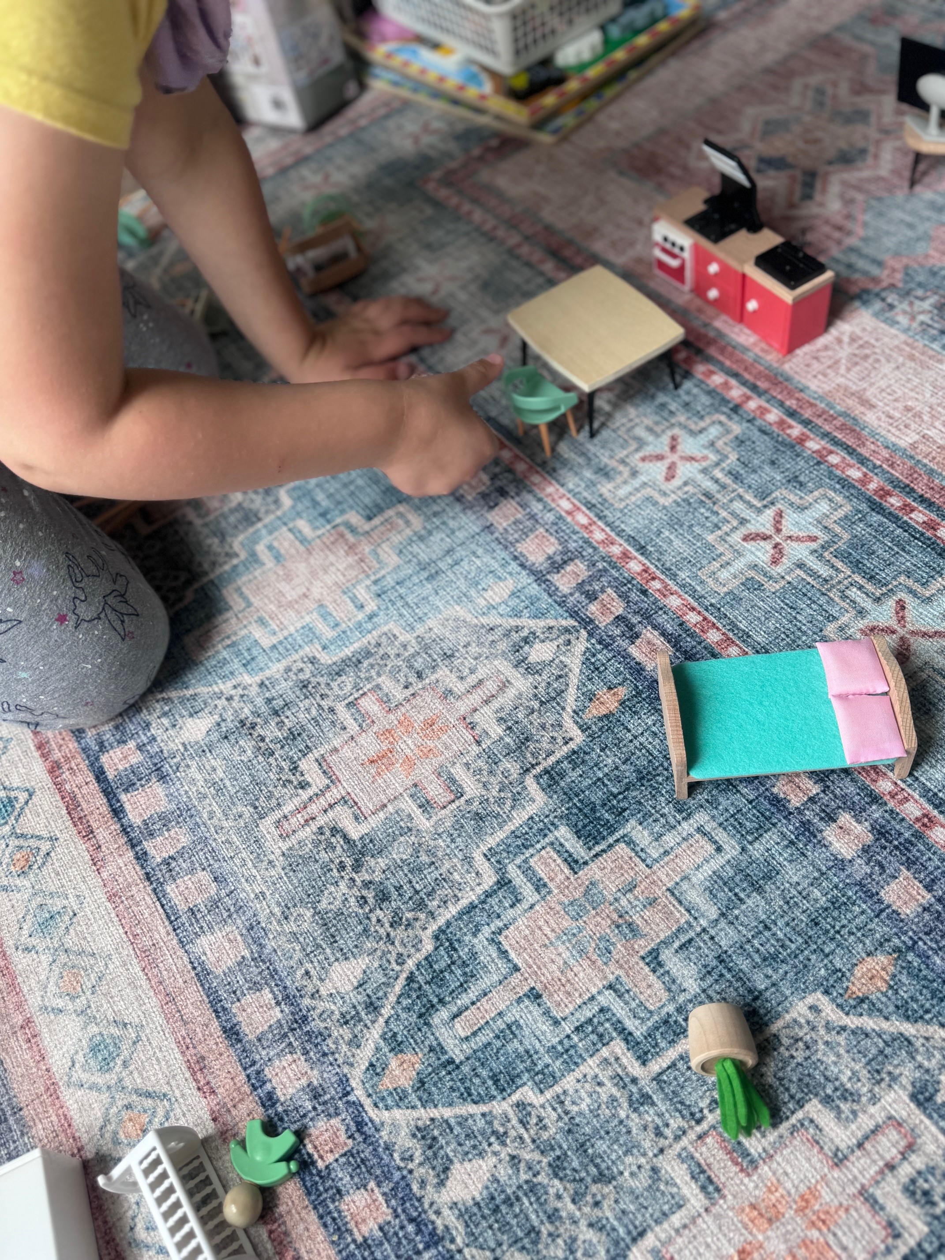
On-Site Counseling
Mental health providers offer trauma-focused counseling
This offers an alternative and confidential environment for children to recover from abuse

Slide 6

Multi-Disciplinary Team
The multi-disciplinary team is the core of the children's advocacy center and ensures that each child's needs are met. AWAKE coordinates meeting monthly to discuss current child abuse cases in Jackson County.
AWAKE
District Attorney
Law Enforcement Agencies
DSS
Medical and Mental Health Providers
School Counselors
Juvenile Justice

Slide 7
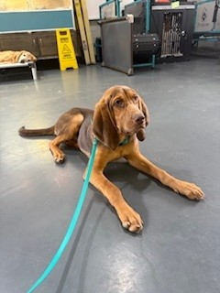

Community Outreach
We do provide free training, programs and presentations to schools, clubs and civic groups.
  Puppet shows
  Tours of AWAKE
  Newsletters

Slide 8
Statistical Trends from Fiscal Year 2024-2025
- Significant growth in total and new individuals served, indicating increased demand and outreach.
- Sharp rise in personal advocacy services, especially individual advocacy and forensic exams/interviews.
- Shift toward older child victims (7-17 years) and more female new clients.
- Victimizations, particularly sexual and physical abuse, increased substantially.
- Emotional support saw a major shift increase in crisis intervention and counseling

Slide 9
Raw Data
Types of Victimizations (All Individuals Served)
Type | 2023-2024 | 2024-2025 | Change
Sexual Abuse | 79 | 139 | +60
Physical Abuse | 33 | 70 | +37
Neglect | 4 | 19 | +15
Witness to Violence | 26 | 42 | +16
Drug Endangerment | 1 | 4 | +3
Other | 4 | 7 | +3
Kidnapping (Non-Custodial) | 1 | 2 | +1
Improper Supervision / Injurious Environment | 2 | 1 | -1
Not Reported/Tracked | 7 | 4 | -3
Total | 158 | 288 | +130

Slide 10
Community Outreach Trainings
Key Metrics Comparison
Metric | FY 2023-2024 (07/01/2023 - 06/30/2024) | FY 2024-2025 (07/01/2024 - 06/30/2025) | Change | % Change
Total individuals served (unduplicated) | 148 | 241 | +93 | +62.8%
New individuals served | 100 | 128 | +28 | +28.0%

Slide 11
Funding Percentages for AWAKE - Jackson
VOCA continues to decrease in funding allowance for CACs nationwide: AWAKE = -31% which equates to an overall 2.7% loss
  -$26,244 shortfall
    This is food for children
    This is emergency lab work for child sexual abuse victims
    This is medical supplies necessary for ensuring the safety of our community’s children
    This is supplies for victims and their families to keep them safe – and often keep them alive

Slide 12
Contact Information
AWAKE Children's Advocacy Center
20 Colonial Square, Sylva, NC 28779 (physical)
P.O. Box 755 Sylva, NC 28779
(828) 586-3574
Please report suspected child abuse to DSS and law enforcement, and they will make the referral to AWAKE

