Slide 1

The Village Green
Dale Gordon,
Executive Director

Slide 2
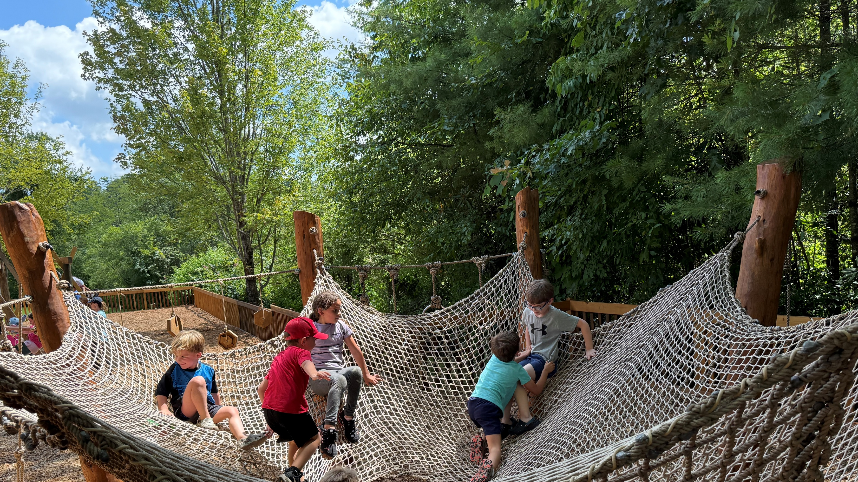
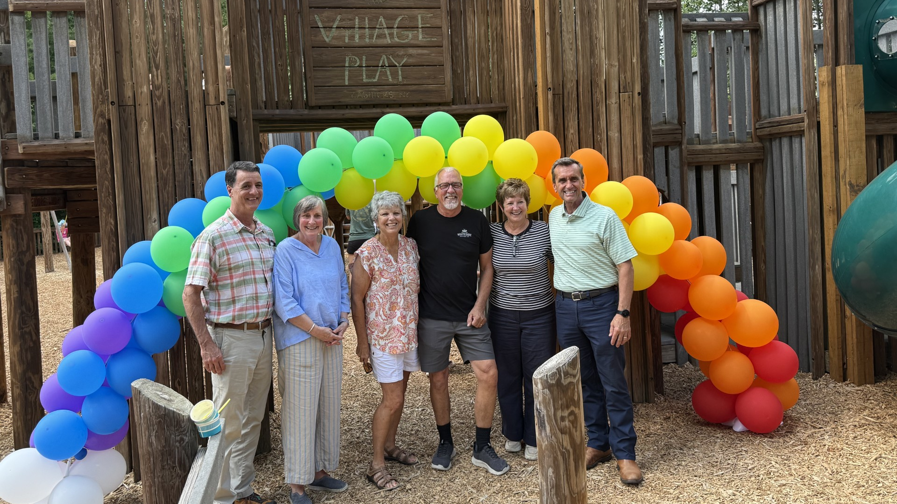
Village Play renovation

Slide 3
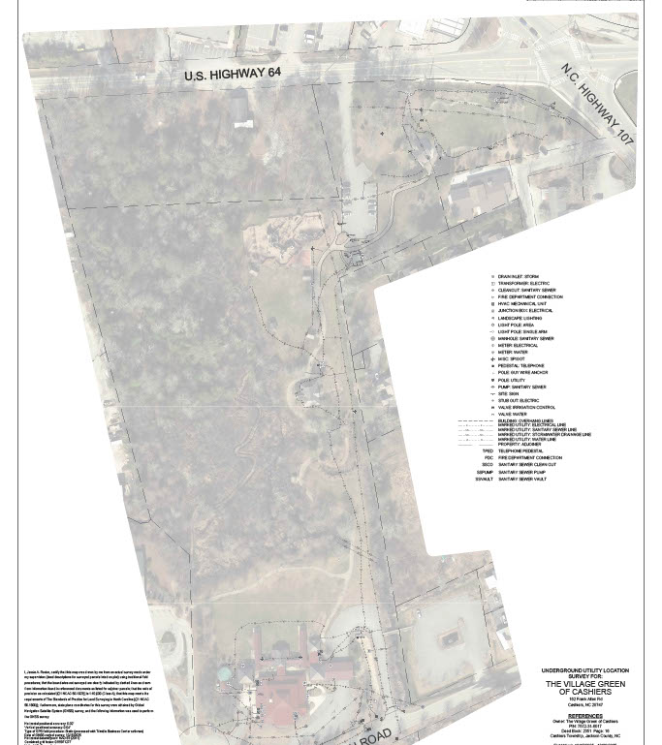
Campus Geo Mapping

Slide 4
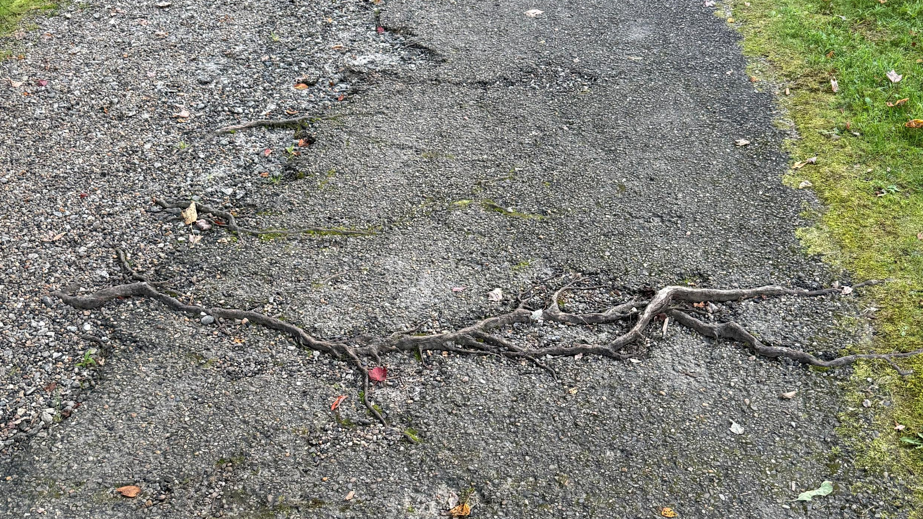
Trail Repaving needs exposed roots tripping hazards broken chip and seal

Slide 5
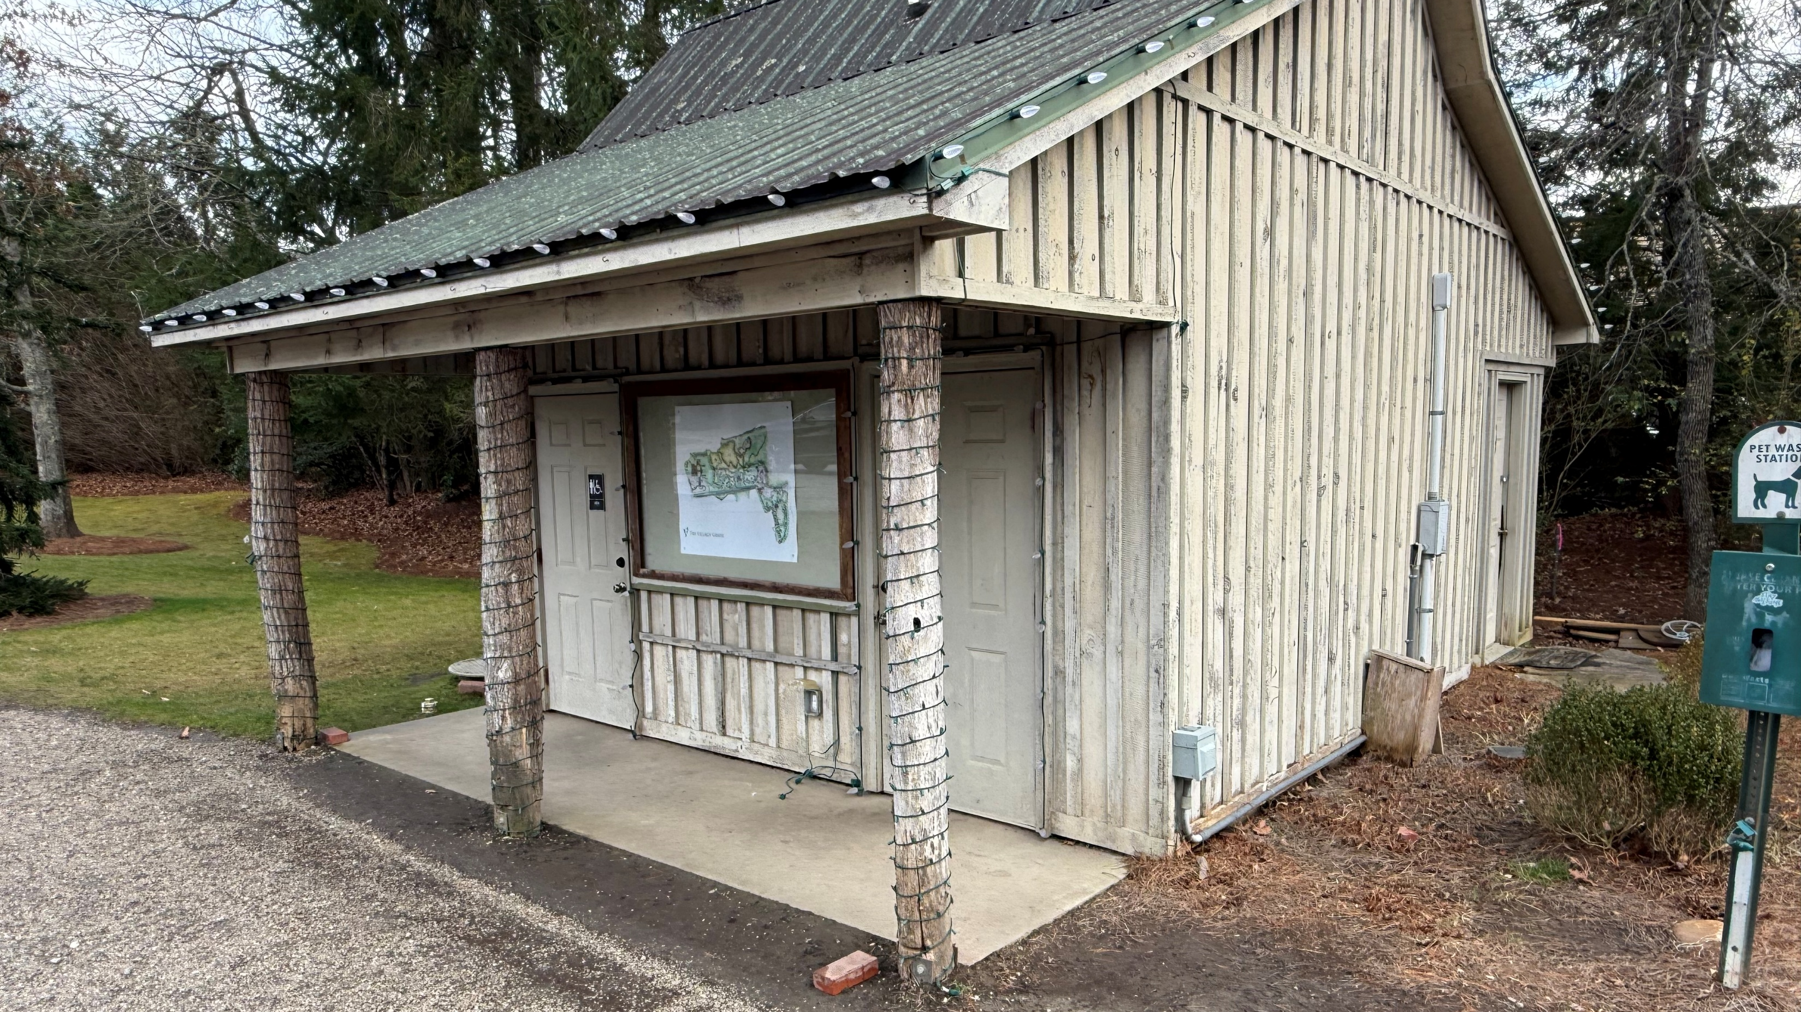

Slide 6
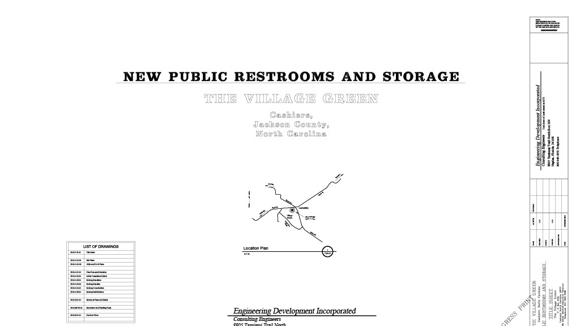

Slide 7
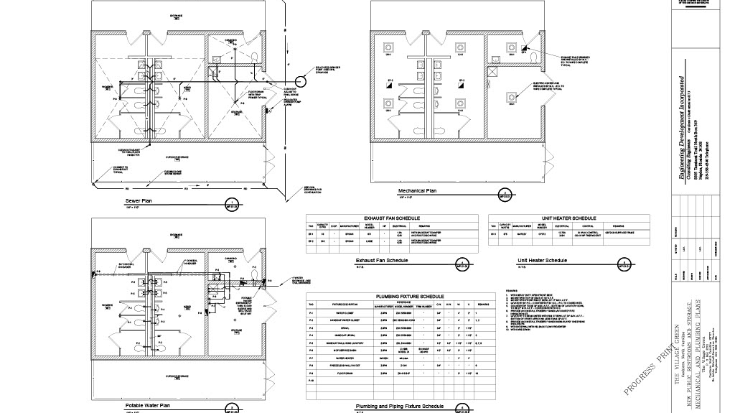

Slide 8
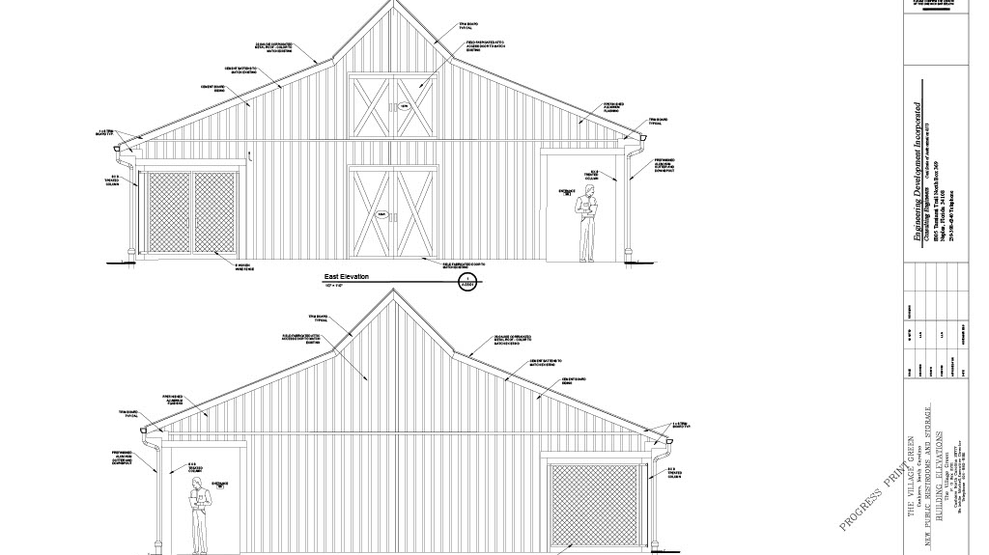

Slide 9


Slide 10


Slide 11


Slide 12


Slide 13


Slide 14


Slide 15


Slide 16


Slide 17


