Slide 1



Building Safer, Stronger Communities through Education, Advocacy, and Connection.
Funding Impact Report & Year Three Community Investment Proposal
Presenters:
Executive Director: DeMakus Staton
Director of Operations:
Kayla Brown
Director of Community Engagement:
Lisa Wells

Slide 2
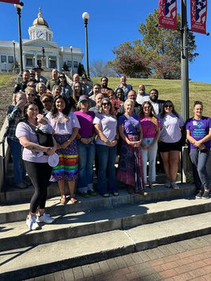
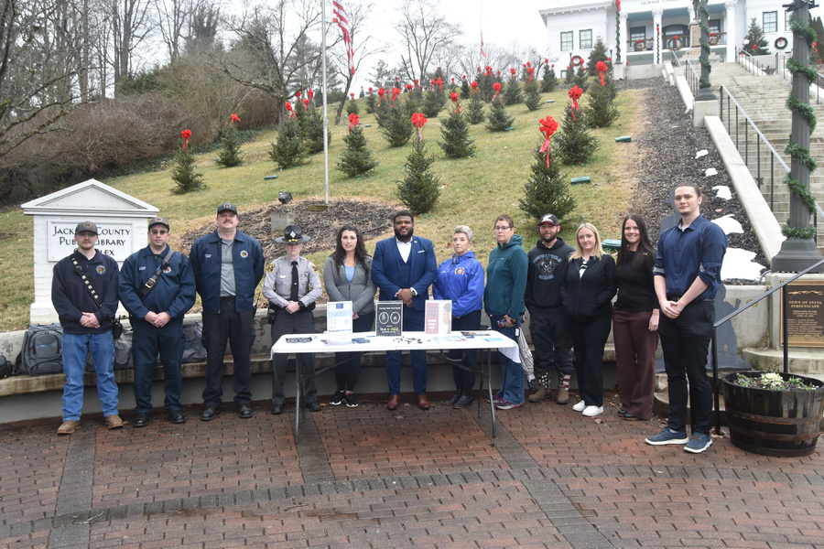
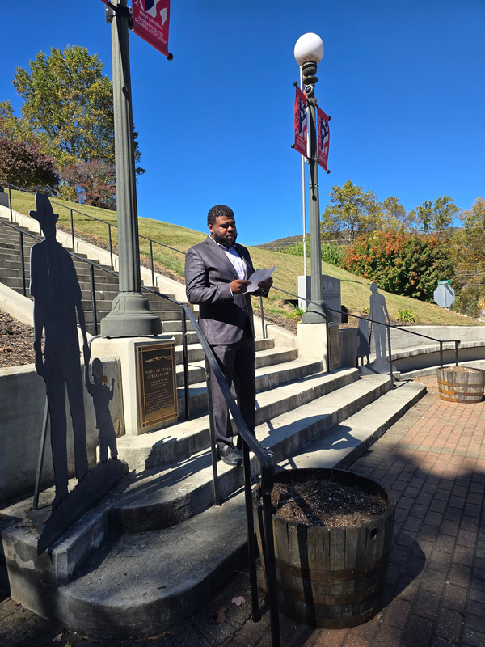
WHO WE ARE
Reflection of Inspiration, Inc. (ROI) is a non-profit organization dedicated to empowering community groups and organizations through education, advocacy, and capacity-building programs that strengthen families and communities.
ROI is recognized as a Dual Tribal Domestic and Sexual Violence Coalition, serving federally recognized Tribal Nations from the Northeastern Woodlands to the Everglades and across the Gulf of Mexico.
Families, tribal nations, and rural communities across Jackson County and the United South & Eastern Tribes depend on access to safety, education, and trusted support systems.
“When communities are supported, prevention becomes possible and healing becomes sustainable.”.

Slide 3
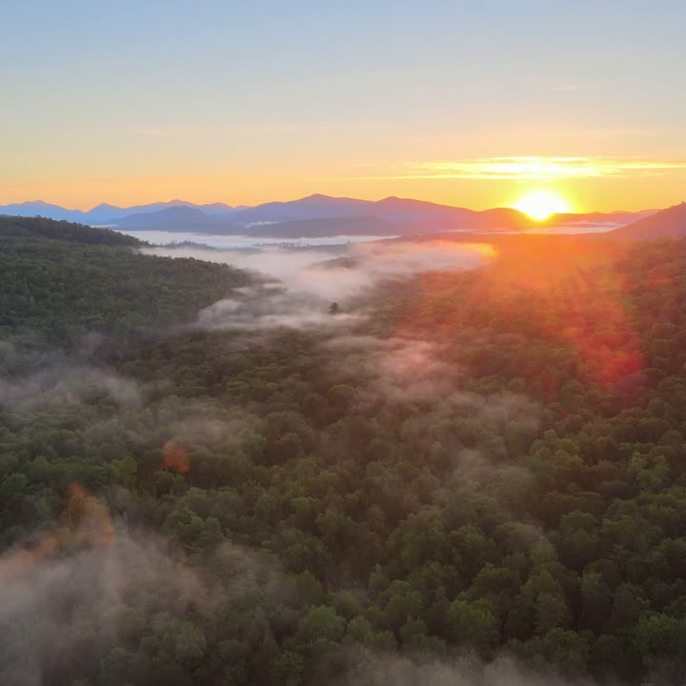

OUR MISSION
Reflection of Inspiration empowers individuals and organizations to be successful for their families and within their communities by encouraging positive development.
OUR VISION
Strengthen communities by engaging its members with positive support.
Rooted in Appalachian and Tribal Values of Resilience,
Respect, and Responsibility.

Slide 4




Trainings & Education:
Technical Assistance:
Crisis Intervention, trauma-informed care, advocacy and legal training, men’s advocacy and prevention programs
Consultation, program development and enhancement, grants management, policy and procedure development.
OUR SERVICES
Community Support:
Advocacy Work
Supporting local efforts that raise awareness about domestic violence, sexual assault, and other pressing community issues.
Centered on walking alongside survivors, families, and community partners to ensure access to safe, culturally grounded, and responsive systems of support. By strengthening collaboration between service providers, and local agencies, ROI helps build pathways to safety, prevention, and long-term stability.

Slide 5

YEAR ONE FUNDING: LAYING THE FOUNDATION
–Supported ROI in expanding its capacity to serve Jackson County.
–Completed Peer Support Specialist training: Wellness Recovery Action Plan (WRAP) Level I, a program focused on prevention and wellness strategies to help individuals get well, stay well, and create the lives they want through structured tools and action plans.
–Completed WRAP Level II training and earned certification as a WRAP Facilitator.
What Is WRAP (Wellness Recovery Action Plan)?
The Wellness Recovery Action Plan (WRAP) is a structured, evidence-informed, and person-centered approach that helps individuals identify tools, supports, and strategies to maintain wellness and respond effectively to life’s challenges. WRAP empowers participants to create a personalized plan based on their strengths, cultural values, and lived experiences, promoting self-advocacy, resilience, and long-term well-being.
Notes:
WRAP is designed to:
Decrease and prevent unwanted or troubling feelings or behaviors.
Increase the personal choices we make about how we live our lives.
Improve our quality of life.
Help us achieve our goals and dreams.

Slide 6
YEAR TWO — EXPANDING COMMUNITY IMPACT
–ROI will host a Sexual Assault Awareness Event focused on educating the community about what constitutes sexual assault, recognizing warning signs, and understanding the importance of consent.
–The event will teach boundary-setting, healthy relationships, and personal safety. Participants will learn how to protect themselves and others from harm through awareness and informed decision-making.
–Community members will learn about mutual consent, respect, and bystander intervention. These tools empower participants to prevent assault and support individuals at risk. Prevention efforts help break cycles of violence and create safer environments.

Slide 7


Slide 8
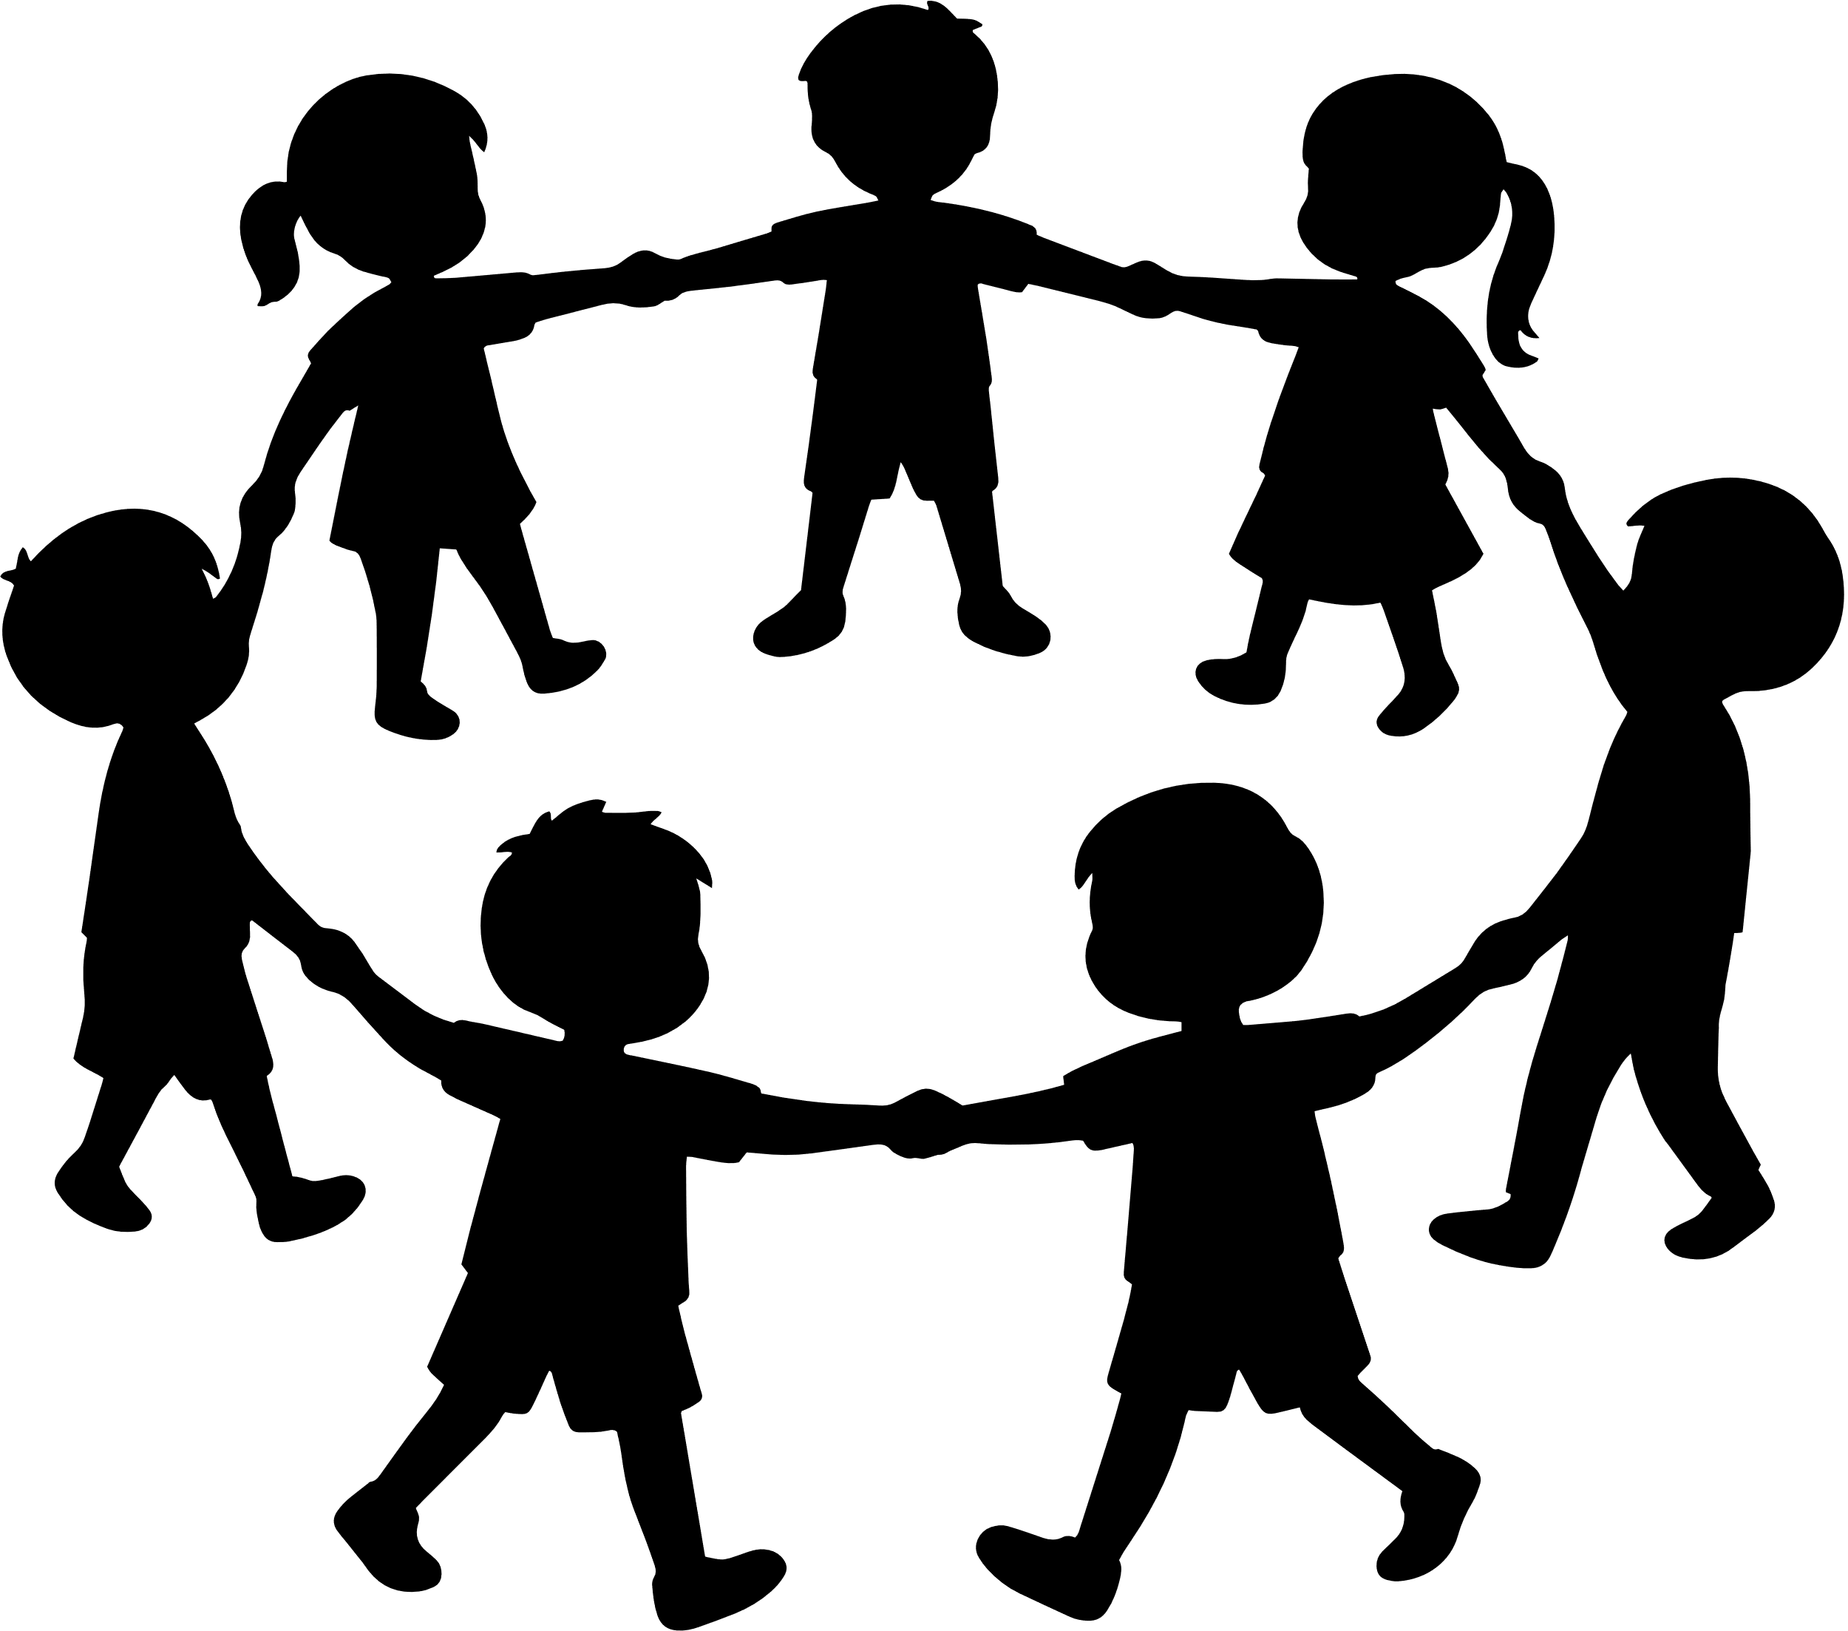
IT TAKES A VILLAGE TO RAISE AWARENESS
This event brings together families, students, local colleges, community leaders, and neighbors to raise awareness, share resources and promote prevention through education & connection.
By coming together, we can highlight awareness, encourage prevention, and strenghen the support systems that help our community thrive.

Slide 9
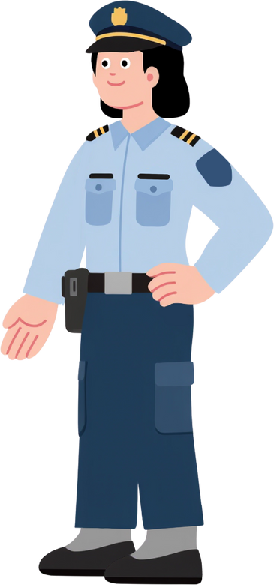
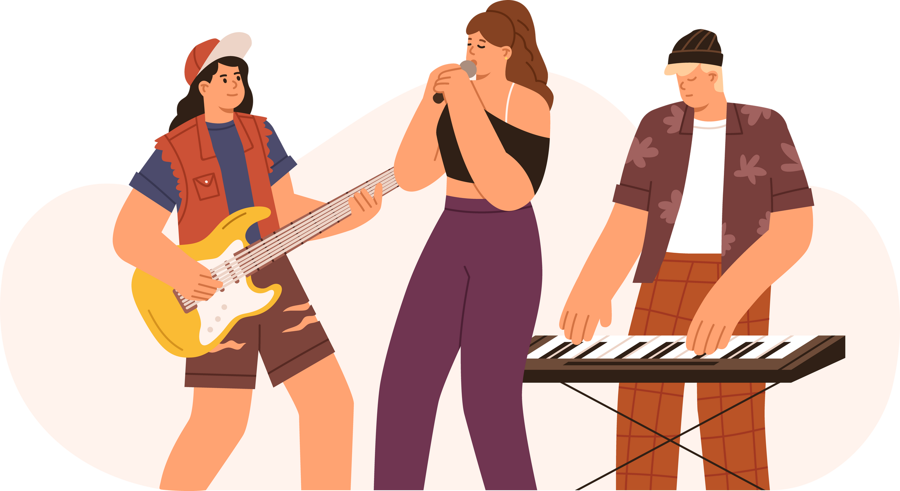



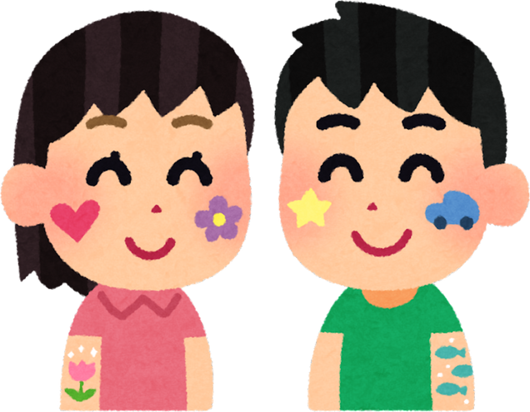
• “Village Wall” or Awareness Mural
Let attendees write messages of support, hope, or commitments to keeping their community safe on a large banner or wall.
• Art Station for All Ages
Provide crafts where kids and adults can decorate hearts, hands, or puzzle pieces that symbolize community and protection. Painting creek rocks with words of togetherness to be placed throughout Jackson County.
Local Hero Spotlights
Feature community leaders, teachers, first responders, or advocates who help keep people safe.
Entertainment with Purpose
• Live Performances,local dance groups, choirs, or youth performers to share uplifting, empowering performances.
• Drum Circle or Music Zone
A communal activity that symbolizes unity and healing.
Wellness & Support Spaces
• Quiet/Calm Tent
A shaded, peaceful area with coloring sheets, soft music, and seating for anyone who needs a break.
Giveaways with Meaning
• Safety Kits
Small bags with hotline cards, stickers, bracelets, and info about local resources.
Resource Booths
Local advocacy groups, counselors, or support organizations to share brochures, hotline cards, and info for adults in a calm, non-intimidating way.
• Parent Corner
A small area with guidance on how to talk to kids about boundaries, consent, and safety in age-appropriate ways.

Slide 10

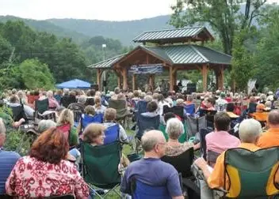
PROPOSED FUNDING REQUEST: ANNUAL EVENT
•Making this an annual event which will make communities stronger, enforcing safety, promotes education, and empowers individuals with knowledge and resources.
Benefits:
–Educate the Community
–Promote Health Relationships and Consent
–Builds Prevention Skills
–Break Silence and Reduce Stigma
–Strengthen Community Support Networks
–Demonstrate Community Commitment to Safety
Jackson County’s investment will be tracked, reported, and reflected in real-world impact.

Slide 11

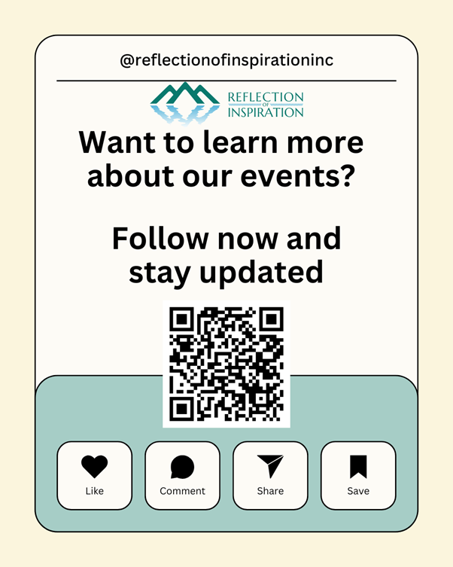
Together, we are building a safer, stronger future for Jackson County families and communities.
We welcome your questions and continued collaboration.

