Slide 1




Slide 2

What is Center for Domestic Peace?
24-Hour Safeline
(828)-586-1237
Domestic violence, sexual assault, and human trafficking services
154B Medical Park Loop
(adjacent to Harris Regional)
A 501(c)(3) non-profit organization that takes a holistic, community focused approach towards ending interpersonal violence in Jackson County, North Carolina.
Center for Domestic Peace (CDP) provides a wide variety of services to those experiencing interpersonal violence in our community.

Slide 3
CDP History Highlights
2012: REACH of Macon County begins providing domestic violence services to Jackson County
2016: Center for Domestic Peace (CDP) is formed to address the ongoing need for services in Jackson County. This is done in partnership with REACH of Macon County.
2020: The first Executive Director is hired and CDP begins providing Domestic Violence services independent of of REACH of Macon County.
2022: Sexual Assault Services are being provided at CDP making it a fully independent dual agency.
2023: Planning for a new shelter is underway with funding from Jackson County and Dogwood Health Trust.
2026: The new emergency shelter will open as a refuge for survivors of interpersonal violence.

Slide 4
Who do we serve?

Slide 5
Who do we serve?

Slide 6

Who do we serve?
Everyone!

Slide 7
Services Offered
24-Hour Crisis Intervention and Response
Emergency Shelter
Court Advocacy
Individual and Group Therapy
Information and Referrals
Outreach and Prevention

Slide 8
24/7 SAFELINE - (828) 586-1237
Free and confidential access to victim advocacy
Assistance with emergency shelter needs
Danger assessments, safety planning, and next steps
Sexual assault hospital response and accompaniment
Resource distribution and referrals

Slide 9
Intervention & Response:
Victim Advocacy
CDP staff provide direct client services support survivors of interpersonal violence
Specialized advocacy from Bilingual, Court, Housing, and Outreach/Prevention Advocates
Sexual Assault Advocate works with survivors in coordination with community partners
All Advocates assess needs, validate experiences, plan safety, and provide resources
CDP Advocacy is trauma-informed and grounded in the Empowerment Model

Slide 10
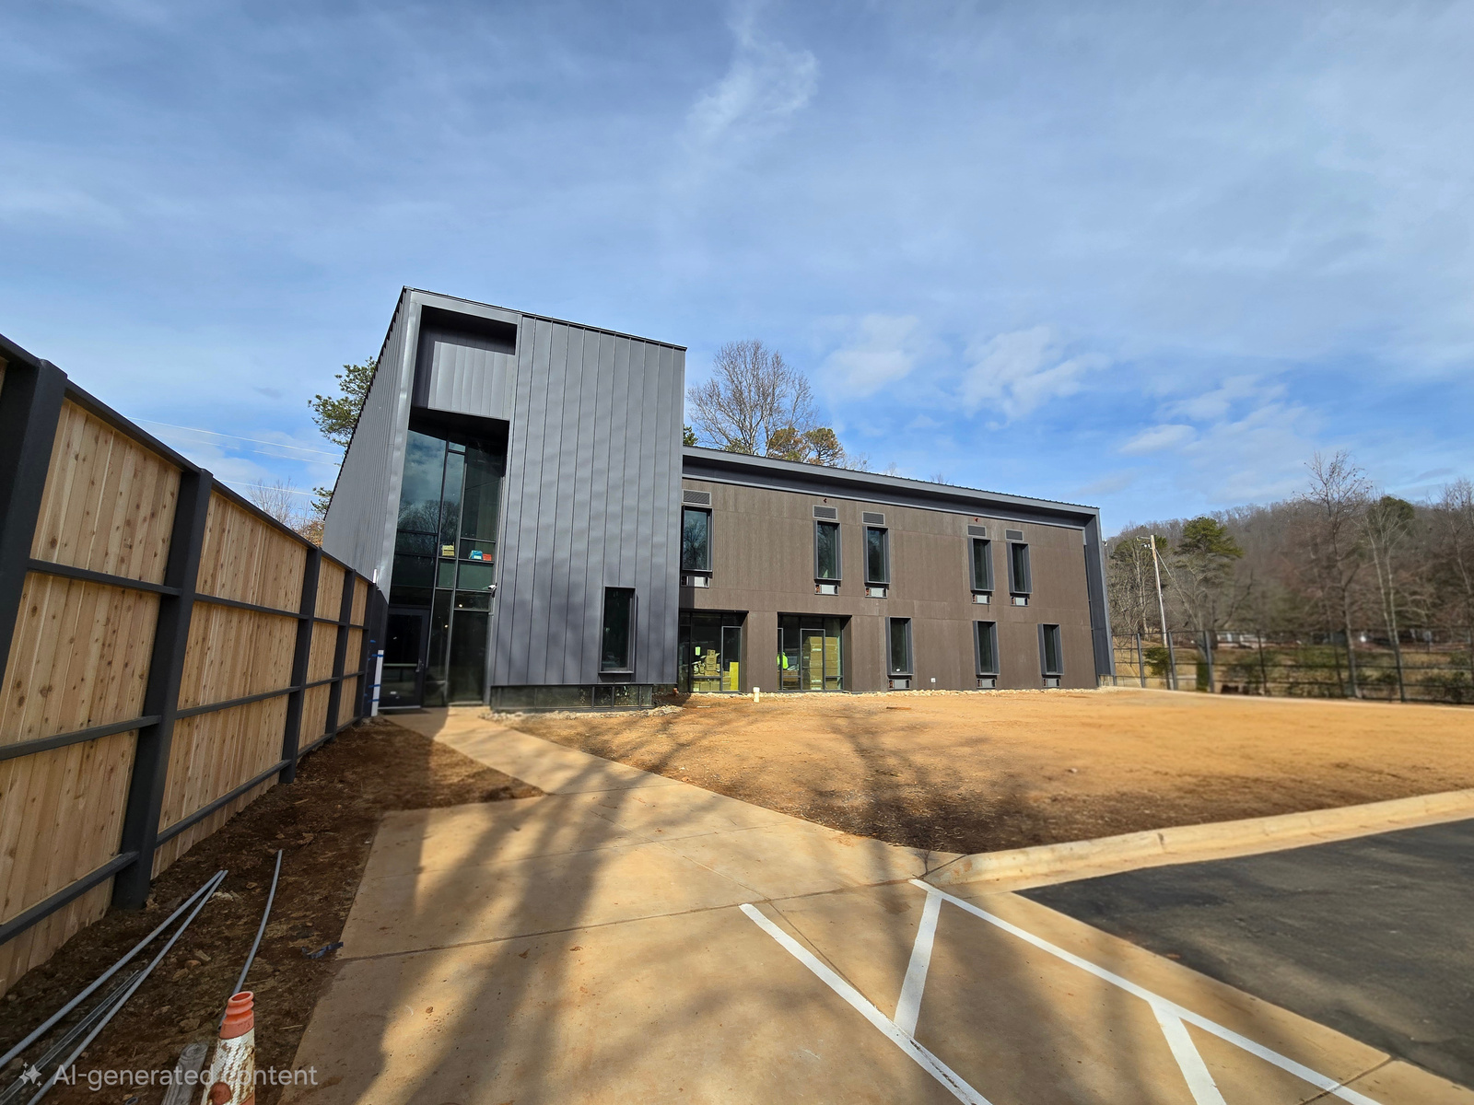
Emergency Shelter
CDP provides temporary emergency housing for those fleeing interpersonal violence
Presently using hotels and partner agencies
New Emergency Shelter will accommodate up to 18 persons

Slide 11
Court Advocacy
Court accompaniment for clients
Assistance in filing Domestic Violence Protection Orders and No Contact Orders in state and tribal courts
Track updates during court proceedings to ensure clients are aware of changes and outcomes
Maintain knowledge of civil and criminal court procedures and policy changes

Slide 12
Court Advocacy
Provide clients with relevant court updates:
  Upcoming court dates
  Defendant arrest information
  Plea agreements and case developments
Facilitate and participate in monthly meetings with the Jackson County District Attorney’s Office
Communicate client desired outcomes and concerns to the DA
Track and maintain valid Release of Information (ROIs) to communicate with the DA, Legal Aid, and other counsel

Slide 13
Counseling and Therapy
Domestic Violence and Sexual Assault Survivors Support Groups
In House Therapist
  Free counseling for survivors of interpersonal violence
Referrals to free licensed therapists and counselors
Spanish speaking counselors and therapist referrals
Children 13 and under
  WNC Alliance in Waynesville

Slide 14
Outreach & Prevention
Emphasis on prevention, education, and community outreach
Educational presentations on healthy relationships, consent, internet safety, interpersonal violence, and CDP services
Jackson County Schools, WCU, SCC, and other partners
WCU campus outreach including tabling events and group collaborations
Participation in community groups, events, and awareness initiatives

Slide 15

Information and Referrals
Child Advocacy
  AWAKE Child Advocacy Center
  Department of Social Services
Courts
  Jackson County DA
  Jackson County Clark
  Jackson County Magistrate
Legal
  Legal Aid
  Pisgah Legal
Law Enforcement
  Jackson County Sheriff’s Office
  Sylva Police Department
  WCU Police Department
Health Care
  Harris Regional
  Jackson County Health Department
  Other providers
Mental Health
  In-house referrals
  Contracted therapists
  Blue Ridge Health
Housing
  Mountain Projects
  HERE in Jackson County
Clothing/material resources
  In-house resources
  Great Smokies Health Thrift

Slide 16

Annual Impact:
Intervention:
Served 312 Survivors
  256 Domestic Violence
  56 Sexual Assault
Provided 3,091 services
Answered 343 Safeline calls
Utilized 2,881 volunteer hours
Shelter & Housing:
Sheltered 22 People
445 nights of safety
Housed 17 people in Safe at Home

Slide 17

Annual Impact:
Advocacy:
102 survivor safety plans
153 danger assessments
101 survivors provided with financial and job assistance
Court Advocacy:
185 Survivors interacting with the justice system
Assisted with 102 Domestic Violence Protective Orders
Made 29 Mandatory reports to DSS

Slide 18

Annual Impact:
Outreach & Prevention:
Attended 106 outreach events
5000+ unique interactions
Prevention education to 773 students
Therapeutic Services:
Provided 146 clinical counseling sessions
Held 12 support group sessions for survivors
Currently providing in-house service to 12 clients

Slide 19

Operations

Slide 20
Thank you, Jackson County for your support of the
Center for Domestic Peace!

Slide 21
Interested in getting involved?
Please contact us!
Monday-Friday: 9am-5pm
(828) 586-1237

