Slide 1


Slide 2
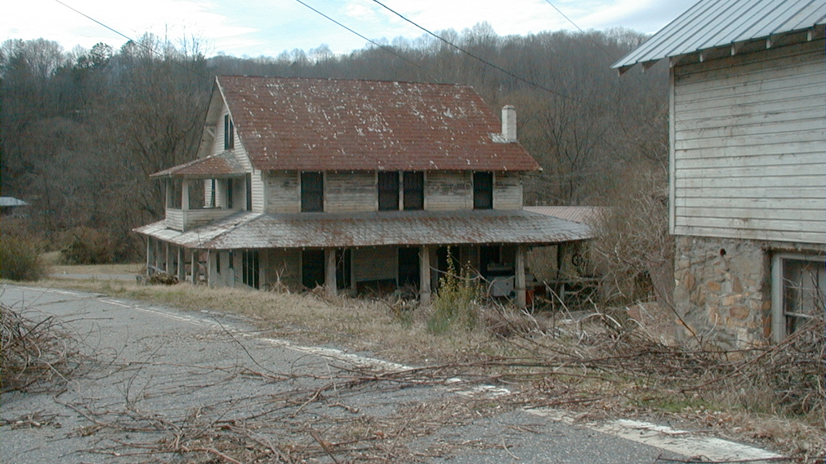

Slide 3
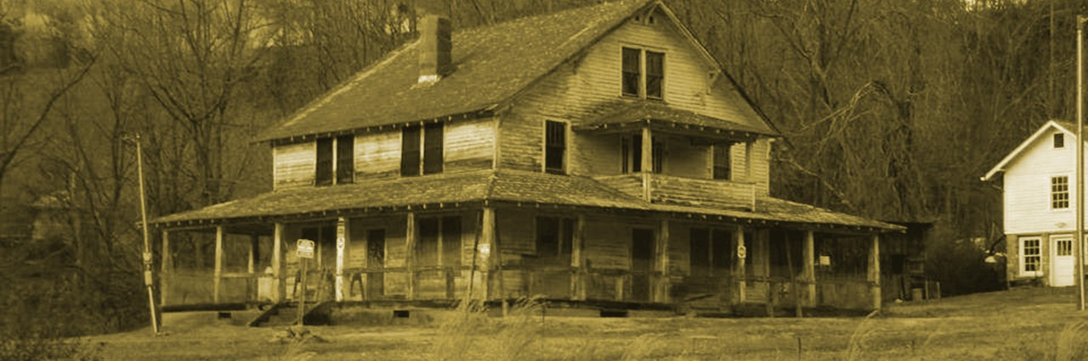
Monteith Farmstead Canning house has been restored, work is still needed on the main house.

Slide 4
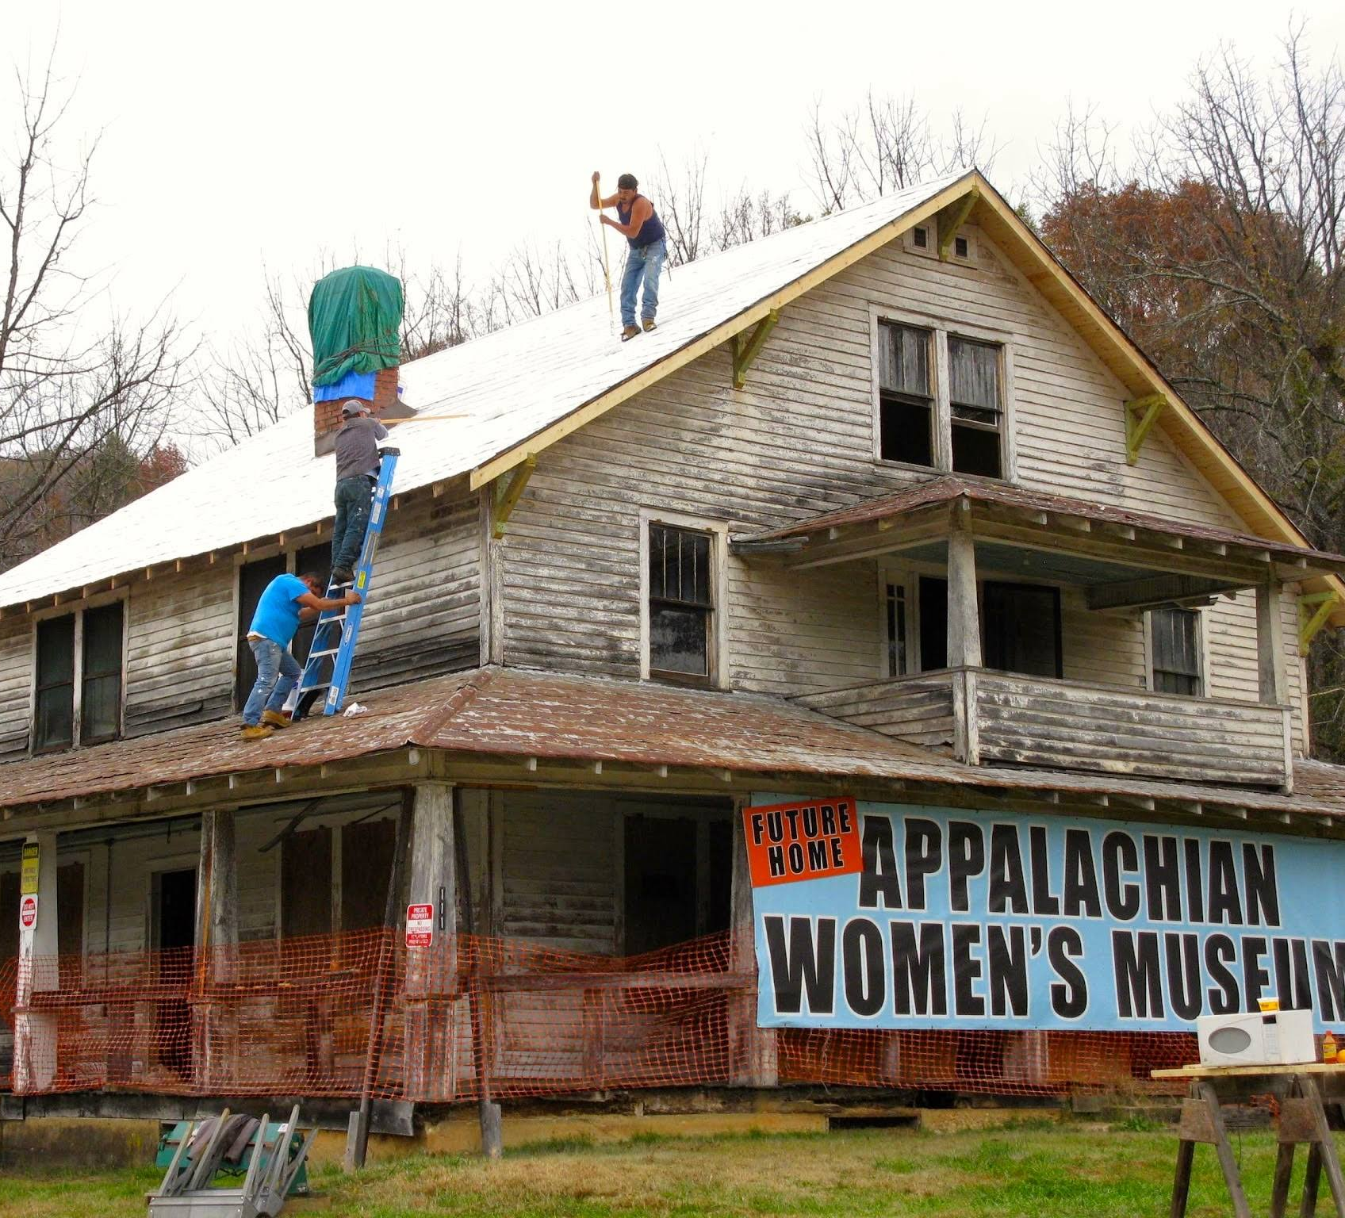
New roof and building stabilized.

Slide 5
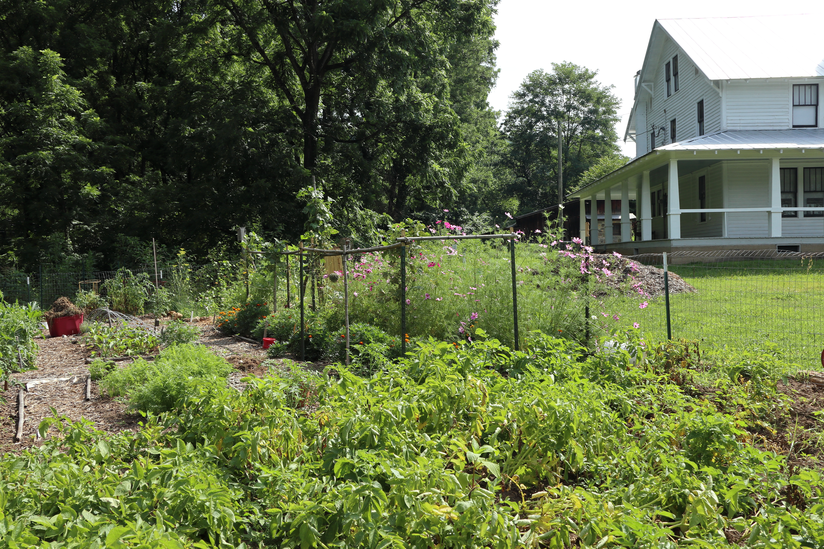
Victory garden similar to those planted by Appalachian women during WWII and just after.
Our garden is planted, maintained, and harvested by volunteers.
The food and flowers grown are donated to United Christian Ministries in aid to our neighbors.

Slide 6
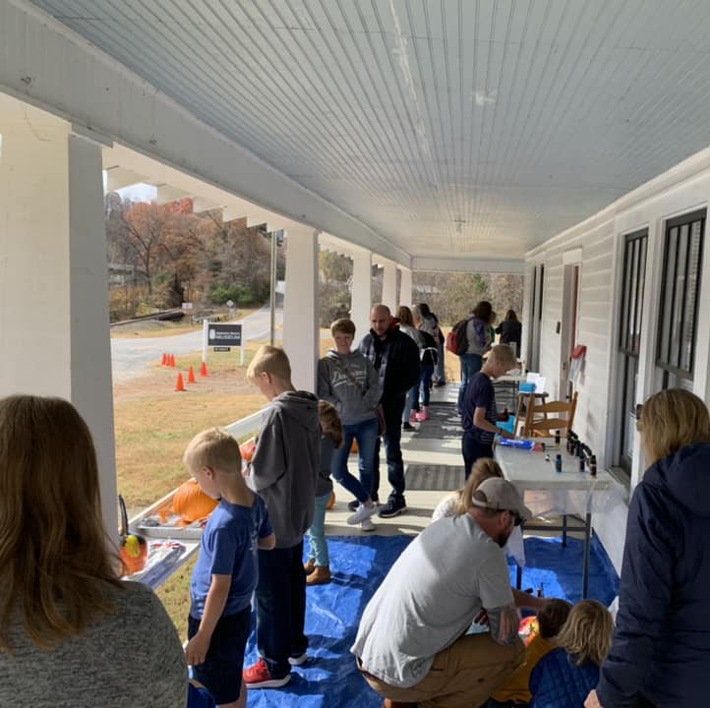
Kids Porch Events

Slide 7
