Slide 1

Jackson County Permitting & Code Enforcement
General Information and
Permitting Software Updates
Jackson County Board of Commissioners Meeting
December 2, 2025

Slide 2

Permitting & Code Enforcement
Our department has 20 full time employees that inspect and issue permits for:
Erosion & Sediment Control – Site grading and stormwater planning for new construction sites.*
Floodplain – Any type of use that occurs in a mapped floodplain area requires a permit; this helps us determine what special measures may need to be taken for development. In some flood areas certain types of development may not be permitted.
Building Permits – Any new structures or changes to a system (framing, electrical, plumbing, mechanical) usually require a permit.*
Fire Inspections & Permits – We issue permits for large tent events and fireworks shows. We, also, inspect businesses, schools, apartments, and foster homes for compliance with the State Fire Prevention Code.
*There are some exemptions for agricultural uses.

Slide 3
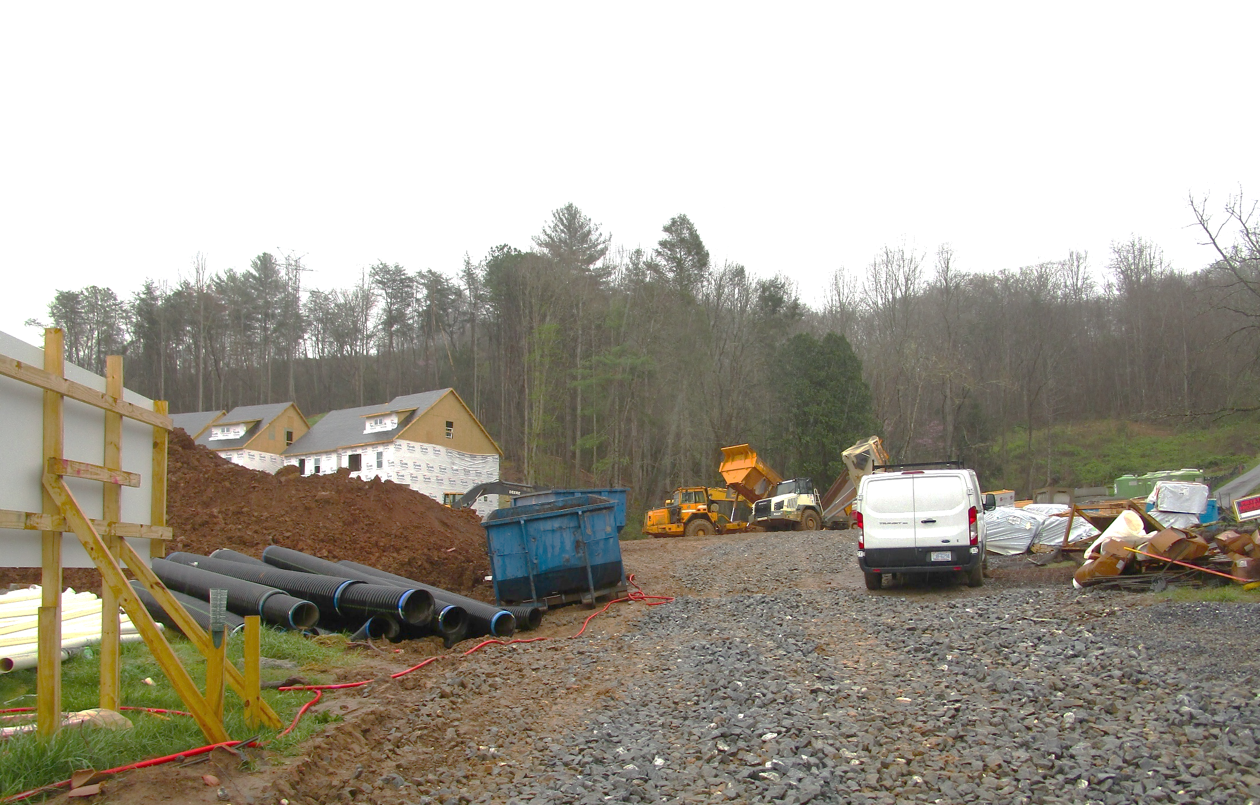
Erosion Control Permitting
For larger projects the Land Development Permit is still required, but a separate Erosion Control Permit would be required for our office to permit any land disturbance greater than half an acre. Some items that we look for during review of these permits are:
Check the site plan to be sure a sufficient buffer zone is retained along any natural water course or lake (usually 25’ or 30’ buffer zones are required).
Erosion control devices must retain any sediment onsite throughout construction; offsite sedimentation damage must not occur.
The angle of cut or fill slopes should be minimal so that they can be properly stabilized.
Temporary and permanent ground cover measures must be taken so that the site is stabilized after any phase of construction is complete.
A plan for stormwater runoff may be necessary per NC standards or any applicable local ordinances. Stormwater standards help to limit destructive runoff and flooding generated by impervious surface areas.

Slide 4
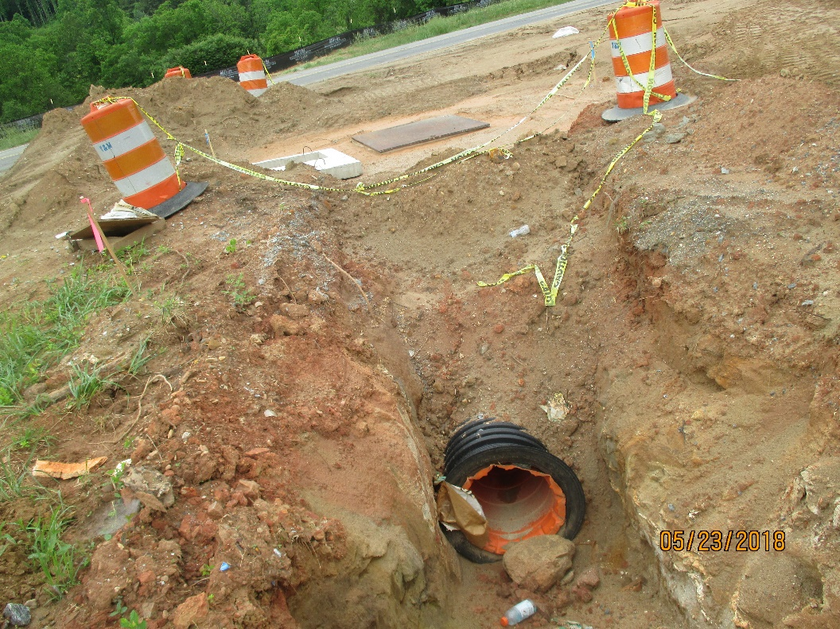
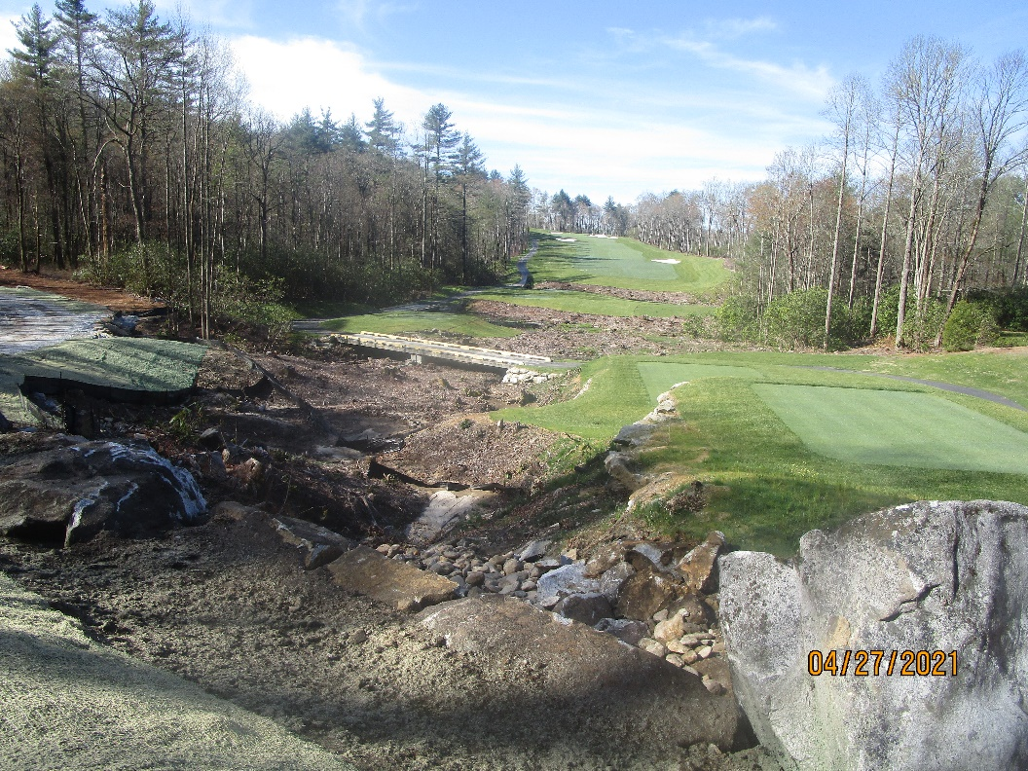
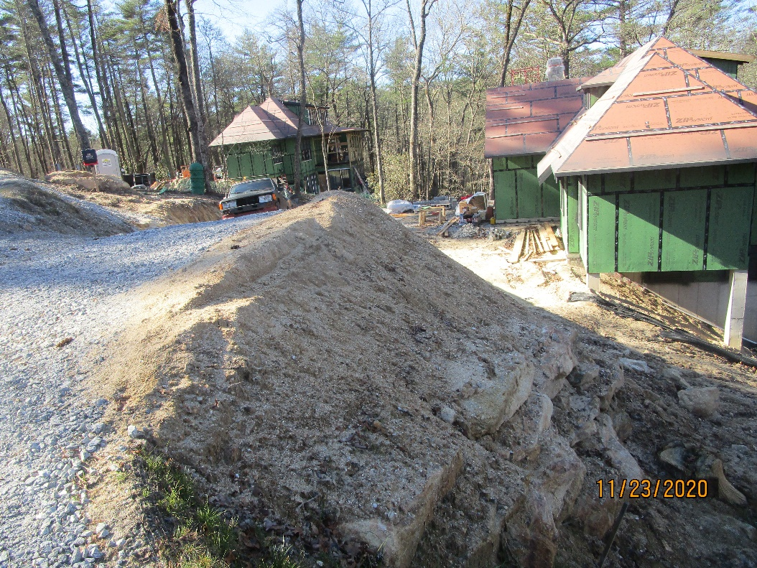
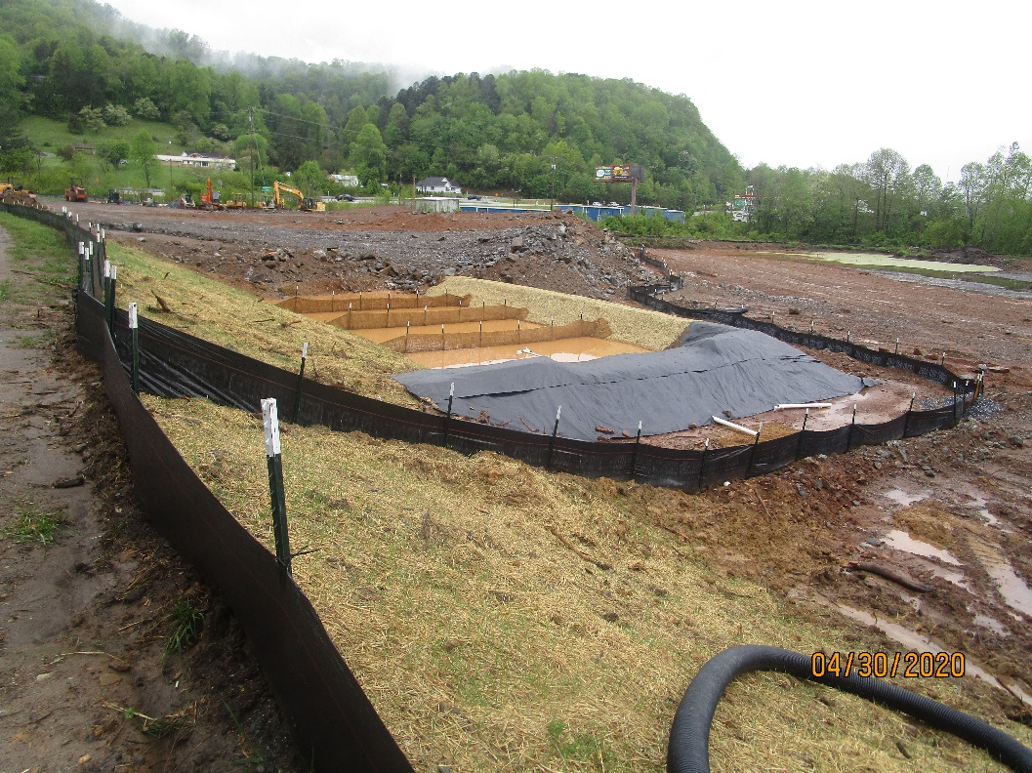
Not all job sites are created equal…

Slide 5
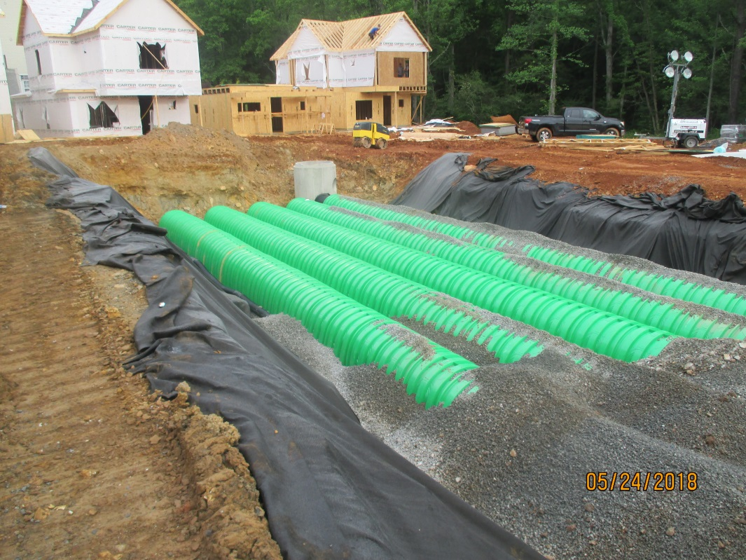
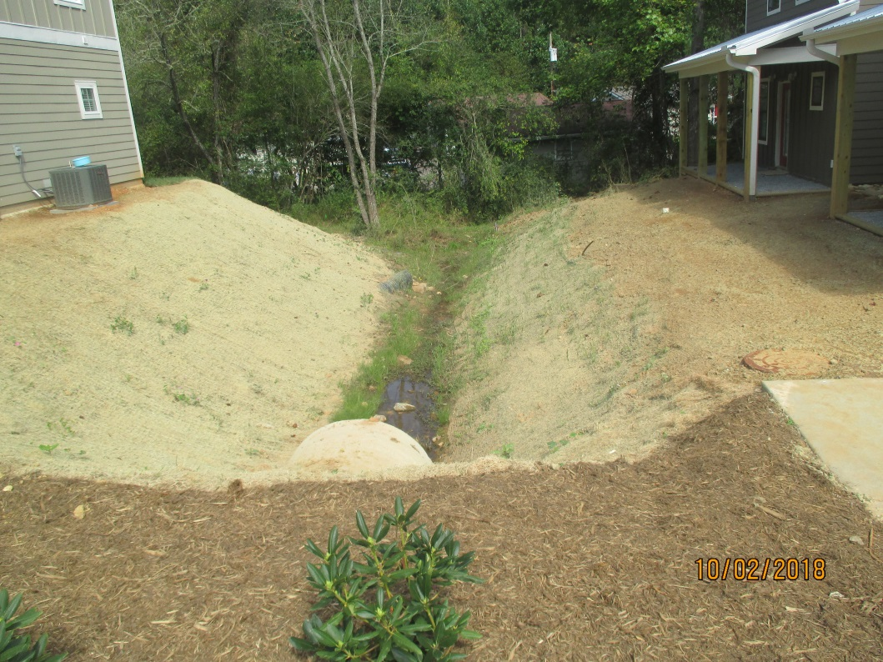
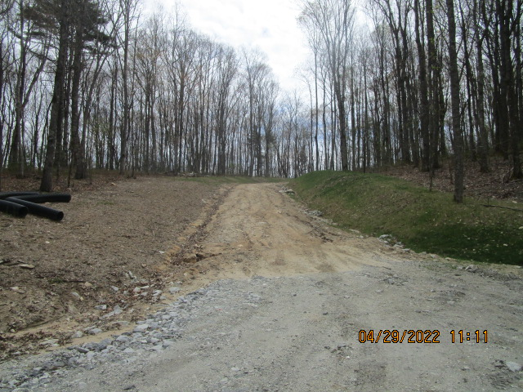
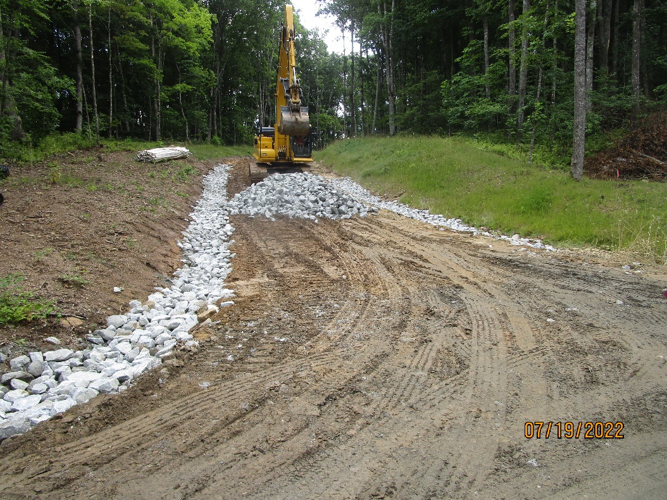
Before and after the installation of an engineered underground retention system.
Ditch lines and sediment basins are very important when constructing a new roadway; that water has to run somewhere!

Slide 6
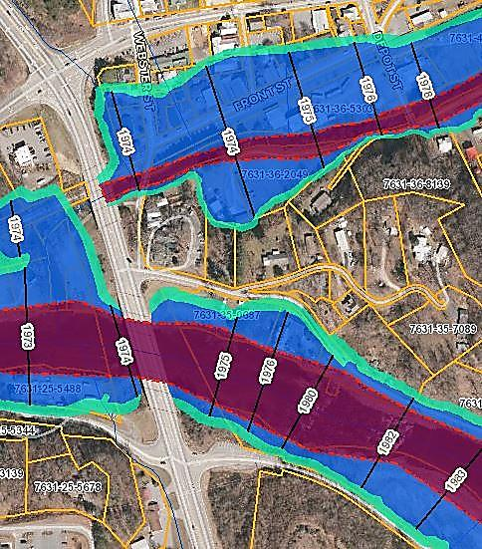

Floodplain Permitting
Basic Development Information and Map Explanation
Red/Purple Shaded Area – This area is known as the Floodway. No construction or development is typically allowed in this area, with a couple of exceptions that have to be determined by the CFM.
Blue Shaded Area – This area is referred to as the 100-year floodplain.
Development is permitted in this area as long as the lowest floor of the lowest enclosed area is elevated to 2 feet above the BFE (base flood elevation) for residential construction, or commercial construction has been flood-proofed to 2 feet above the BFE.
Light Green Shaded Area – This area is known as the 500 year floodplain and is not enforced per the Jackson County Flood Damage Prevention Ordinance. This information is provided as reference for planning purposes.

Slide 7
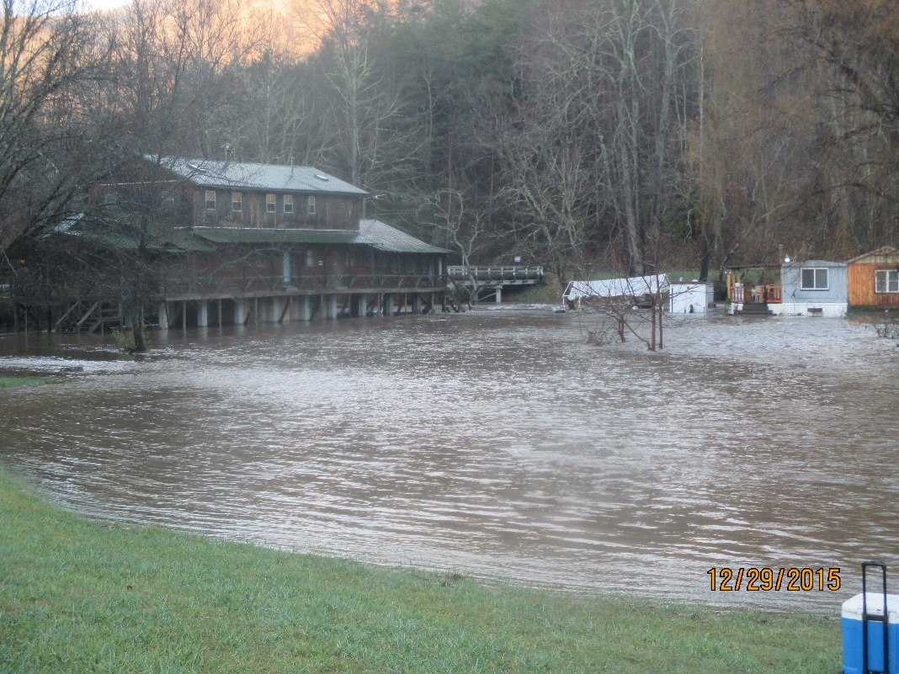
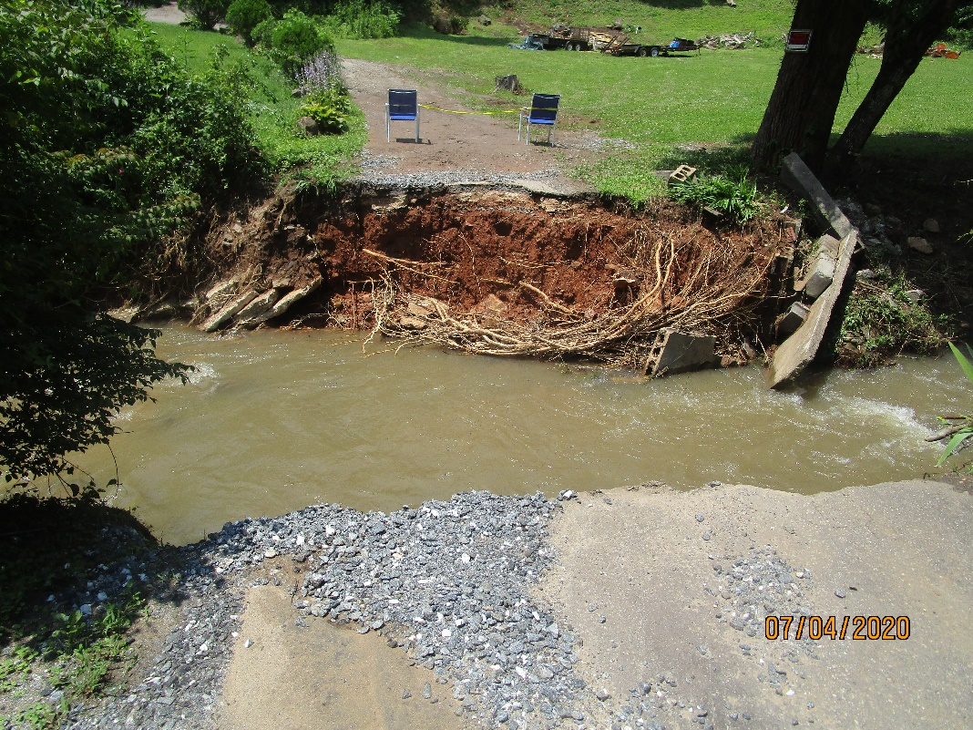
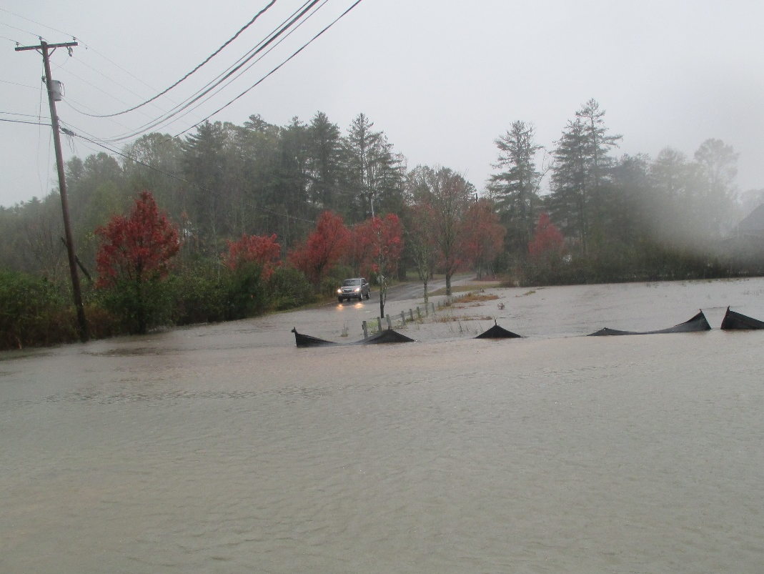
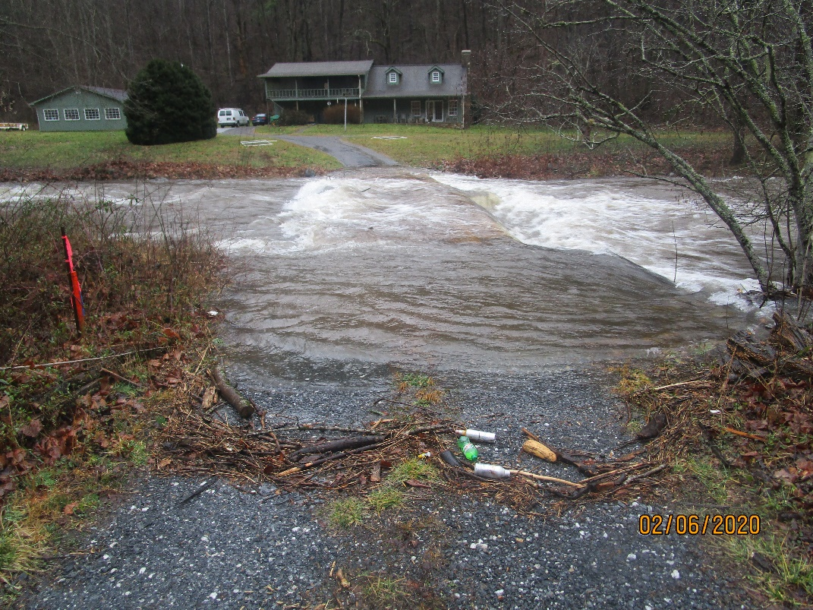
There have been several flood events in our county and it is important for us to look at floodplain areas to be sure that any new construction is elevated above possible flood waters.

Slide 8
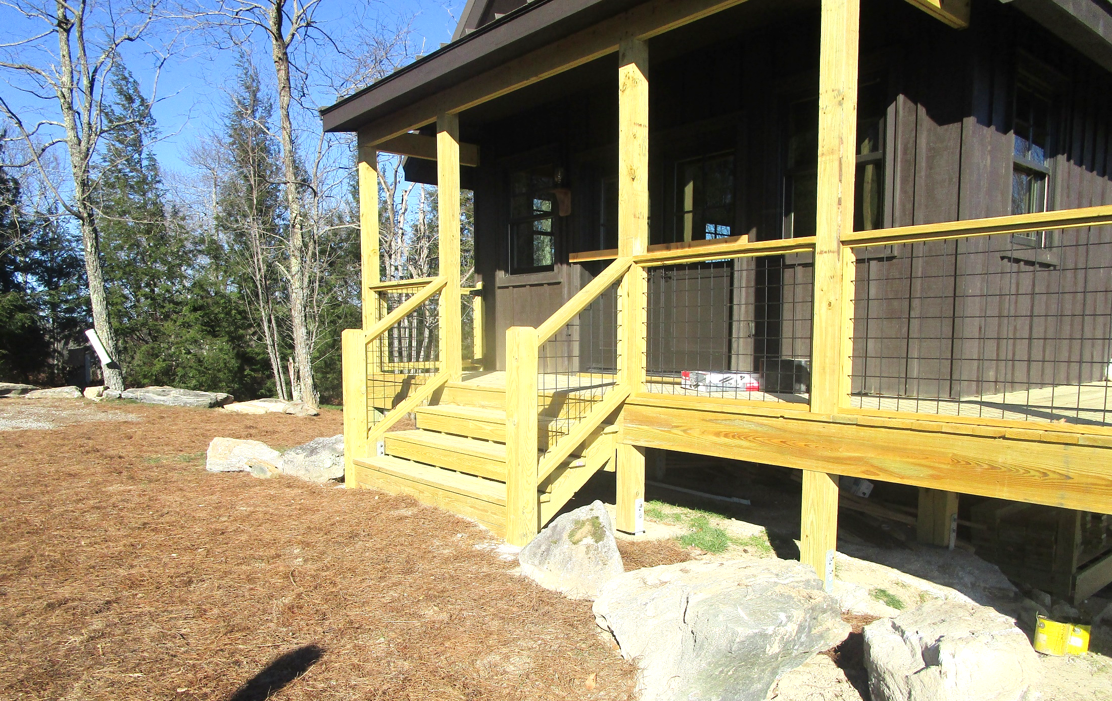
Building Permits
Our office issues several different types of Building Permits:
New Single Family (Detached) – A permit is issued to construct a new residence. When it is detached that means it is one home on its own. These permits may include an attached structure like a garage, but this does not make it an attached new single family residence.
New Single Family (Attached) – These permits are issued when up to 4 residences are attached.
New Multi-Family – These permits are issued for multiple residences that are attached; an example of this type of permit would be townhouses or apartments.
Addition (Residential or Commercial) – When the customer is adding square footage to an existing structure.
Remodel (Residential or Commercial) – When work is being done within the existing footprint of a structure.

Slide 9
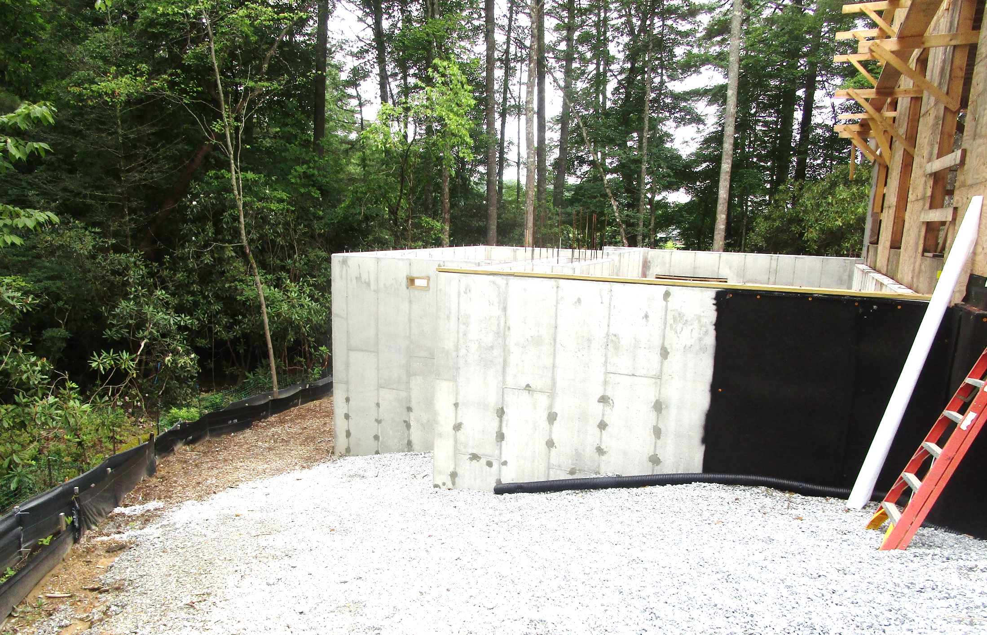
Building Permits
More types of Building Permits:
Manufactured Home – Permits issued under this heading can be any size or type of manufactured home; single-wide, double-wide, triple-wide, or camper trailers.
New Commercial – An entirely new commercial structure. Commercial uses are anything related to a business and not for residential use.
New Work (Residential or Commercial) – Any new structure that is constructed to be used secondary to another structure on the property; i.e. garages, sheds.
Miscellaneous – Permits that are issued for any change and/or new installation of a system. These permits can be used for building, mechanical, electrical, or plumbing work. Any other type of Building Permit is a “blanket” permit and would include this trade work; miscellaneous is only for work that is done independently.

Slide 10
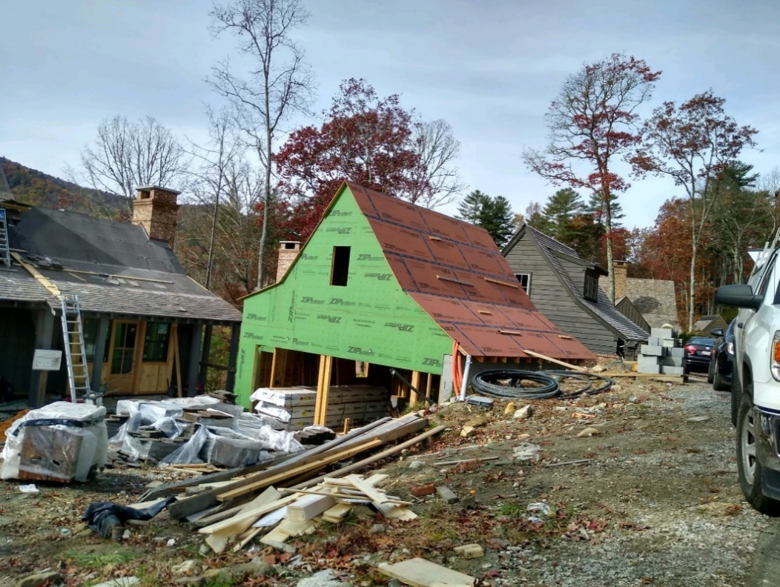
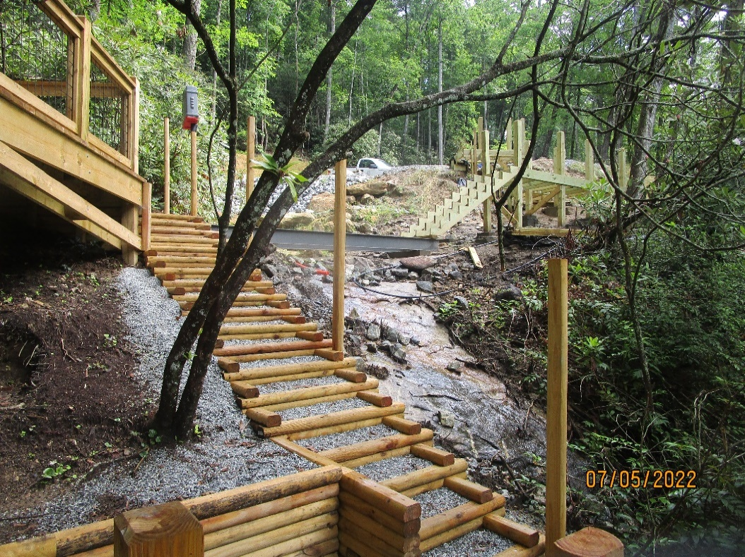
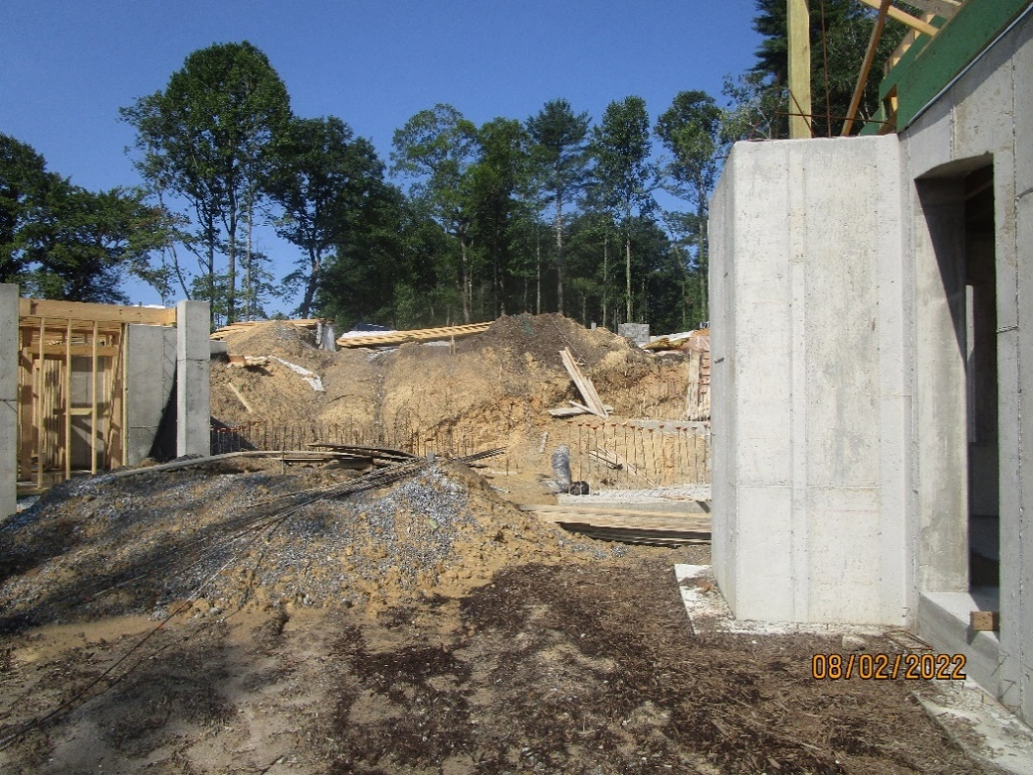
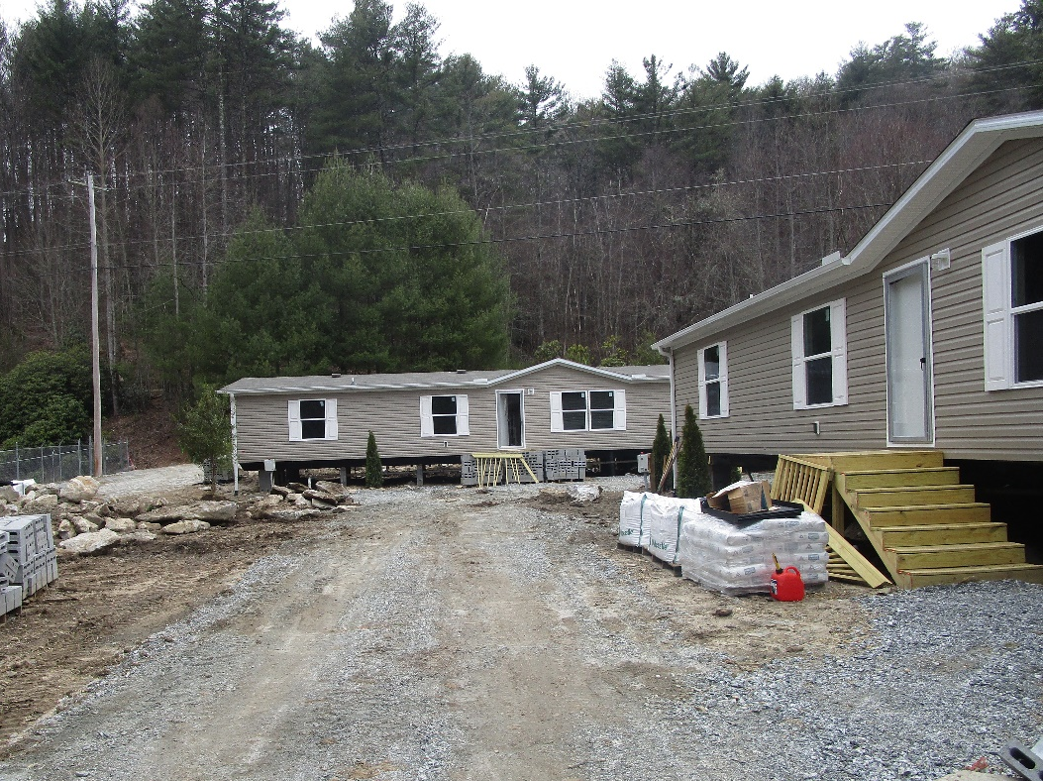
No two residential construction sites are the same. Every type of Building Permit can greatly differ by structure, design, or environmental conditions.

Slide 11
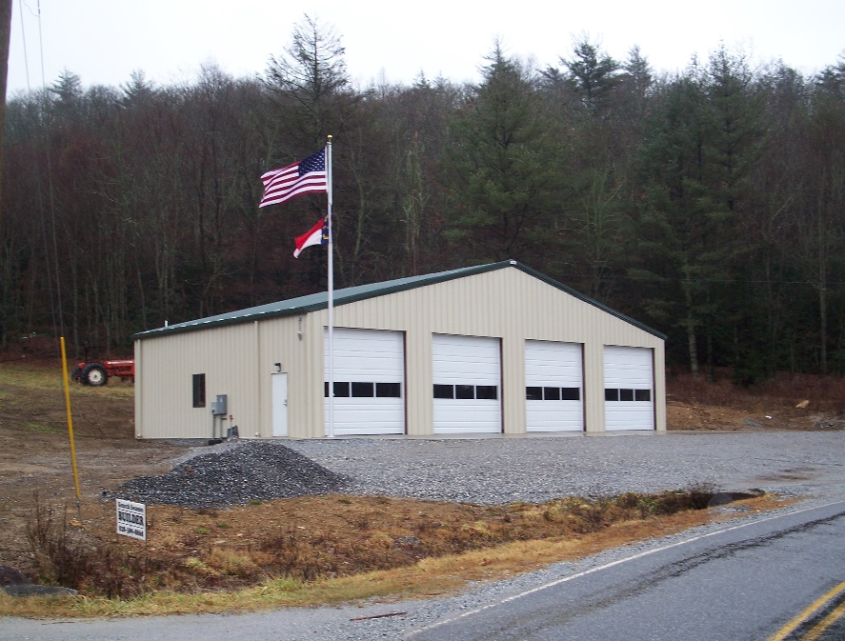
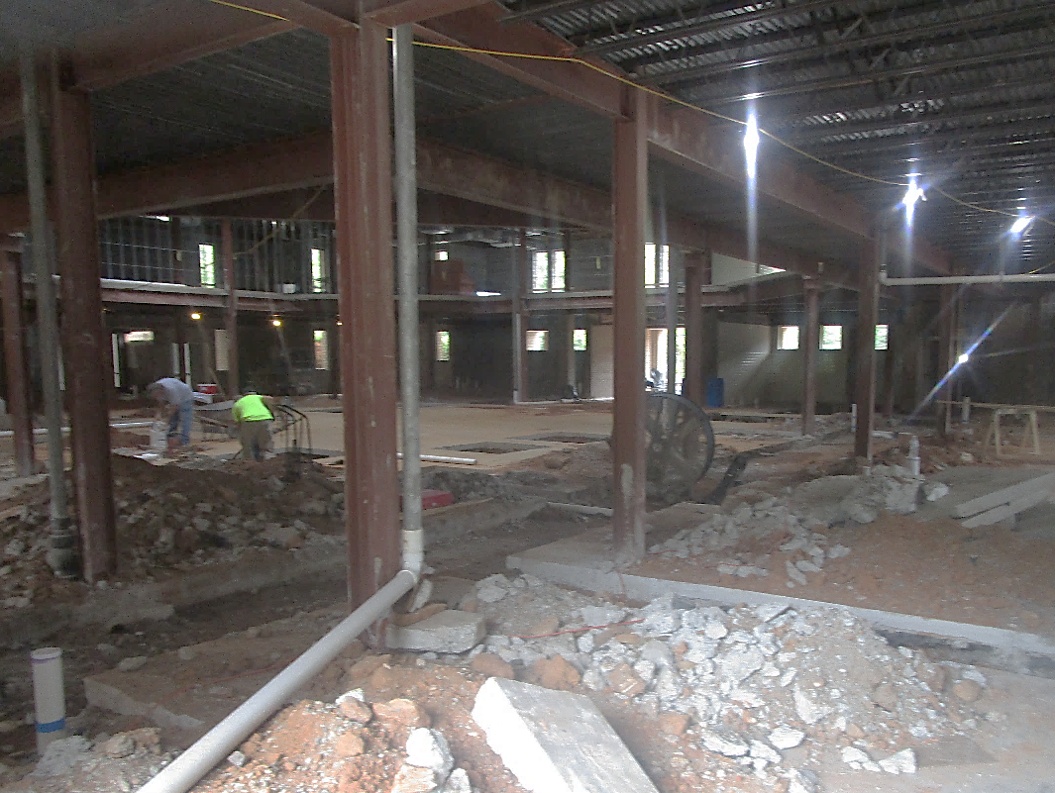
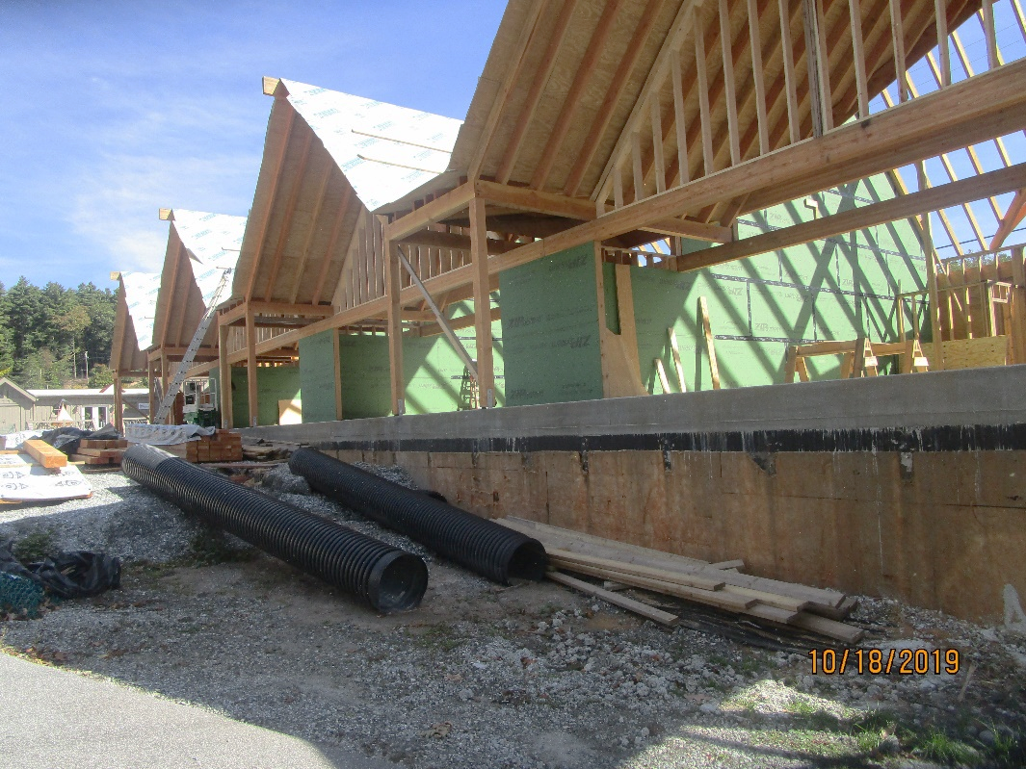
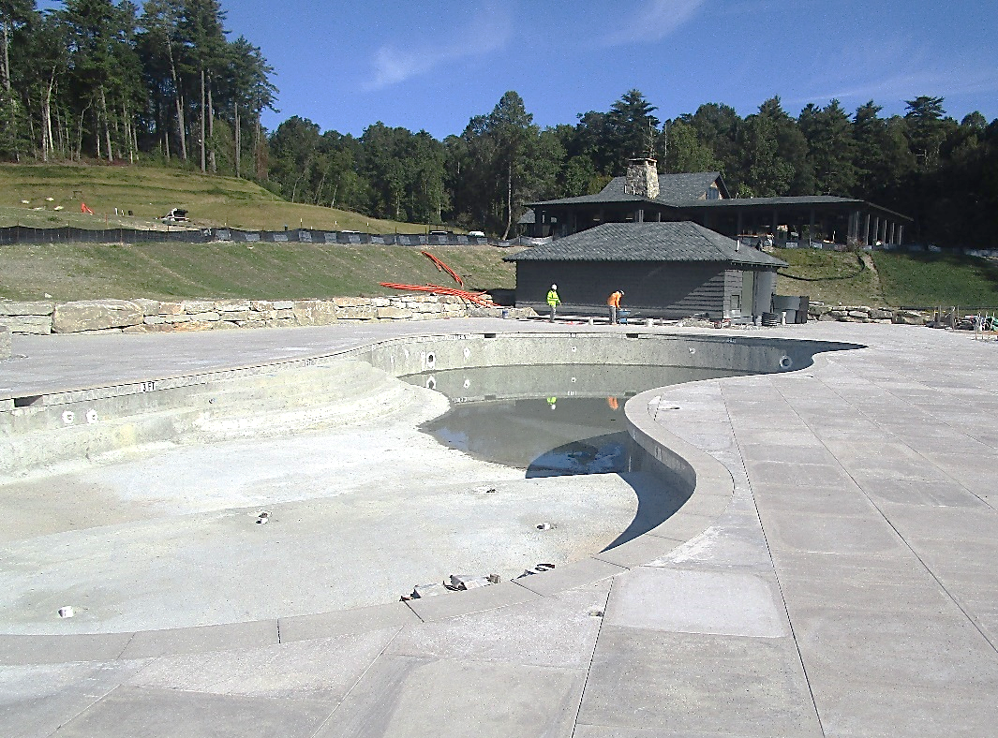
Commercial sites vary, as well, covering anything from new fire departments to office remodels, new retail space, or clubhouses with swimming pools. Any structure not for your personal use falls under commercial permitting.

Slide 12
Fire Inspections & Permits
Our offices conduct fire inspections and issue fire prevention permits to be sure that the necessary safety requirements are met for new and existing buildings and several community events throughout the county. Examples of some of the things that we inspect for fire safety:
Large tents for local events, weddings, etc.
Fire safety for commercial structures – schools, restaurants, retail shops, apartments, hospitals, etc.
NC Division of Social Services mandatory inspections of foster homes
Emergency planning and preparedness
Any large fireworks shows in the county must be inspected for safety.

Slide 13
On February 24, 2025 we went live with our Tyler permitting software.
As of November 1st, we have processed 3,684 new permits and applications in the system between the Permitting & Code Enforcement Office and Environmental Health.

Slide 14
Permitting Totals Feb 24 – Nov 1
Land Development Permits – 883 permits
(including land disturbances of less than ½ an acre)
Erosion Control Large Projects (more than ½ acre) – 23 permits
Floodplain Permits – 21 permits
Residential | Building |  | Commercial | Building |  | Other
Addition/ Remodel | 184 |  | Addition/ Remodel | 35 |  | Demolition | 11
New Single Family | 168 |  | New Commercial | 18 |  | Miscellaneous | 1164
New Work | 109 |  | New Work | 19 |  | Tent Events | 28
Manufactured Homes | 77 |  | ABC Permits | 8 |  | Fireworks | 11
There have been at least 12,255 inspections completed in the new system.

Slide 15
Permitting Stats by Office Through Nov 1
Residential | Sylva |  | Commercial | Sylva |  | Other | Sylva
New Single Family | 91 |  | New Commercial | 8 |  | Miscellaneous | 678
Addition/ Remodel | 81 |  | Addition/ Remodel | 24 |  | Tent/Fireworks | 5
New Work | 58 |  | New Work | 7
Manufactured Homes | 81 |  | ABC Permits | 2 |  | Total Permits | 1035
Residential | Cashiers |  | Commercial | Cashiers |  | Other | Cashiers
New Single Family | 115 |  | New Commercial | 5 |  | Miscellaneous | 624
Addition/ Remodel | 103 |  | Addition/ Remodel | 12 |  | Tent/Fireworks | 33
New Work | 46 |  | New Work | 9
Manufactured Homes | 6 |  | ABC Permits | 6 |  | Total Permits | 959

Slide 16
Our previous permit system did not have permitting and reviews available for Planning or Emergency Management.
Since we’ve gone live, 2,774 applications and reviews have been processed by those departments in the new system.
There have been 1,661 online users registered since we have gone live with the system.
We have taken $367,756 in payments online.

