Slide 1
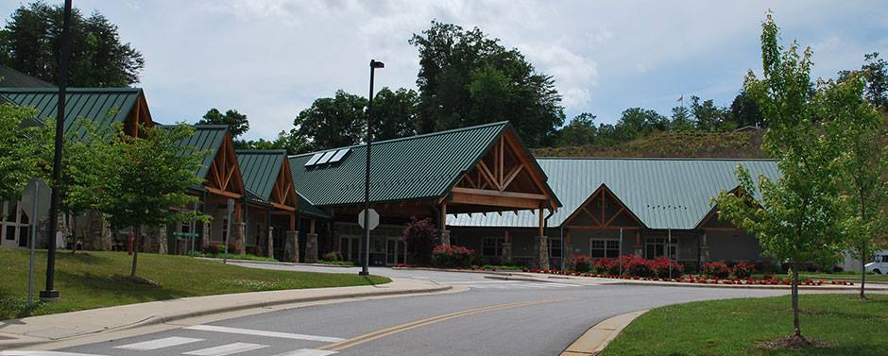
Jackson County Department on Aging
Impact Report FY 24-25

Slide 2

Department on Aging
One-stop of resource center dedicated to providing services and support to the aging population of Jackson County.
Mission – We aim for the highest quality of life for seniors in Jackson County

Slide 3
Department on Aging
Building opened in 2009
Other locations – Cashiers Senior Center, Woodshop, Woodlot
Over 600 volunteers each year
Council on Aging Advisory Board
Team Effort – Great staff, JC Board of Commissioners, Volunteers, Other County Departments, & Community
Impact for this presentation from July 1, 2024 – June 30, 2025

Slide 4
Services
Options Counseling
Project C.A.R.E
Project F.I.R.E
Project Lifesaver
Respite Lending Closet
Senior Christmas Boxes
Senior Games
Seniors’ Health Insurance Information Program
Senior Fan Program
Sylva Senior Cafe
Adult Day Program
Ani-meals
Caring Hands Respite
Cashiers Senior Center
Consumer Directed
Health & Wellness Programs
In-Home List
Jackson County Senior Center
Liquid Supplement
Meals on Wheels

Slide 5
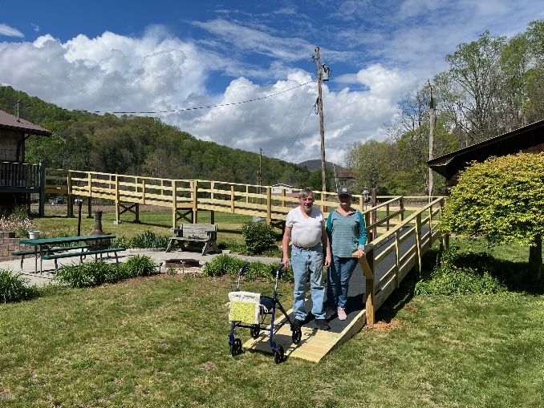
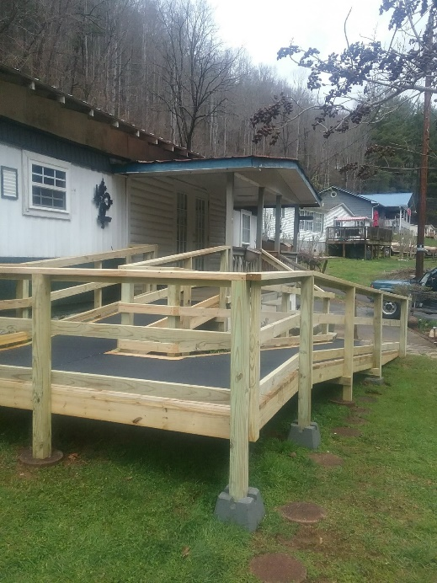
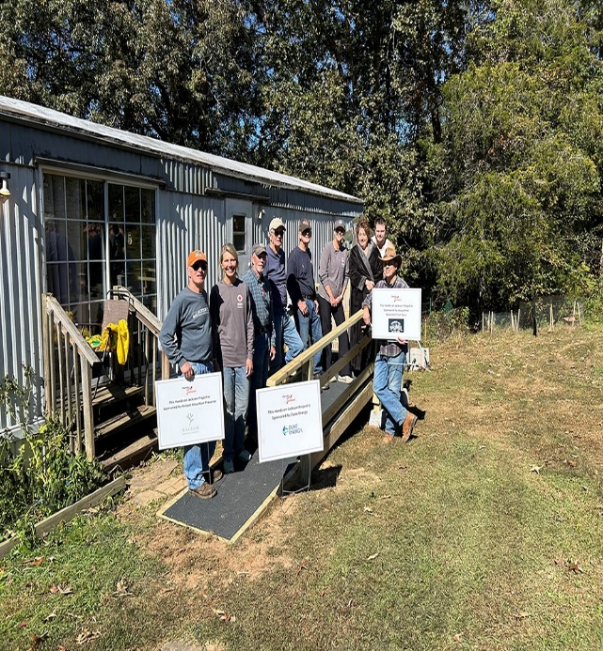
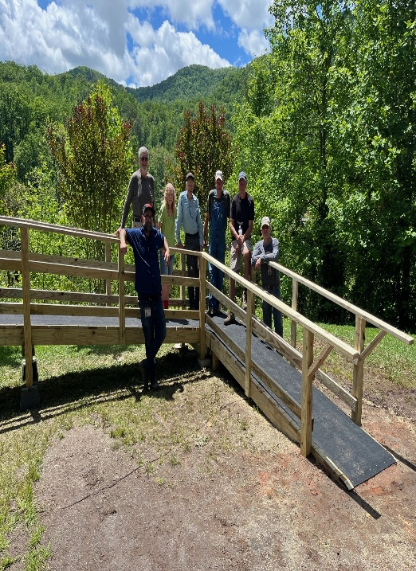
Project C.A.R.E.
Ramps and home modifications to help seniors maintain independence in their homes
45 Ramps Built
9 ramp/deck repairs
5 set of stairs, 10 handrails
24 grab bars, 2 Shower Wands
164volunteers ( mixed groups, church, education, etc.)
549 volunteer hours
22 Fans were given to seniors in need through Duke Energy funding

Slide 6
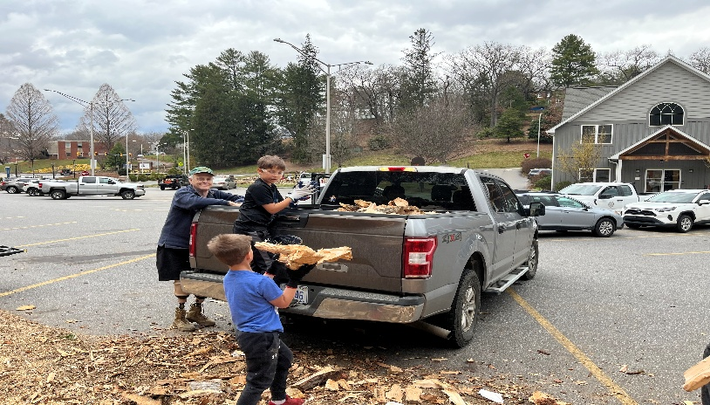
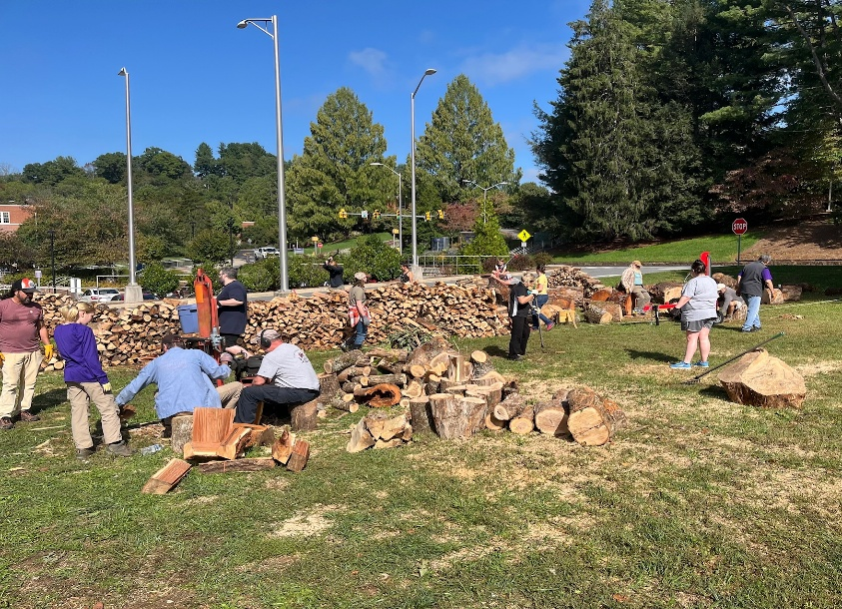
Project F.I.R.E.
Volunteer Day once a month October through March
270 firewood loads delivered to seniors in need
Wood is 100 % donated to Department on Aging
290 volunteers cut, split , & helped deliver the firewood
870 hours volunteered

Slide 7
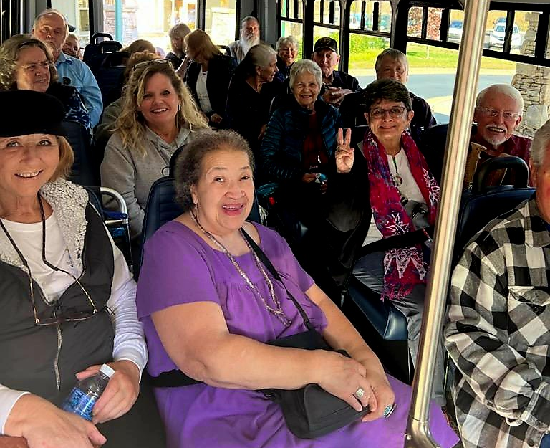
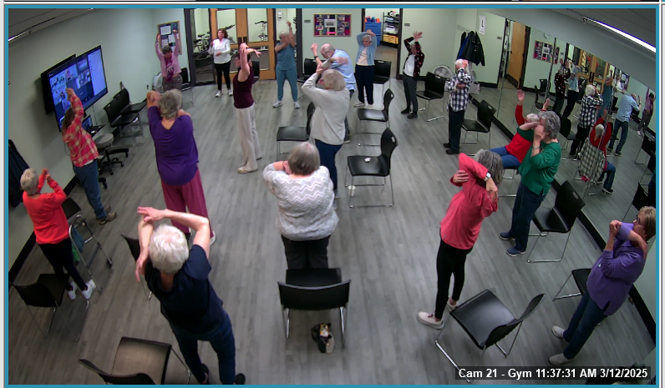
Jackson County Senior Center
Activities, trips, clubs, classes, health & wellness, and more
962 participants for classes/events, + 1,363 guests
600 + participants for health & wellness, + 200 guests
An additional 585 served by AARP Tax Aide, with the assistance of 14 volunteers
Classes held virtually & in-person
Certified Senior Center of Excellence by the NC Division of Aging & Adult Services

Slide 8
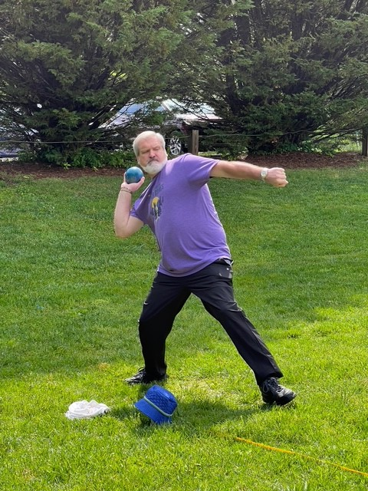
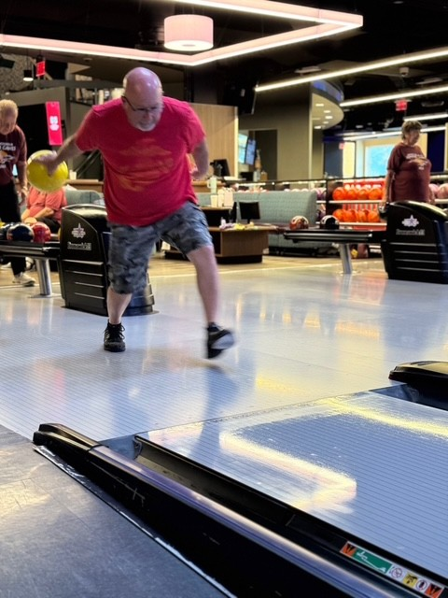

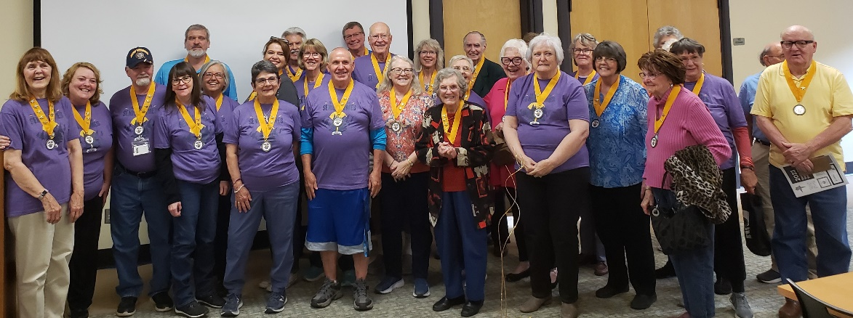
Smoky Mountain Senior Games
Partnership with Jackson County Parks & Recreation
99 different activities
105 participants registered for Local Senior Games
20 + competing at the NC Senior Games held in Raleigh

Slide 9

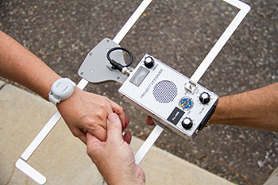
Support Services
Information provided to 6,606 contacts
Options Counseling for 35 families providing assistance to 556 services
In-Home List to 136new families, 177 active lists, 45 trained providers for hire
Project Lifesaver – 9 bracelets to families dealing with dementia
Lending closet for lift chairs, shower chairs, etc. – 23 loans

Slide 10
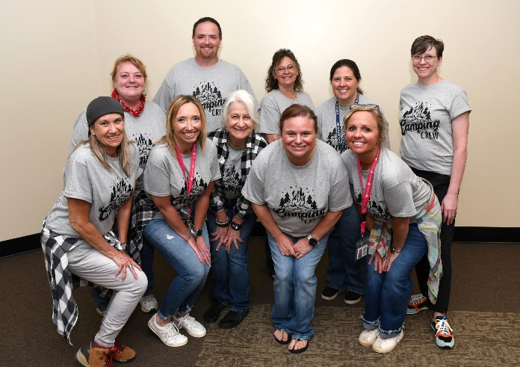
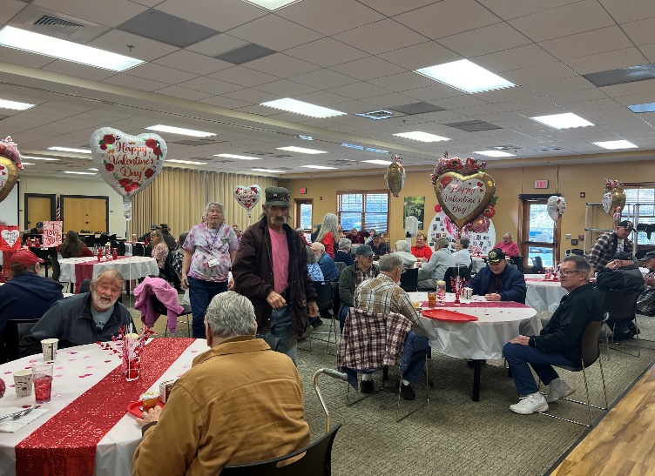
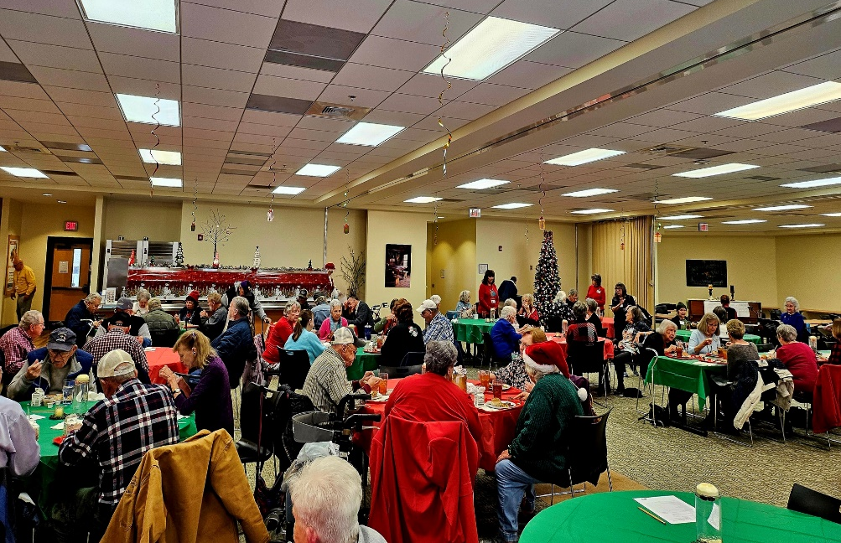
Congregate Nutrition
Provided lunch and socialization for seniors at 2 locations
Monthly themed events
Served a total 15,875 meals to 227 seniors
Distributed 175 cases (4,200 meals) of Ensure Plus to those with compromised nutrition

Slide 11
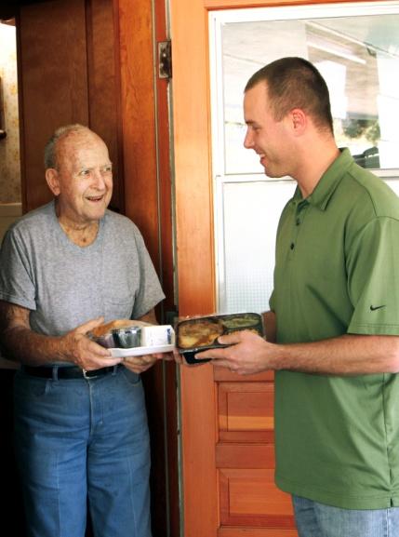
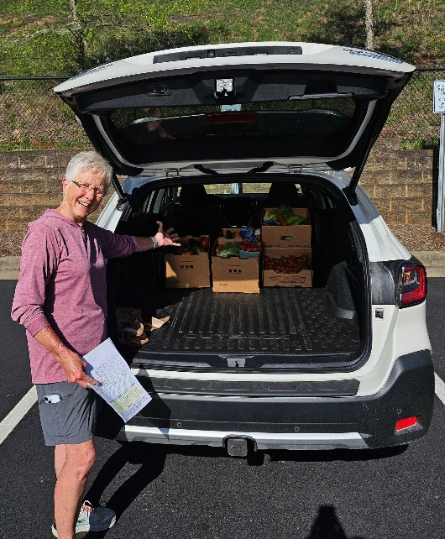
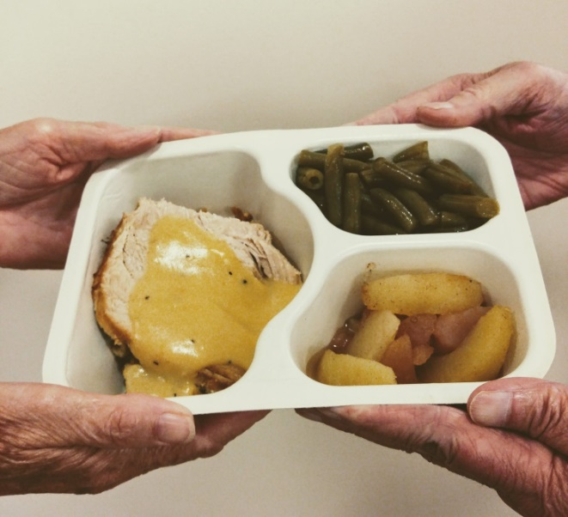
Meals on Wheels
Provided 26,679 meals to homebound seniors
Served 214 homebound seniors
138 volunteers served 5775 hours & drove 111,558 miles
March for Meals on Wheels
Ani-meals – distributed 2920 pounds of food to pets of Meals on Wheels clients
122 fresh produce boxes

Slide 12

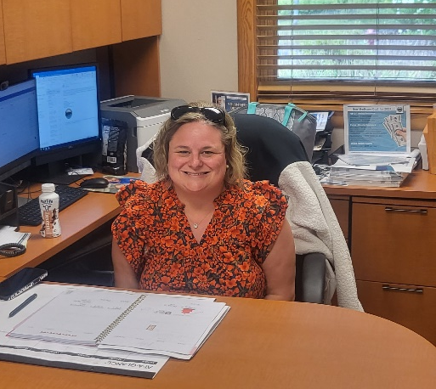
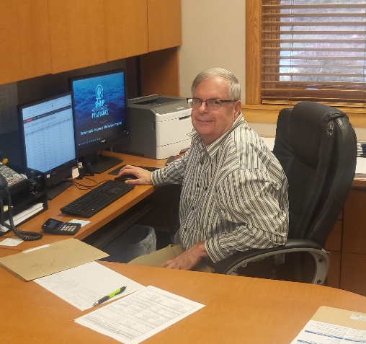
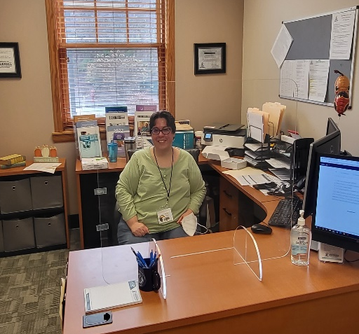
SHIIP
Seniors’ Health Insurance Information Program
Multiple Outreach Events
Free, unbiased counseling
504 Medicare Beneficiaries Contacts saving them almost $2.1 million
1 Volunteer serving 15 hours

Slide 13
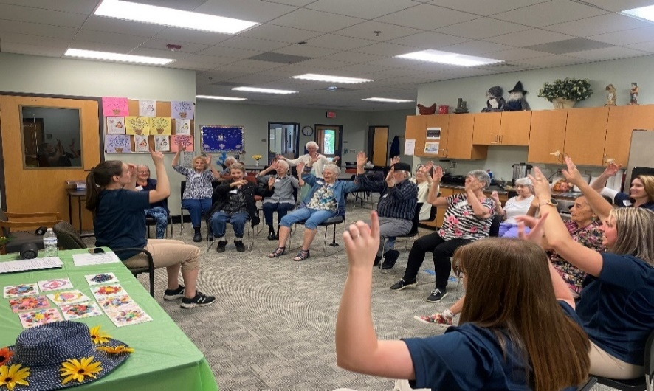
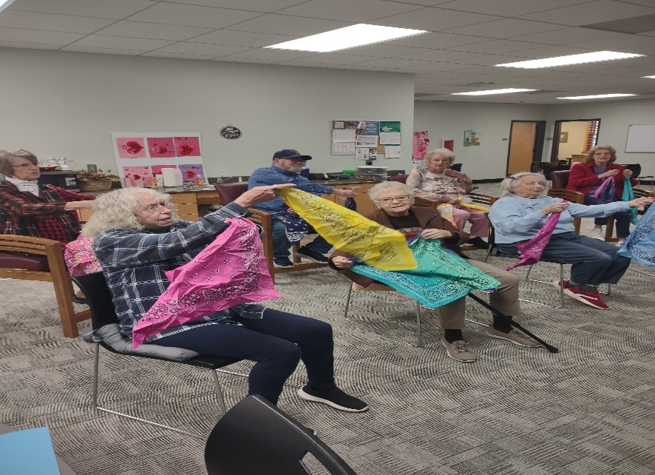
Adult Day Program
Provided respite for 37 families
Help with cognitive state of participants while providing much needed relief for the caregiver
Partnership with WCU & SCC for direct experience for students
A total of 17 regular volunteers for a total of 1352 hours
3,418 meals provided

Slide 14
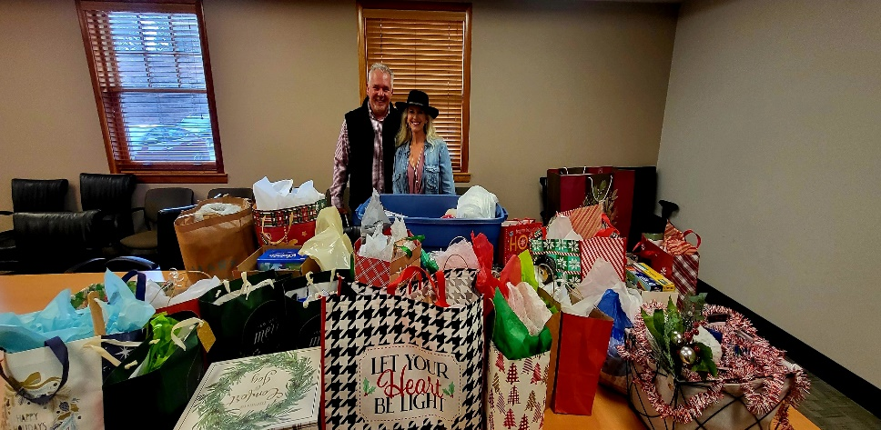
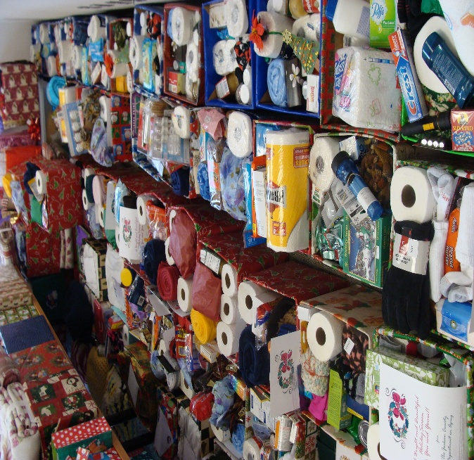
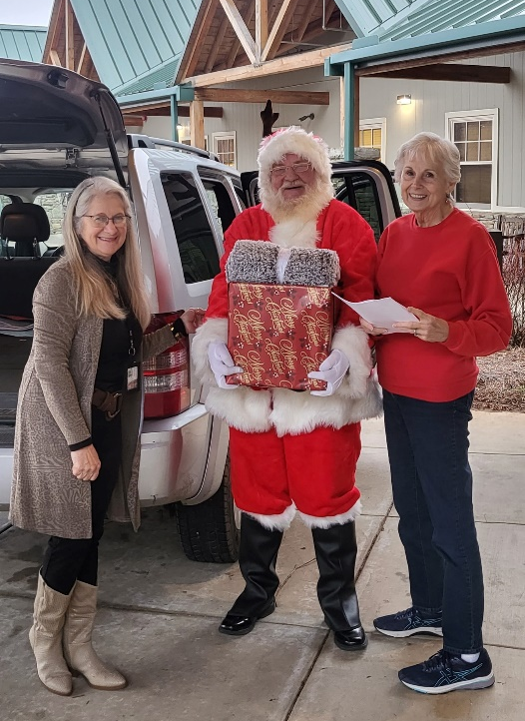
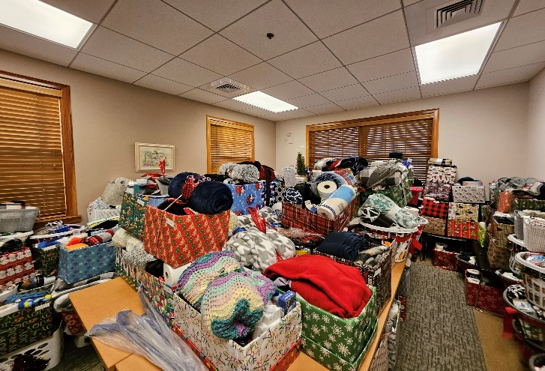
Senior Christmas Boxes
Delivered 920 Christmas boxes to seniors in need during the month of December
Boxes included canned food, toiletry items, & other household products.
55 volunteers served 234 hours

Slide 15
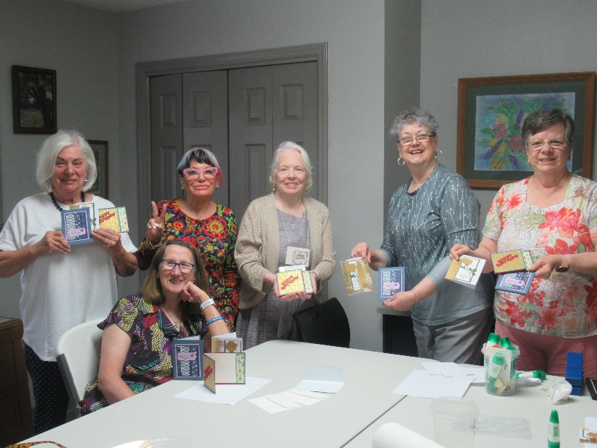
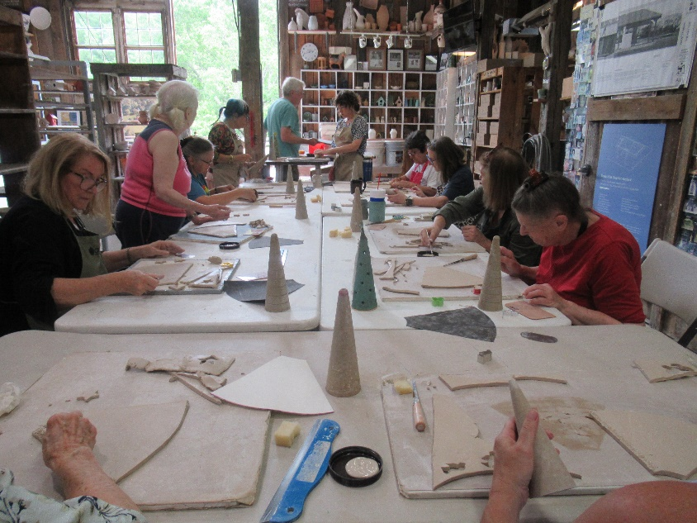
Cashiers Senior Center
Served 1,424 meals to seniors providing lunch and socialization
A total of 105 activities to 132 seniors
Activities, trips, clubs, classes,
health & wellness, and more.
Hosted annual volunteer appreciation event
Serves as satellite location for Department on Aging

Slide 16

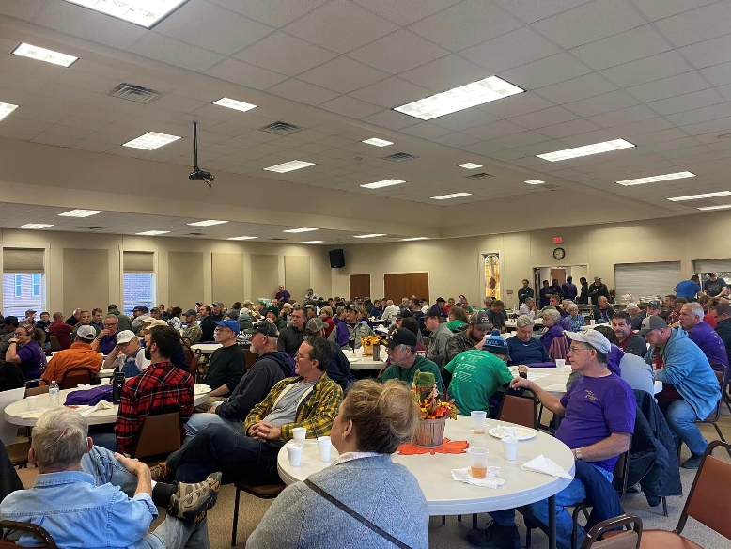
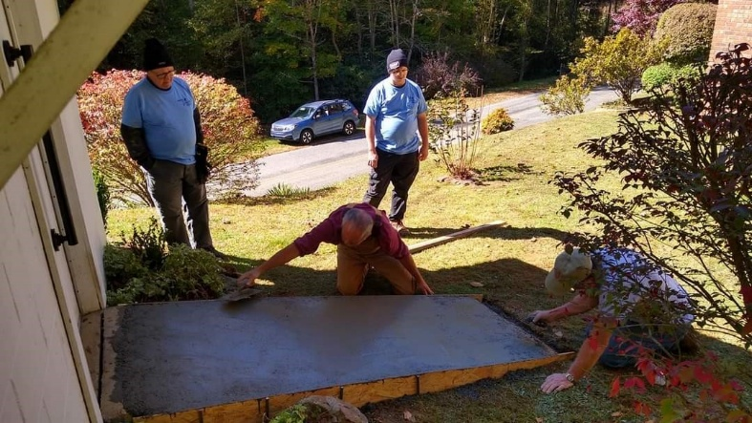
Day of Caring Event Fall of each year
Collaboration focused on providing assistance to neighbors in need through mobilizing community volunteer teams of all skill levels and matching them with volunteer projects.
Great impact and serves large number of seniors.

Slide 17
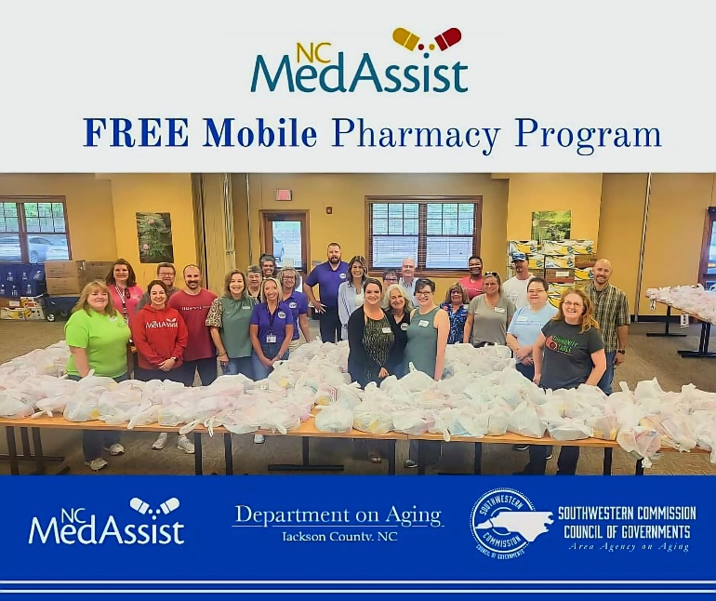
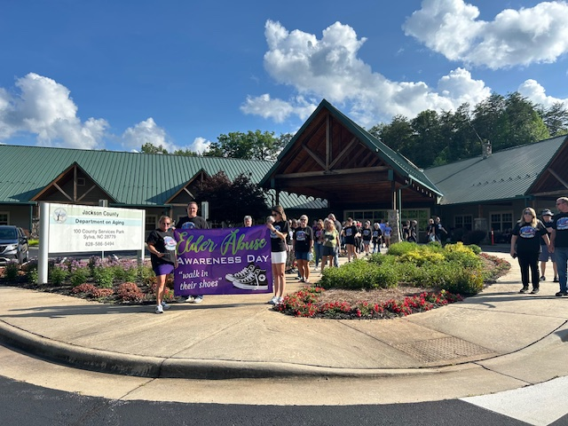
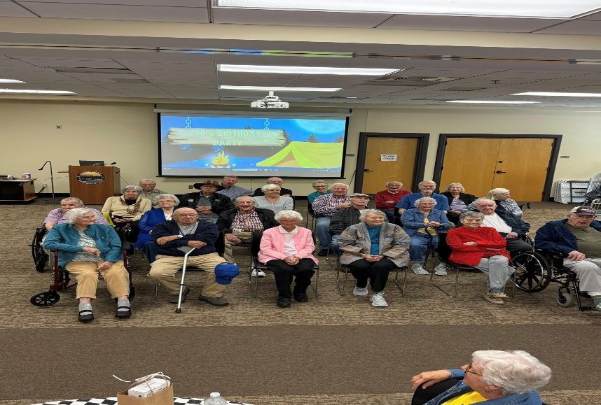
Special Events
Caregiver Events, Scam/Shred Event, Mobile Free Pharmacy, Elder Abuse Awareness Walk, 90’s Birthday Party, Medicare 101, Volunteer Recognition Event, Support Groups, Seminars, & more
Mobile Free Pharmacy/Shred Truck
Elder Abuse Awareness Walk
90’s Birthday Party

Slide 18
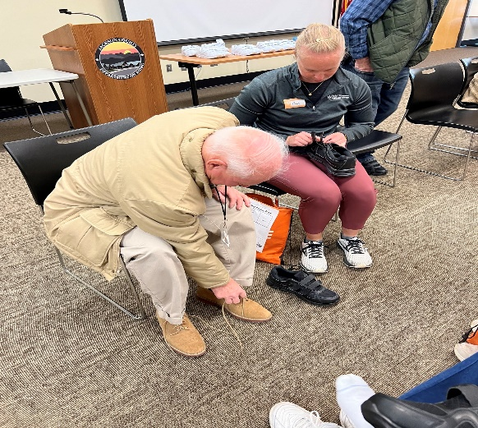
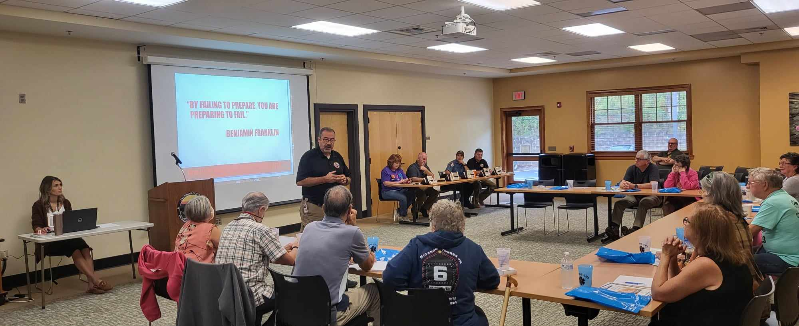
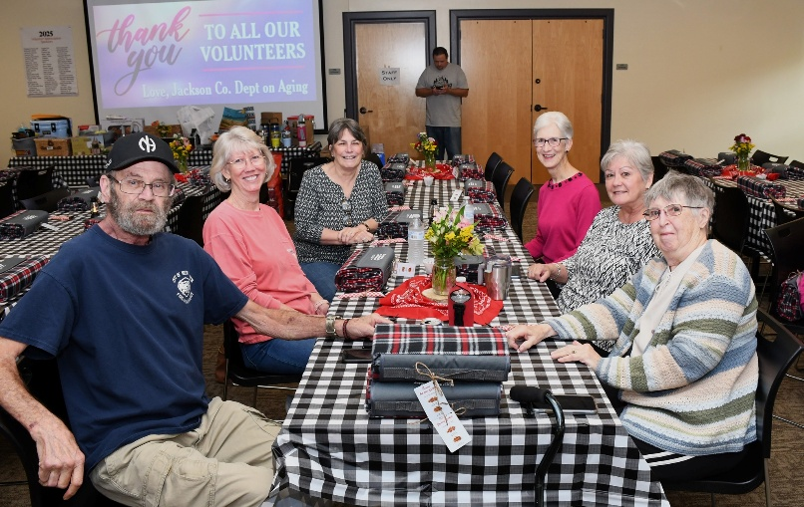
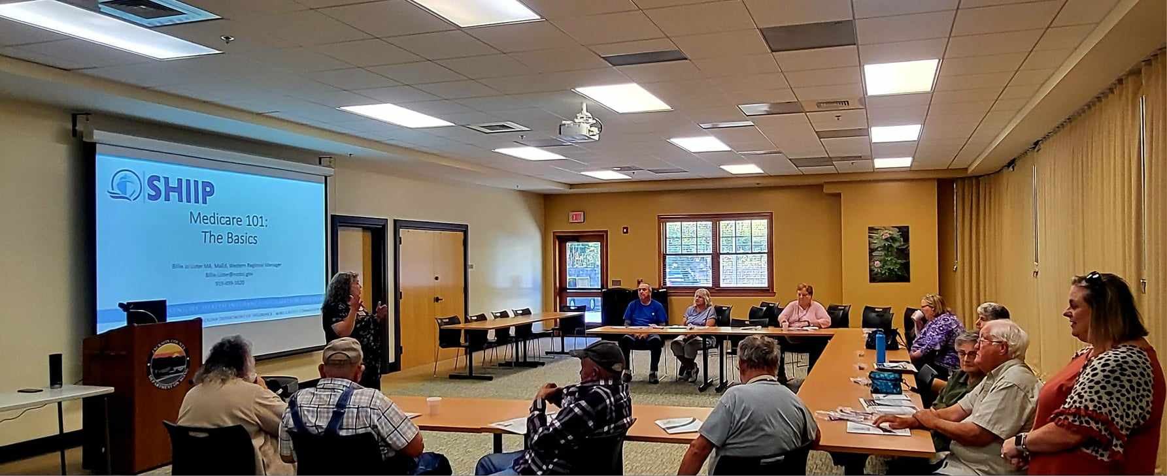
Special Events - Continued
Samaritan’s Feet Event
Emergency Preparedness
Volunteer Recognition
Medicare 101

Slide 19
Volunteers
We could not provide our services without our volunteers
Total of 714 Volunteers served approximately 9,980 hours of service
Value is $334,430 (Independent Sector –Value of Vol Time)
THANK YOU TO ALL VOLUNTEERS!

Slide 20

Questions?
Department on Aging Contact information:
    828-586-5494 Front Desk
    Website: http://www.aging.jacksonnc.org/
    Sign up to receive our Jacksonian Newsletter

