Slide 1
TCPF Applications
Jackson County TDA
February 3, 2026

Slide 2
Pinnacle Park
Trail
Expansion

Slide 3
Pinnacle Park Master Plan Implementation (Phase Two)
Project Goal: Upgrade critical infrastructure and accessibility to support sustainable growth.
Total Project Cost: $682,645
TCPF Grant Request: $341,322
Matching Funds: $341,323 (PARTF Grant) — 100% Secured
Local Investment: 100% of costs expected to be spent within the community.

Slide 4
Critical Infrastructure & Visitor Facilities
Paved Trailhead: Construction of a 18-space parking lot (plus one bus space) with a stone-stacked retention wall and professional signage.
Enhanced Facilities: Installation of a single-stall vault toilet and high-durability trash receptacles.
Educational Assets: Construction of an outdoor classroom to serve school groups and university researchers.
Sustainability: The Town of Sylva has committed $20,000 annually for routine maintenance.

Slide 5
Expanding Access for All Visitors
ADA Accessible Trail: 303-linear-foot accessible section leading to a viewing platform with interpretive signage.
Target Demographics: Specifically improves access for seniors, families, and individuals with movement limitations.
Backcountry Expansion: Development of 5,940 linear feet of new hiking trails.
Campsite Upgrades: Significant improvements to existing backcountry campsites.

Slide 6
Driving Growth for Jackson County
Annual Visitation
20% Increase (+4,600 vehicle visits)
Overnight Stays
2,300 new bookings / 6,342 new room nights annually
Lodging Revenue
$976,000 in new annual revenue
Total Direct Spending
$1,857,000 annually (Retail, Food, Transport)
Job Support
Bolsters 1,440 full-time jobs in the outdoor economy

Slide 7
The Village Green Restrooms

Slide 8
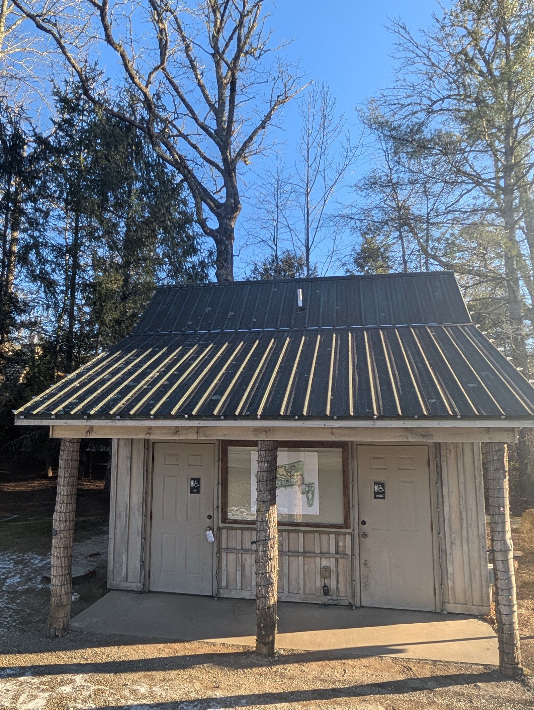
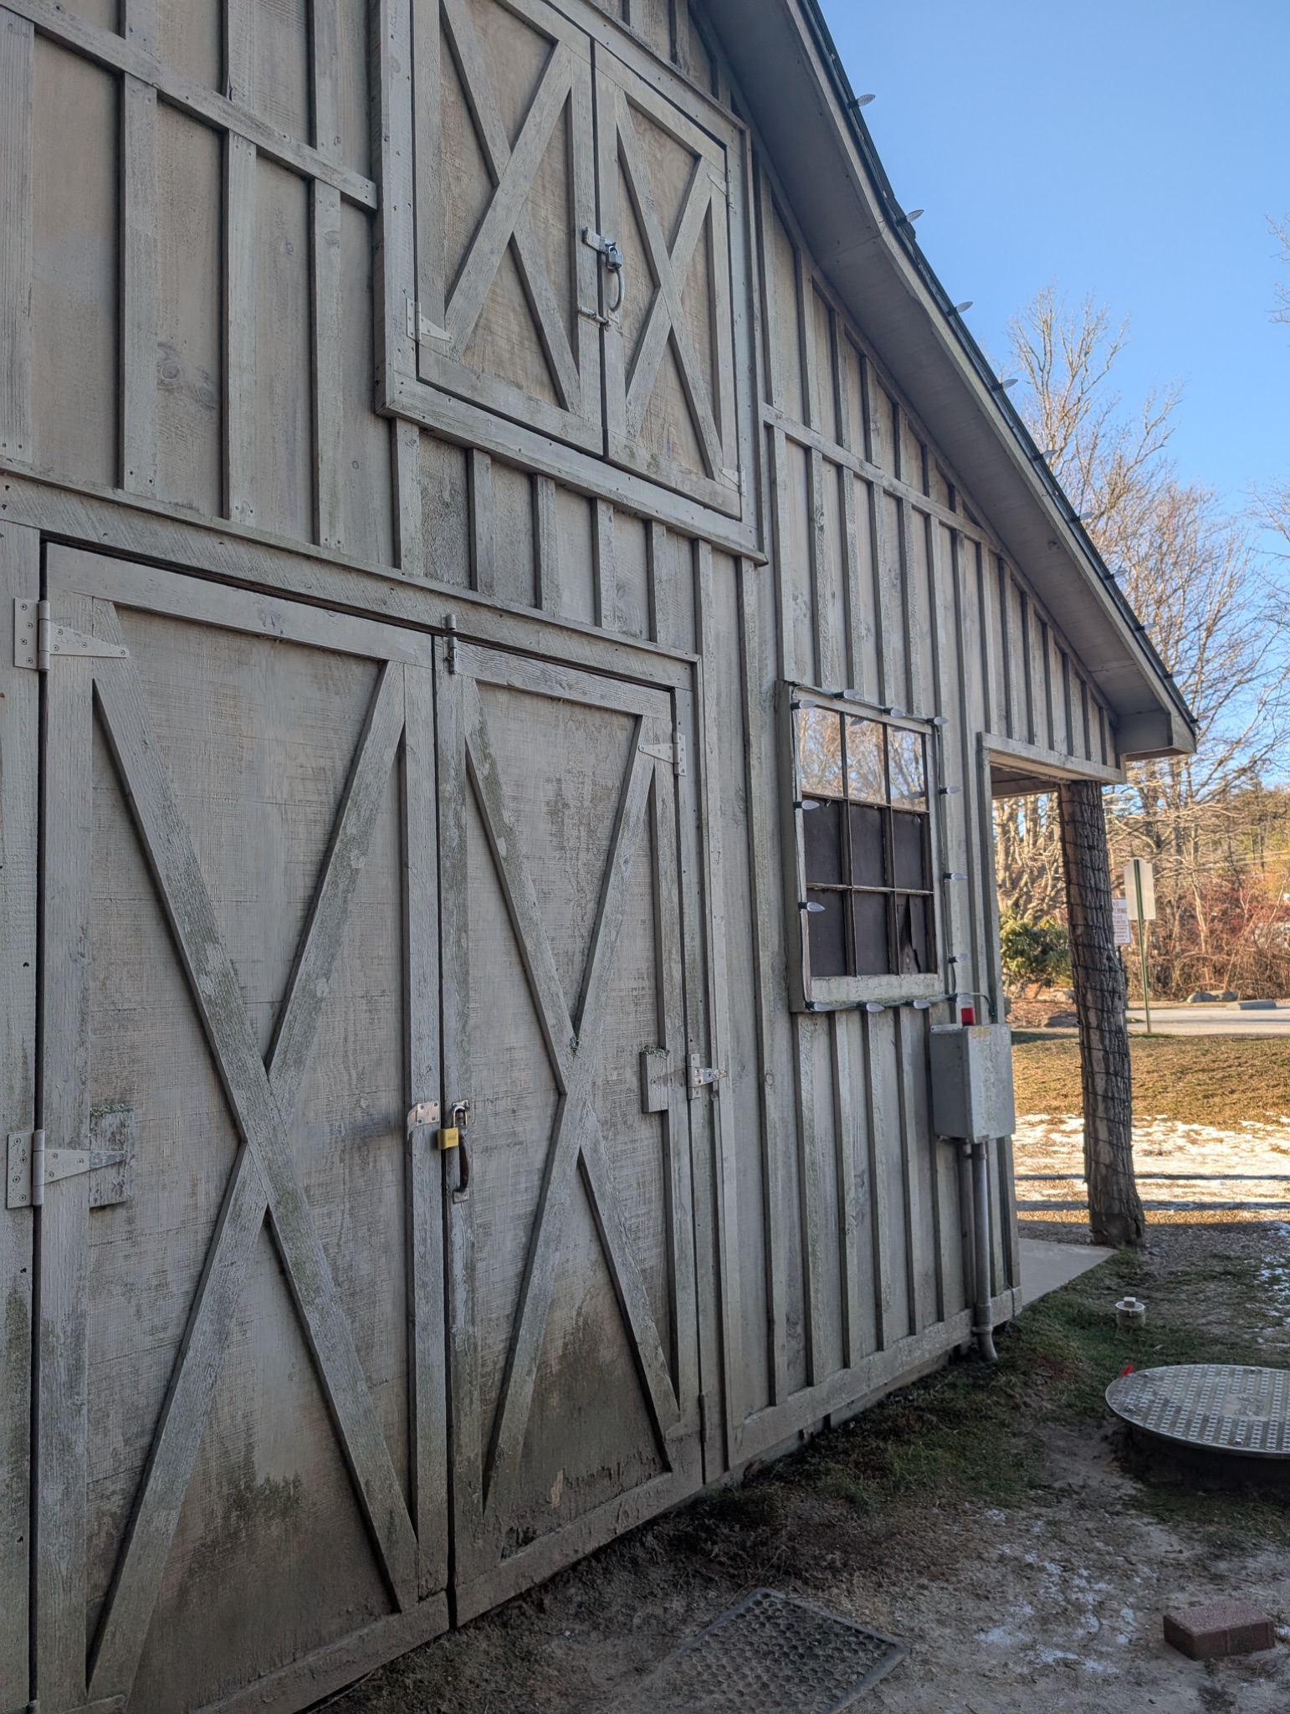

Slide 9
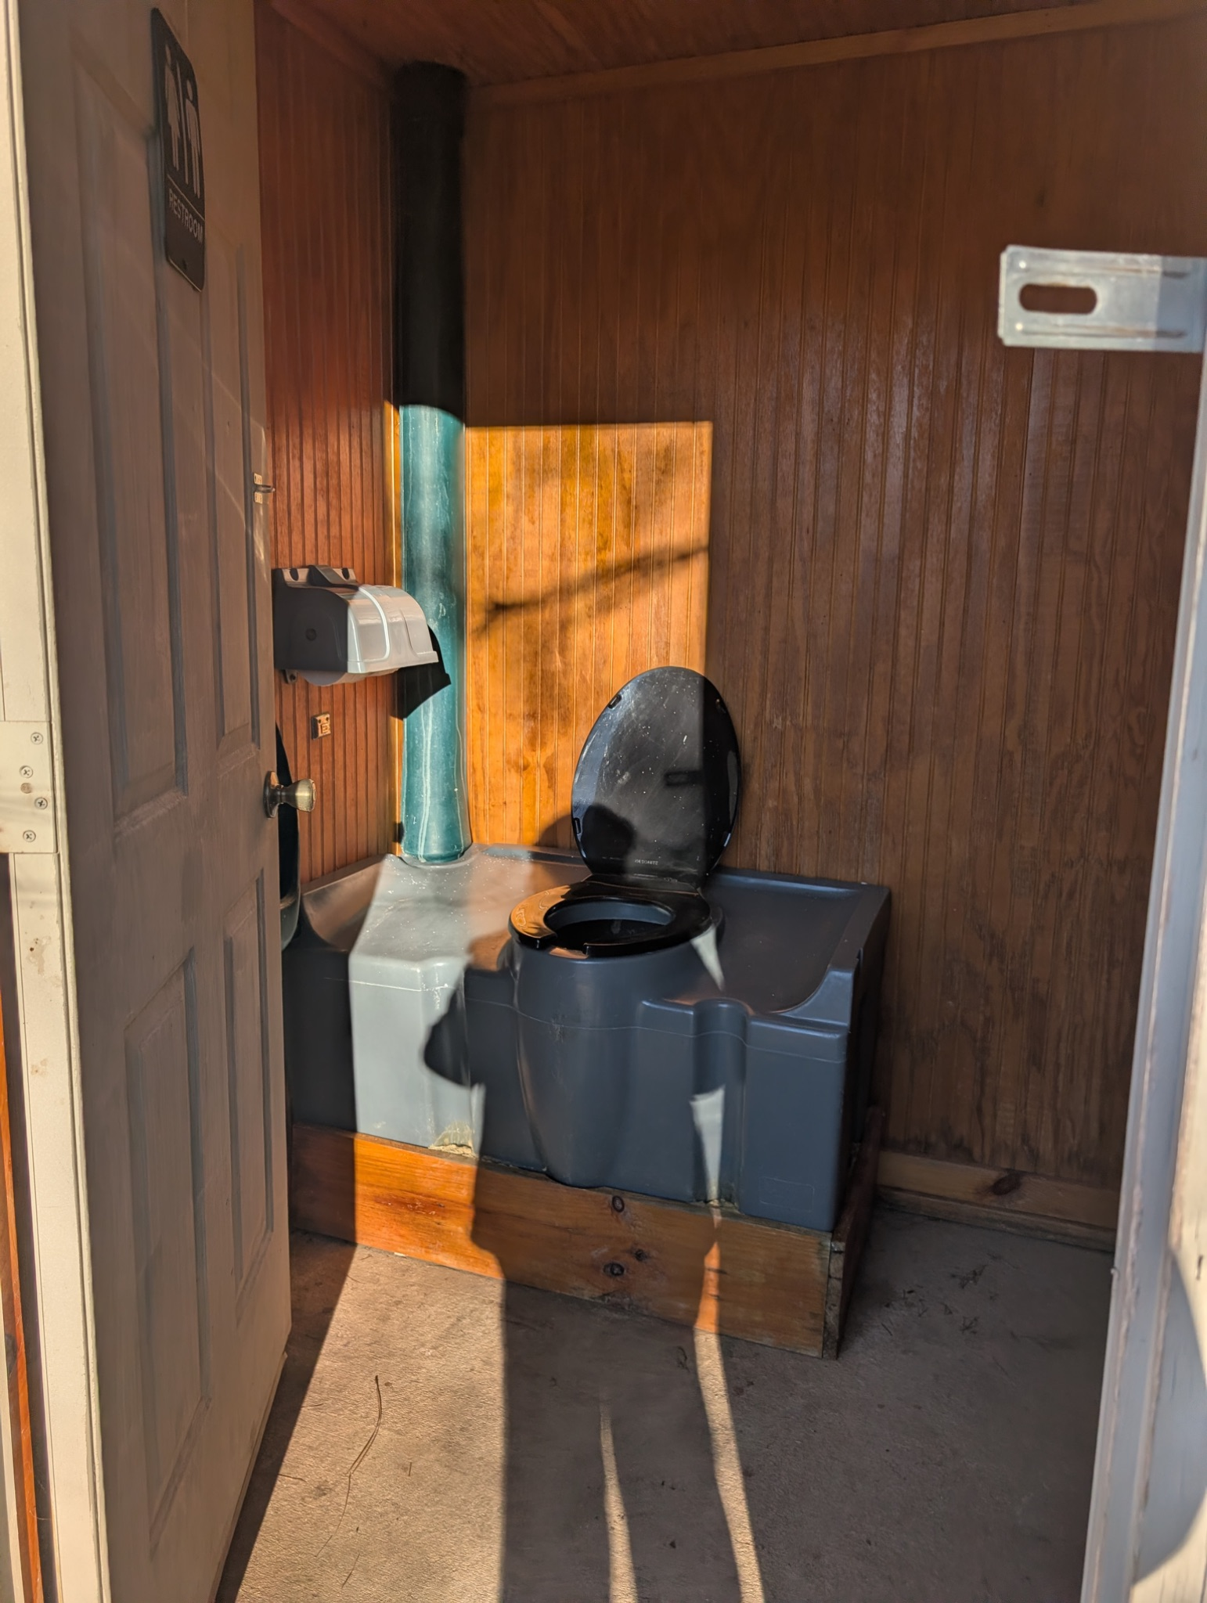
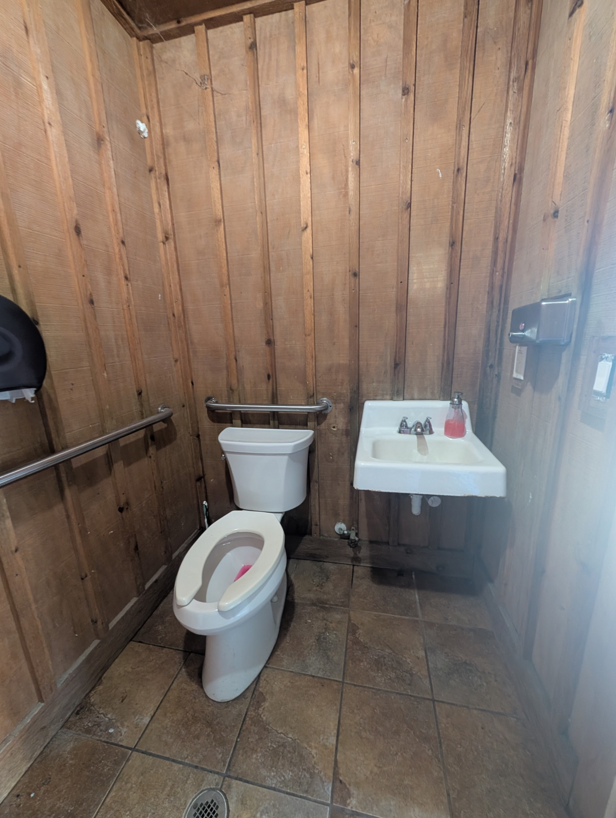

Slide 10
Rebuild & Expand Public Restrooms at The Village Green
Total Project Cost: $675,000
TCPF Grant Request: $204,000
Match Secured: $425,000 from Jackson County and $46,000 in Private Donations.
Organization: The Village Green of Cashiers Inc. (501(c)(3) nonprofit).
Economic Efficiency: 100% of project costs will be spent locally.

Slide 11
The Critical Infrastructure Gap
Sole Provider: This is the only public restroom facility in the Cashiers Commercial District.
Outdated Facility: The existing building is over 20 years old, deteriorating, and unheated.
Capacity Bottleneck: Currently offers only two unisex toilets to serve thousands of visitors during peak festivals.
Winter Limitations: Lacks heat and running water in winter, forcing reliance on a single portable toilet.
The Problem: This "permanent porta-potty" situation creates a negative impression for winter visitors.

Slide 12
Project Scope & Upgrades
Objective: Show the high-quality, year-round solution being proposed.
Expanded Capacity: Increasing from two to six toilets, plus a separate baby changing area.
Year-Round Access: Fully winterized and heated construction for 12-month use.
Universal Accessibility: Full ADA compliance for seniors and individuals with mobility challenges.
Major Infrastructure: Replacement of a critical 18-inch culvert and installation of a new 400A electrical service.
Design: Matches the town’s village aesthetic with a professional 30-year expected lifespan.

Slide 13
Tourism & Economic Impact
Annual Visitation
35,000 (2024) → 37,000 projected (2026)
Community Events
Supports 275+ free annual events (e.g., Leaf Festival)
Room Nights
Supports an estimated 16,000 room nights annually
Business Support
Reduces operational strain on private shops/restaurants
Strategic Goal
Encourages longer stays and repeat visitation to nearby retailers

Slide 14
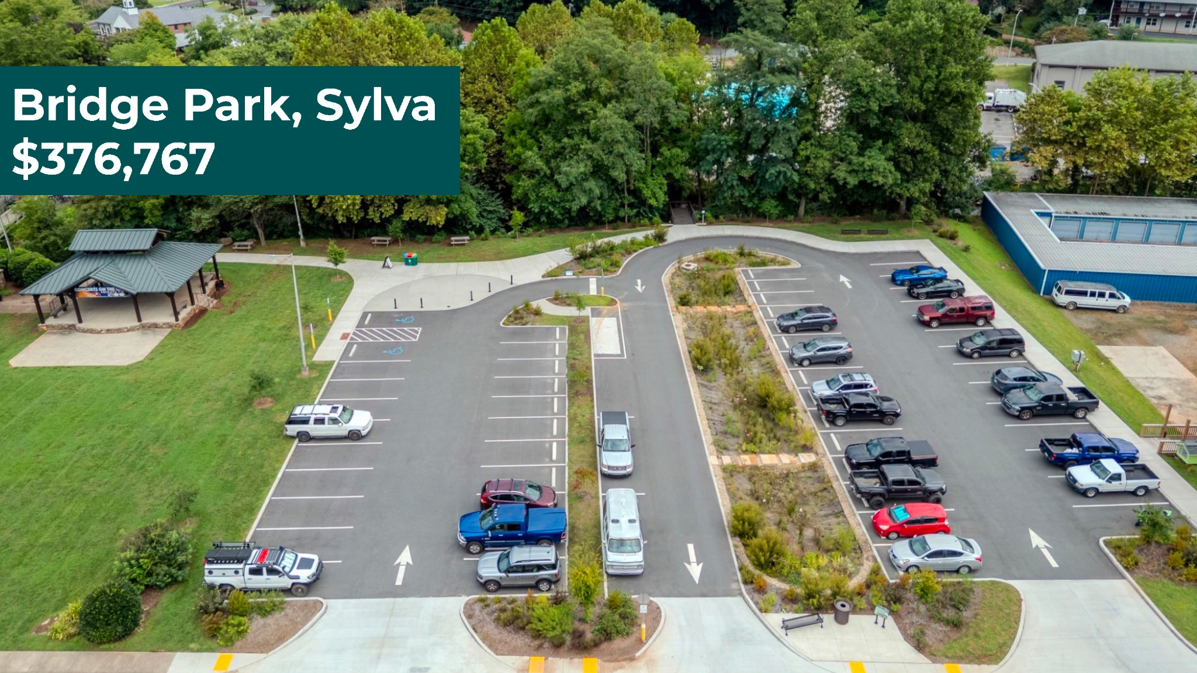
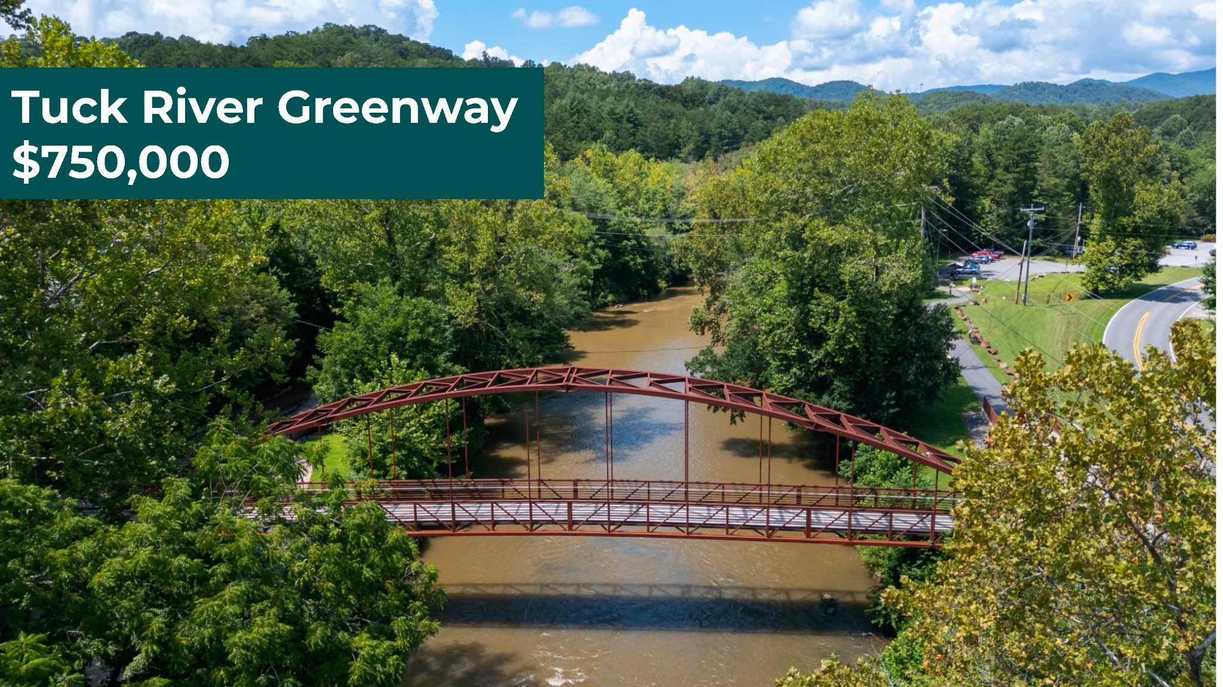
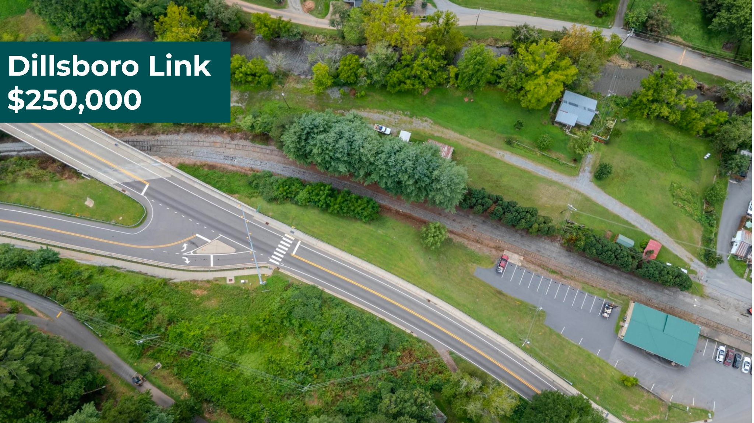
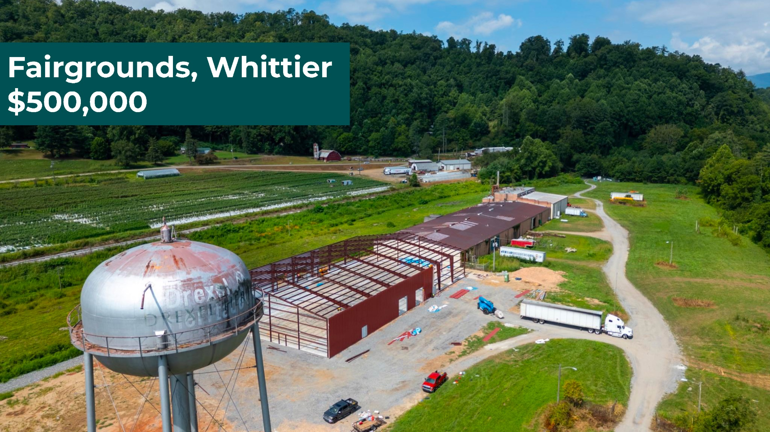
Thank you Commissioners for your Support!

