Slide 1
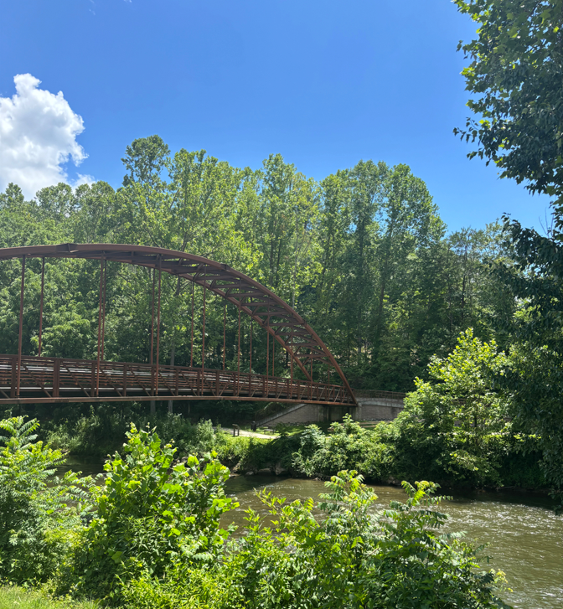
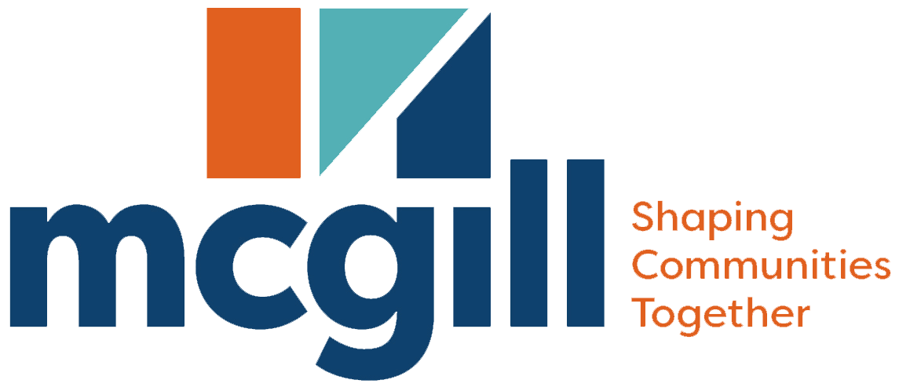

System-wide Parks and Recreation
Status update
Jackson County
Notes:
As an initial step in kicking off the process to develop a comprehensive plan for the Lincoln City/New Bern, we thought it would be appropriate to provide a primer on comprehensive planning and what it means for Wendell. In this brief presentation, we also aim to answer your questions about the process. We want you to know what to expect along the way. More importantly, we want to know about your expectations. So, at the end, we have a couple of questions for you, as we’d like to find out what you hope to accomplish with the process and/or the plan itself.

Slide 2
The Two Views of Recreation Offerings
Local governments generally fall somewhere along this spectrum
Parks and Recreation as an
EXPENSE
Similar to a police department or a fire department.
Money goes in
Services come out
Nothing more, no significant impact on the bottom line
Parks and Recreation
as an
INVESTMENT
You get the service, but you also get the economic dividends of your investment
Money goes in
Services come out
+
Additional ROI comes from the investment
Parks
&
Recreation
This spectrum generally gauges how leadership views parks and recreation

Slide 3
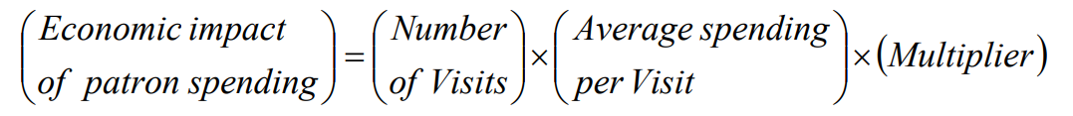
Research Supports That Parks And Recreation
Acts More Like An INVESTMENT
Property Values Increase: Economic research has demonstrated consistently that homes and properties located near parklands have higher values than those located farther away. Higher home values not only benefit the owners of these properties but also add to the tax base of local governments. 1.
Economic Development:
Parks and recreation improves the quality of life in communities and benefits the local economic development of a region. Eighty-seven percent of corporate executives responding to a 2023 Area Development survey rated-quality-of life features as an important factor for a headquarters, factor or other company facility. 1.
Visitor Spending:
Many local park and recreation agency amenities spur tourism to their respective locales, generating significant economic activity, including but not limited to increased sales, local restaurants/bars and hotels1.
8%-20%
87%
Events are not a matter of IF you will have an impact, but how much of an impact it will have 3.
of Executives see quality of life as important when locating facilities
Average property value increase
2.
Sources:
1. “The Economic Impacts of Parks: An Examination of the Fiscal Effects of Operations and Capital Spending by Local Park and Recreation Agencies on the US Economy.
2. Crompton, J.L. 2001. Parks and Economic Development. PAS Report No. 502. American Planning Association, Chicago, Illinois.
3. Center for Economic Studies: Michigan State University: 2007 Quantifying the Economic Impacts of Community Events

Slide 4
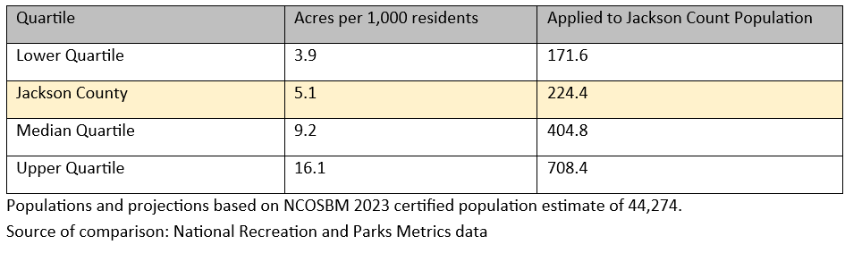
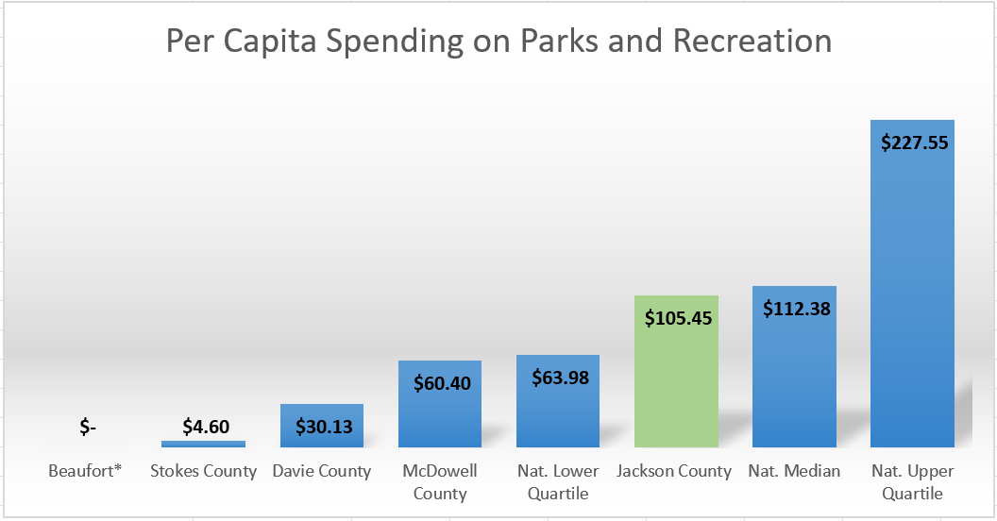
Programs and System Analysis
Your park system acreage is well below the national median
&
your budget is slightly below average
Notes:
There are about 6 objectives of all community planning processes and the resulting plans that we consider benefits to the community:
The first is framing the issues and opportunities. By defining them, we can create a “snapshot” of what’s happening today so everyone can move forward with purpose.
We can then focus on what we want for the future of the community. We need a clear view of that future condition. We can all move in the same direction if we’re working toward a shared vision.
The plan, which will have detailed recommendations and implementation strategies, should serve as a guide in all decision making. This is especially important when City leaders are faced with decisions about development approvals and the use of tax revenue for capital investments, such as utilities to support desired development or parks and other public amenities to improve the quality of life in the community.
The plan should also have everyone singing from the same sheet of music, so to speak. By communicating what the community wants and how to achieve it, all department and partner agencies can coordinate efforts to maximize available resources.
When pursuing grants, the adopted plan can increase chances of obtaining funding. It can strengthen the application by demonstrating the City’s commitment to specific improvements.
And, finally, the plan is a step toward compliance with State statutes… among other things, an up-to-date plan is required as a foundation for local land development regulations, such as zoning. Soon, the City will be subject to the new requirements of 160D.

Slide 5
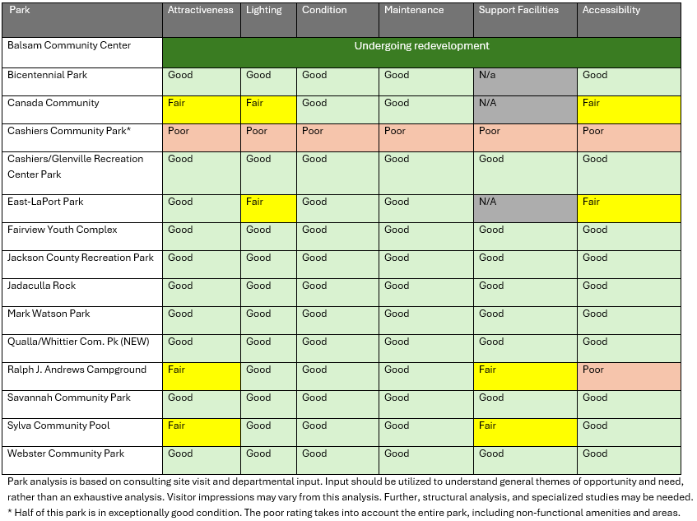
A system that’s is in very good shape
Your system is being very well maintained
__________
The one distressed part of the system has been planned for
Notes:
There are about 6 objectives of all community planning processes and the resulting plans that we consider benefits to the community:
The first is framing the issues and opportunities. By defining them, we can create a “snapshot” of what’s happening today so everyone can move forward with purpose.
We can then focus on what we want for the future of the community. We need a clear view of that future condition. We can all move in the same direction if we’re working toward a shared vision.
The plan, which will have detailed recommendations and implementation strategies, should serve as a guide in all decision making. This is especially important when City leaders are faced with decisions about development approvals and the use of tax revenue for capital investments, such as utilities to support desired development or parks and other public amenities to improve the quality of life in the community.
The plan should also have everyone singing from the same sheet of music, so to speak. By communicating what the community wants and how to achieve it, all department and partner agencies can coordinate efforts to maximize available resources.
When pursuing grants, the adopted plan can increase chances of obtaining funding. It can strengthen the application by demonstrating the City’s commitment to specific improvements.
And, finally, the plan is a step toward compliance with State statutes… among other things, an up-to-date plan is required as a foundation for local land development regulations, such as zoning. Soon, the City will be subject to the new requirements of 160D.

Slide 6
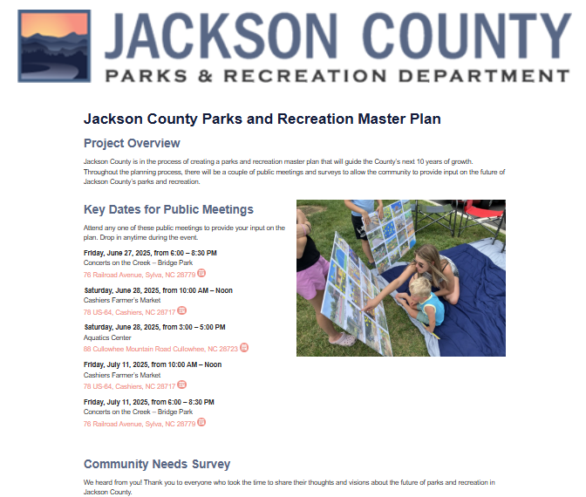
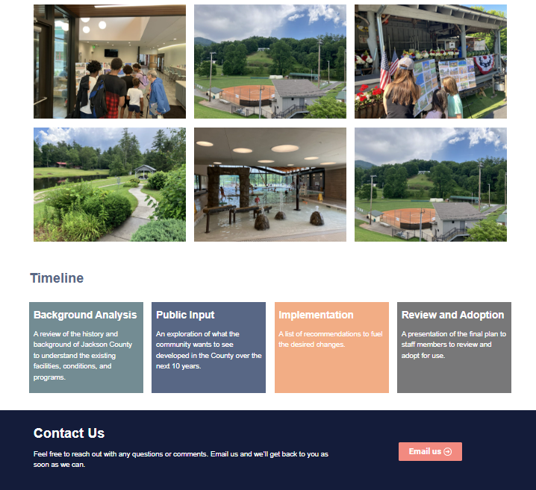
Keeping the county residents informed: project webpage
Notes:
There are about 6 objectives of all community planning processes and the resulting plans that we consider benefits to the community:
The first is framing the issues and opportunities. By defining them, we can create a “snapshot” of what’s happening today so everyone can move forward with purpose.
We can then focus on what we want for the future of the community. We need a clear view of that future condition. We can all move in the same direction if we’re working toward a shared vision.
The plan, which will have detailed recommendations and implementation strategies, should serve as a guide in all decision making. This is especially important when City leaders are faced with decisions about development approvals and the use of tax revenue for capital investments, such as utilities to support desired development or parks and other public amenities to improve the quality of life in the community.
The plan should also have everyone singing from the same sheet of music, so to speak. By communicating what the community wants and how to achieve it, all department and partner agencies can coordinate efforts to maximize available resources.
When pursuing grants, the adopted plan can increase chances of obtaining funding. It can strengthen the application by demonstrating the City’s commitment to specific improvements.
And, finally, the plan is a step toward compliance with State statutes… among other things, an up-to-date plan is required as a foundation for local land development regulations, such as zoning. Soon, the City will be subject to the new requirements of 160D.

Slide 7
Public input meetings
5 public input meetings
held around the County
appx. 300 people provided input
Top
10 request
Rank | Resident | Visitors
1 | Adventure playground/ropes course | Pickleball courts
2 | Greenways | Adventure playground/ropes course
3 | Restrooms | Greenways
4 | Pickleball courts | Bike trails
5 | Dog park | Dog park
6 | Skateboard Park | Amphitheater
7 | Bike pump track | Blueway/paddle access
8 | Indoor aquatics center | Baseball/softball fields
9 | Amphitheater | Restrooms
10 | Blueway/paddle access | Playgrounds
Shared interest in italics
Notes:
There are about 6 objectives of all community planning processes and the resulting plans that we consider benefits to the community:
The first is framing the issues and opportunities. By defining them, we can create a “snapshot” of what’s happening today so everyone can move forward with purpose.
We can then focus on what we want for the future of the community. We need a clear view of that future condition. We can all move in the same direction if we’re working toward a shared vision.
The plan, which will have detailed recommendations and implementation strategies, should serve as a guide in all decision making. This is especially important when City leaders are faced with decisions about development approvals and the use of tax revenue for capital investments, such as utilities to support desired development or parks and other public amenities to improve the quality of life in the community.
The plan should also have everyone singing from the same sheet of music, so to speak. By communicating what the community wants and how to achieve it, all department and partner agencies can coordinate efforts to maximize available resources.
When pursuing grants, the adopted plan can increase chances of obtaining funding. It can strengthen the application by demonstrating the City’s commitment to specific improvements.
And, finally, the plan is a step toward compliance with State statutes… among other things, an up-to-date plan is required as a foundation for local land development regulations, such as zoning. Soon, the City will be subject to the new requirements of 160D.

Slide 8
Focus group findings
4 focus group meetings
We do partnerships really well
Not enough life guards for aquatics
County leadership has been very supportive
Trails and greenways are vital
The park system is helping the local economy
Land availability is a major barrier
Residents and staff are proud of the County’s offerings
Notes:
There are about 6 objectives of all community planning processes and the resulting plans that we consider benefits to the community:
The first is framing the issues and opportunities. By defining them, we can create a “snapshot” of what’s happening today so everyone can move forward with purpose.
We can then focus on what we want for the future of the community. We need a clear view of that future condition. We can all move in the same direction if we’re working toward a shared vision.
The plan, which will have detailed recommendations and implementation strategies, should serve as a guide in all decision making. This is especially important when City leaders are faced with decisions about development approvals and the use of tax revenue for capital investments, such as utilities to support desired development or parks and other public amenities to improve the quality of life in the community.
The plan should also have everyone singing from the same sheet of music, so to speak. By communicating what the community wants and how to achieve it, all department and partner agencies can coordinate efforts to maximize available resources.
When pursuing grants, the adopted plan can increase chances of obtaining funding. It can strengthen the application by demonstrating the City’s commitment to specific improvements.
And, finally, the plan is a step toward compliance with State statutes… among other things, an up-to-date plan is required as a foundation for local land development regulations, such as zoning. Soon, the City will be subject to the new requirements of 160D.

Slide 9
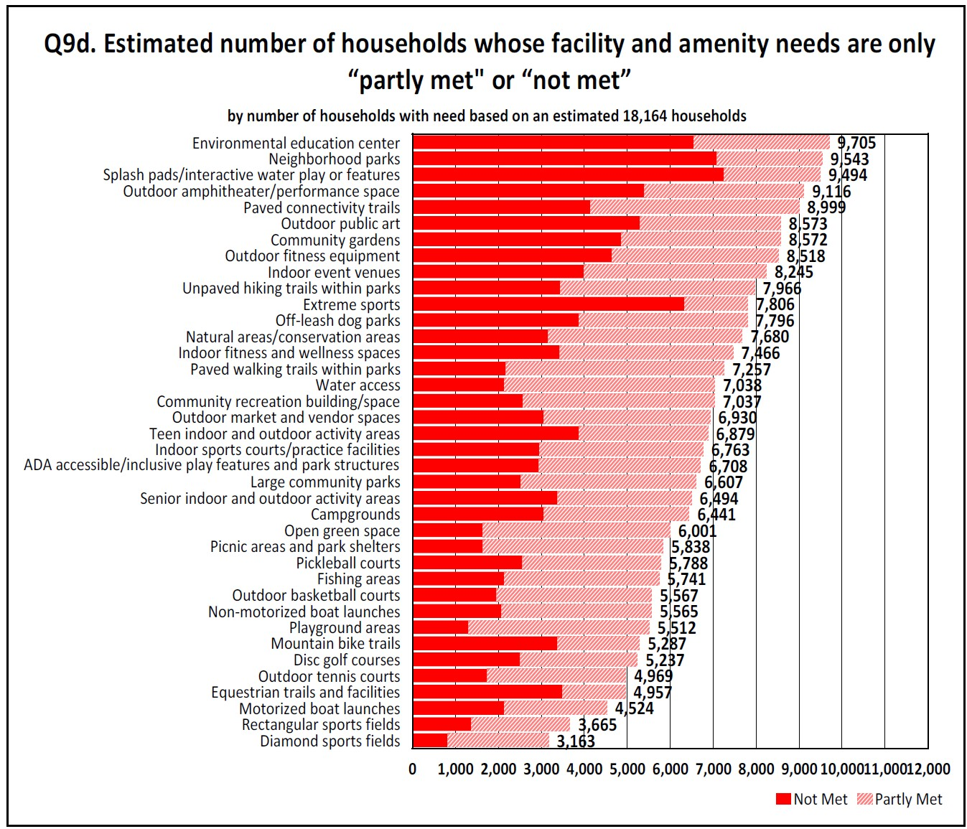
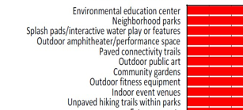
Statistically valid survey
Top 10 largest
unmet facility needs
Notes:
There are about 6 objectives of all community planning processes and the resulting plans that we consider benefits to the community:
The first is framing the issues and opportunities. By defining them, we can create a “snapshot” of what’s happening today so everyone can move forward with purpose.
We can then focus on what we want for the future of the community. We need a clear view of that future condition. We can all move in the same direction if we’re working toward a shared vision.
The plan, which will have detailed recommendations and implementation strategies, should serve as a guide in all decision making. This is especially important when City leaders are faced with decisions about development approvals and the use of tax revenue for capital investments, such as utilities to support desired development or parks and other public amenities to improve the quality of life in the community.
The plan should also have everyone singing from the same sheet of music, so to speak. By communicating what the community wants and how to achieve it, all department and partner agencies can coordinate efforts to maximize available resources.
When pursuing grants, the adopted plan can increase chances of obtaining funding. It can strengthen the application by demonstrating the City’s commitment to specific improvements.
And, finally, the plan is a step toward compliance with State statutes… among other things, an up-to-date plan is required as a foundation for local land development regulations, such as zoning. Soon, the City will be subject to the new requirements of 160D.

Slide 10
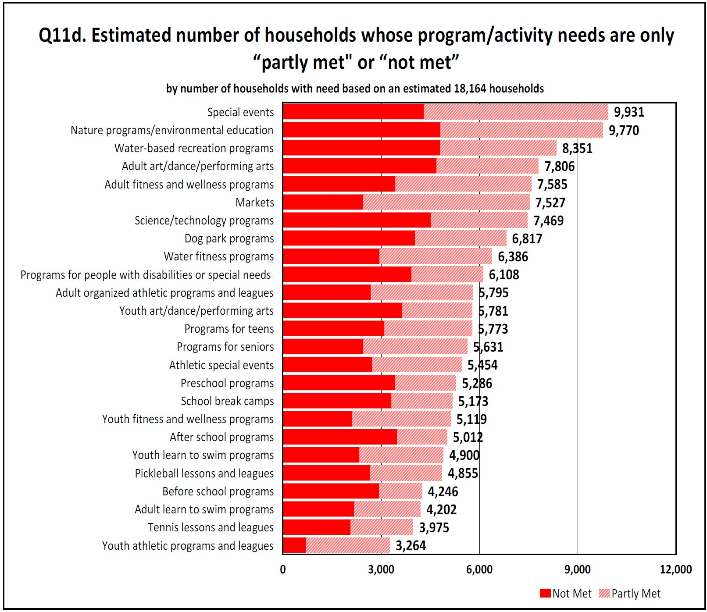
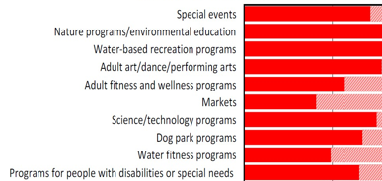
Statistically valid survey
Top 10 largest
unmet programing needs
Notes:
There are about 6 objectives of all community planning processes and the resulting plans that we consider benefits to the community:
The first is framing the issues and opportunities. By defining them, we can create a “snapshot” of what’s happening today so everyone can move forward with purpose.
We can then focus on what we want for the future of the community. We need a clear view of that future condition. We can all move in the same direction if we’re working toward a shared vision.
The plan, which will have detailed recommendations and implementation strategies, should serve as a guide in all decision making. This is especially important when City leaders are faced with decisions about development approvals and the use of tax revenue for capital investments, such as utilities to support desired development or parks and other public amenities to improve the quality of life in the community.
The plan should also have everyone singing from the same sheet of music, so to speak. By communicating what the community wants and how to achieve it, all department and partner agencies can coordinate efforts to maximize available resources.
When pursuing grants, the adopted plan can increase chances of obtaining funding. It can strengthen the application by demonstrating the City’s commitment to specific improvements.
And, finally, the plan is a step toward compliance with State statutes… among other things, an up-to-date plan is required as a foundation for local land development regulations, such as zoning. Soon, the City will be subject to the new requirements of 160D.

Slide 11
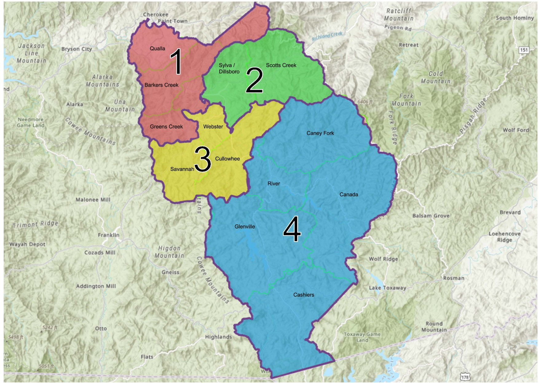
Open survey:
Able to see geographic
differences in need
District 1 (Top 5)
Nature trails
Jogging/walking trails (paved)
Fitness facility
Open space
Farmers market
District 2 (Top 5)
Jogging/walking trails (paved)
Nature trails
Open space
Farmers market
Bicycle trails
District 3 (Top 5)
Jogging/walking trails (paved)
Nature trails
Open space
Fitness facility
Indoor swimming pool
District 4 (Top 5)
Fitness facility
Jogging/walking trails (paved)
Indoor swimming pool
Nature trails
Outdoor swimming pool
Notes:
There are about 6 objectives of all community planning processes and the resulting plans that we consider benefits to the community:
The first is framing the issues and opportunities. By defining them, we can create a “snapshot” of what’s happening today so everyone can move forward with purpose.
We can then focus on what we want for the future of the community. We need a clear view of that future condition. We can all move in the same direction if we’re working toward a shared vision.
The plan, which will have detailed recommendations and implementation strategies, should serve as a guide in all decision making. This is especially important when City leaders are faced with decisions about development approvals and the use of tax revenue for capital investments, such as utilities to support desired development or parks and other public amenities to improve the quality of life in the community.
The plan should also have everyone singing from the same sheet of music, so to speak. By communicating what the community wants and how to achieve it, all department and partner agencies can coordinate efforts to maximize available resources.
When pursuing grants, the adopted plan can increase chances of obtaining funding. It can strengthen the application by demonstrating the City’s commitment to specific improvements.
And, finally, the plan is a step toward compliance with State statutes… among other things, an up-to-date plan is required as a foundation for local land development regulations, such as zoning. Soon, the City will be subject to the new requirements of 160D.

Slide 12
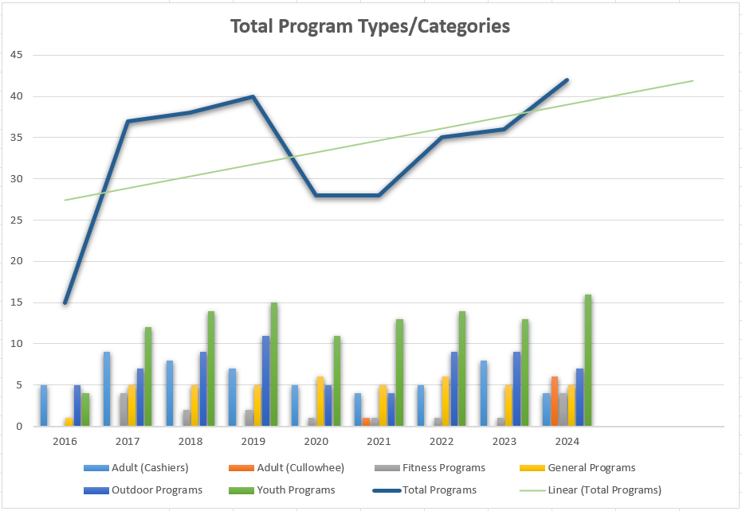
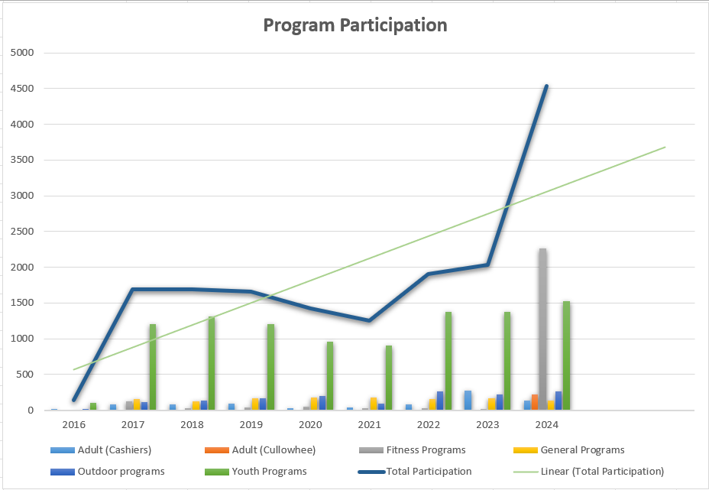
Program and System Analysis Cont.
Your program offerings and participation are growing
Notes:
There are about 6 objectives of all community planning processes and the resulting plans that we consider benefits to the community:
The first is framing the issues and opportunities. By defining them, we can create a “snapshot” of what’s happening today so everyone can move forward with purpose.
We can then focus on what we want for the future of the community. We need a clear view of that future condition. We can all move in the same direction if we’re working toward a shared vision.
The plan, which will have detailed recommendations and implementation strategies, should serve as a guide in all decision making. This is especially important when City leaders are faced with decisions about development approvals and the use of tax revenue for capital investments, such as utilities to support desired development or parks and other public amenities to improve the quality of life in the community.
The plan should also have everyone singing from the same sheet of music, so to speak. By communicating what the community wants and how to achieve it, all department and partner agencies can coordinate efforts to maximize available resources.
When pursuing grants, the adopted plan can increase chances of obtaining funding. It can strengthen the application by demonstrating the City’s commitment to specific improvements.
And, finally, the plan is a step toward compliance with State statutes… among other things, an up-to-date plan is required as a foundation for local land development regulations, such as zoning. Soon, the City will be subject to the new requirements of 160D.

Slide 13
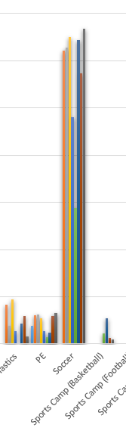
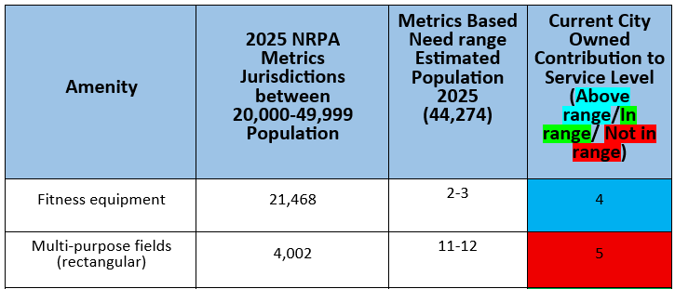
Program and System Analysis Cont.
Some facilities are artificially capping enrollment
Fields can only handle so much play
Notes:
There are about 6 objectives of all community planning processes and the resulting plans that we consider benefits to the community:
The first is framing the issues and opportunities. By defining them, we can create a “snapshot” of what’s happening today so everyone can move forward with purpose.
We can then focus on what we want for the future of the community. We need a clear view of that future condition. We can all move in the same direction if we’re working toward a shared vision.
The plan, which will have detailed recommendations and implementation strategies, should serve as a guide in all decision making. This is especially important when City leaders are faced with decisions about development approvals and the use of tax revenue for capital investments, such as utilities to support desired development or parks and other public amenities to improve the quality of life in the community.
The plan should also have everyone singing from the same sheet of music, so to speak. By communicating what the community wants and how to achieve it, all department and partner agencies can coordinate efforts to maximize available resources.
When pursuing grants, the adopted plan can increase chances of obtaining funding. It can strengthen the application by demonstrating the City’s commitment to specific improvements.
And, finally, the plan is a step toward compliance with State statutes… among other things, an up-to-date plan is required as a foundation for local land development regulations, such as zoning. Soon, the City will be subject to the new requirements of 160D.

Slide 14
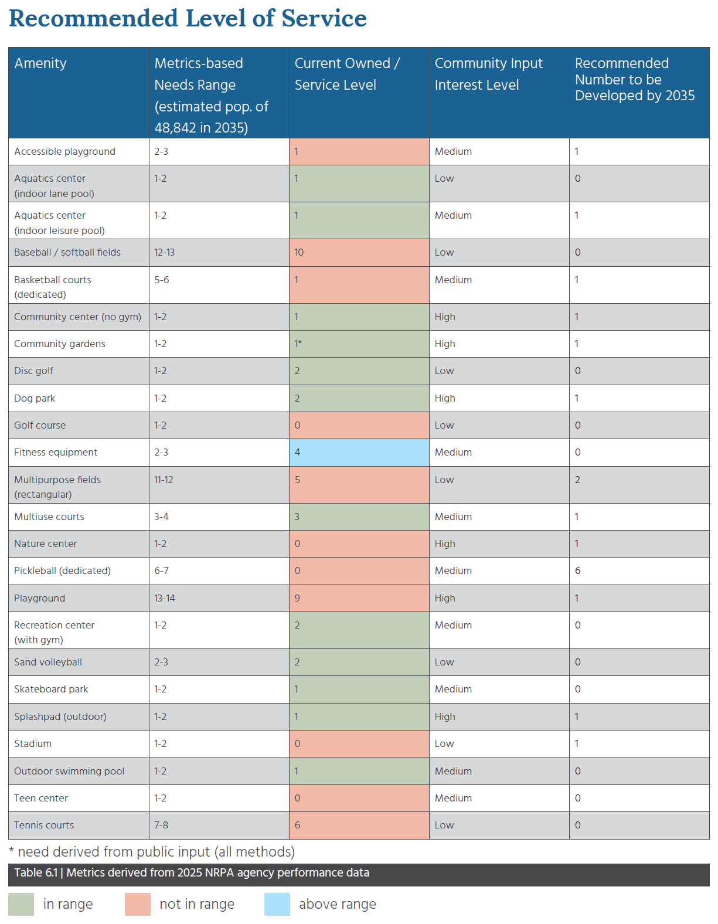
Recommended level of service
The County had already started to plan for several facility types in need of growth
This plan confirms those needs exist
Skate park was needed,
and was just completed!
Playgrounds/Accessible playgrounds
Pickleball
Splash pad
Tennis courts
Notes:
There are about 6 objectives of all community planning processes and the resulting plans that we consider benefits to the community:
The first is framing the issues and opportunities. By defining them, we can create a “snapshot” of what’s happening today so everyone can move forward with purpose.
We can then focus on what we want for the future of the community. We need a clear view of that future condition. We can all move in the same direction if we’re working toward a shared vision.
The plan, which will have detailed recommendations and implementation strategies, should serve as a guide in all decision making. This is especially important when City leaders are faced with decisions about development approvals and the use of tax revenue for capital investments, such as utilities to support desired development or parks and other public amenities to improve the quality of life in the community.
The plan should also have everyone singing from the same sheet of music, so to speak. By communicating what the community wants and how to achieve it, all department and partner agencies can coordinate efforts to maximize available resources.
When pursuing grants, the adopted plan can increase chances of obtaining funding. It can strengthen the application by demonstrating the City’s commitment to specific improvements.
And, finally, the plan is a step toward compliance with State statutes… among other things, an up-to-date plan is required as a foundation for local land development regulations, such as zoning. Soon, the City will be subject to the new requirements of 160D.

Slide 15
Recommended level of service
Other need areas still need to be planned for:
Indoor programing space
Nature center
Event space
Multi-purpose fields
Finding viable parkland will very tough, make the best use and expand your existing parks when possible
Plan for new facilities to meet multiple different needs
Notes:
There are about 6 objectives of all community planning processes and the resulting plans that we consider benefits to the community:
The first is framing the issues and opportunities. By defining them, we can create a “snapshot” of what’s happening today so everyone can move forward with purpose.
We can then focus on what we want for the future of the community. We need a clear view of that future condition. We can all move in the same direction if we’re working toward a shared vision.
The plan, which will have detailed recommendations and implementation strategies, should serve as a guide in all decision making. This is especially important when City leaders are faced with decisions about development approvals and the use of tax revenue for capital investments, such as utilities to support desired development or parks and other public amenities to improve the quality of life in the community.
The plan should also have everyone singing from the same sheet of music, so to speak. By communicating what the community wants and how to achieve it, all department and partner agencies can coordinate efforts to maximize available resources.
When pursuing grants, the adopted plan can increase chances of obtaining funding. It can strengthen the application by demonstrating the City’s commitment to specific improvements.
And, finally, the plan is a step toward compliance with State statutes… among other things, an up-to-date plan is required as a foundation for local land development regulations, such as zoning. Soon, the City will be subject to the new requirements of 160D.

Slide 16
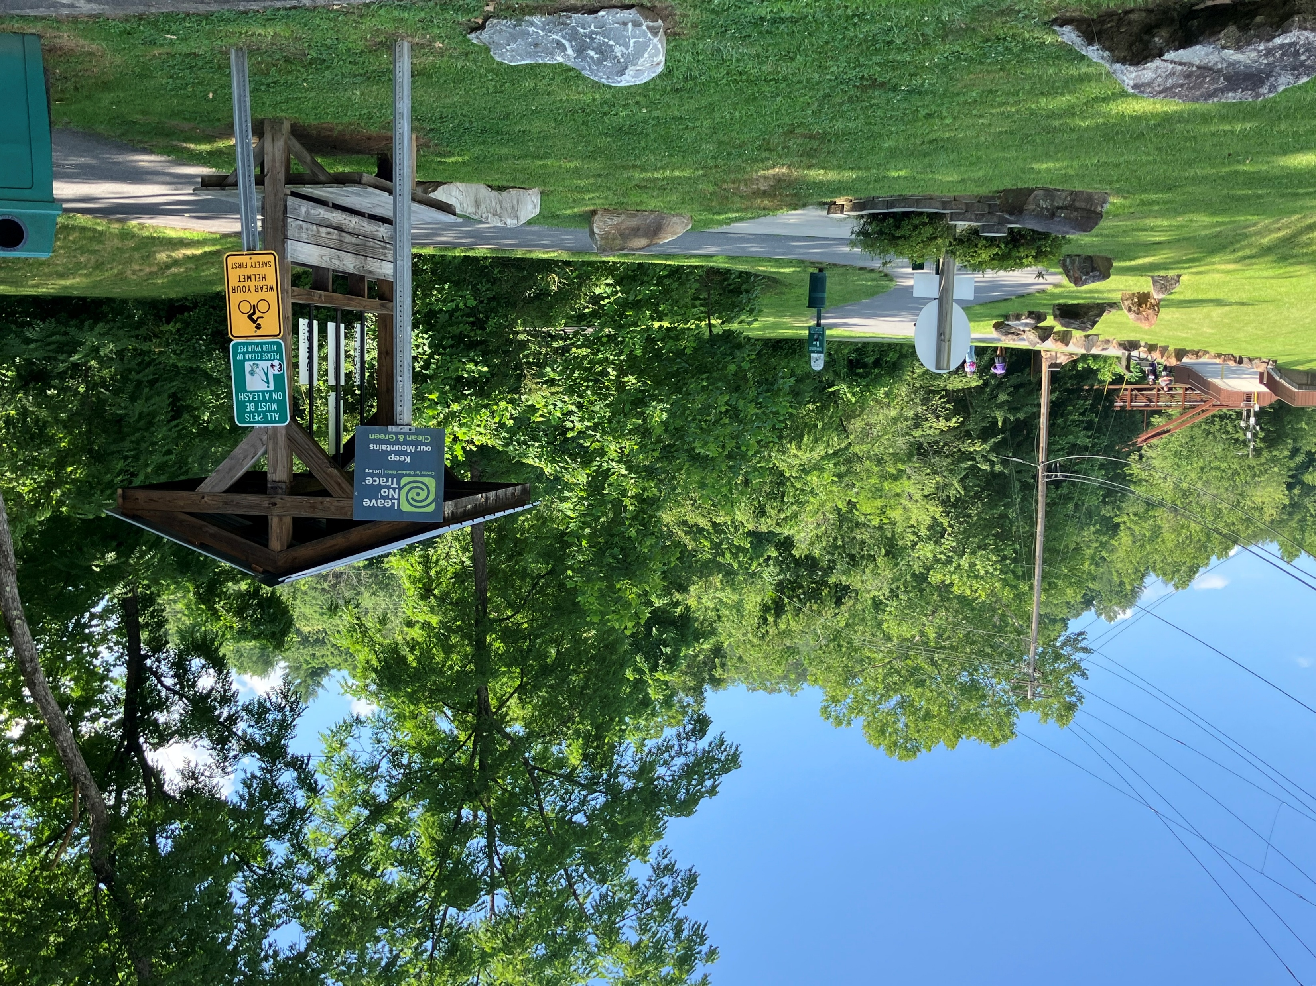
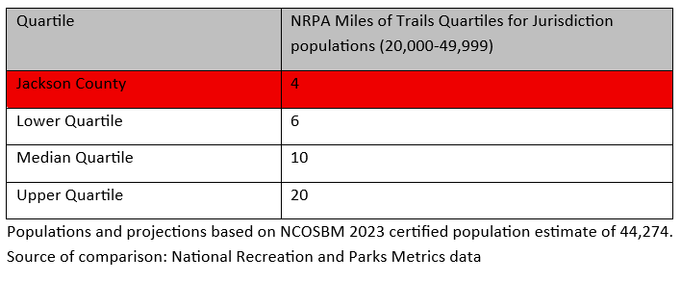
Benchmarking your trails
Need for more trails and greenways is absolutely confirmed
Paved and unpaved trails both within 10 ten facility needs
Notes:
There are about 6 objectives of all community planning processes and the resulting plans that we consider benefits to the community:
The first is framing the issues and opportunities. By defining them, we can create a “snapshot” of what’s happening today so everyone can move forward with purpose.
We can then focus on what we want for the future of the community. We need a clear view of that future condition. We can all move in the same direction if we’re working toward a shared vision.
The plan, which will have detailed recommendations and implementation strategies, should serve as a guide in all decision making. This is especially important when City leaders are faced with decisions about development approvals and the use of tax revenue for capital investments, such as utilities to support desired development or parks and other public amenities to improve the quality of life in the community.
The plan should also have everyone singing from the same sheet of music, so to speak. By communicating what the community wants and how to achieve it, all department and partner agencies can coordinate efforts to maximize available resources.
When pursuing grants, the adopted plan can increase chances of obtaining funding. It can strengthen the application by demonstrating the City’s commitment to specific improvements.
And, finally, the plan is a step toward compliance with State statutes… among other things, an up-to-date plan is required as a foundation for local land development regulations, such as zoning. Soon, the City will be subject to the new requirements of 160D.

Slide 17
Key Recommendation Themes
Trails and greenways
Plan your trail and greenway system
Anticipate continual development
Expand your trail and greenway system
Update several existing parks
Usable land is high demand
Most of your parks are in great shape, but land locked
Plan to update several of your existing parks to meet current demand
More event space is needed
Environ. ed. + community space
Indoor athletics + indoor event space
Develop with dual usage opportunities in mind

Slide 18
Key Recommendation Themes
Marketing & Branding
Lean into being a regional
outdoor recreation destination
Showcase updated parks
Grow your outdoor recreation economic appeal/sector
Staffing
Address lifeguard shortages
Decrease the chance of fatigue related liability
Remove the bottleneck for use of the new aquatics center
Create enterprise opportunities
Leverage your tourism appeal
Camping, RVs and adventure rec.
Ensure residents have priority
Reinvest your visitor revenue back into the park system to leverage general fund investments

Slide 19
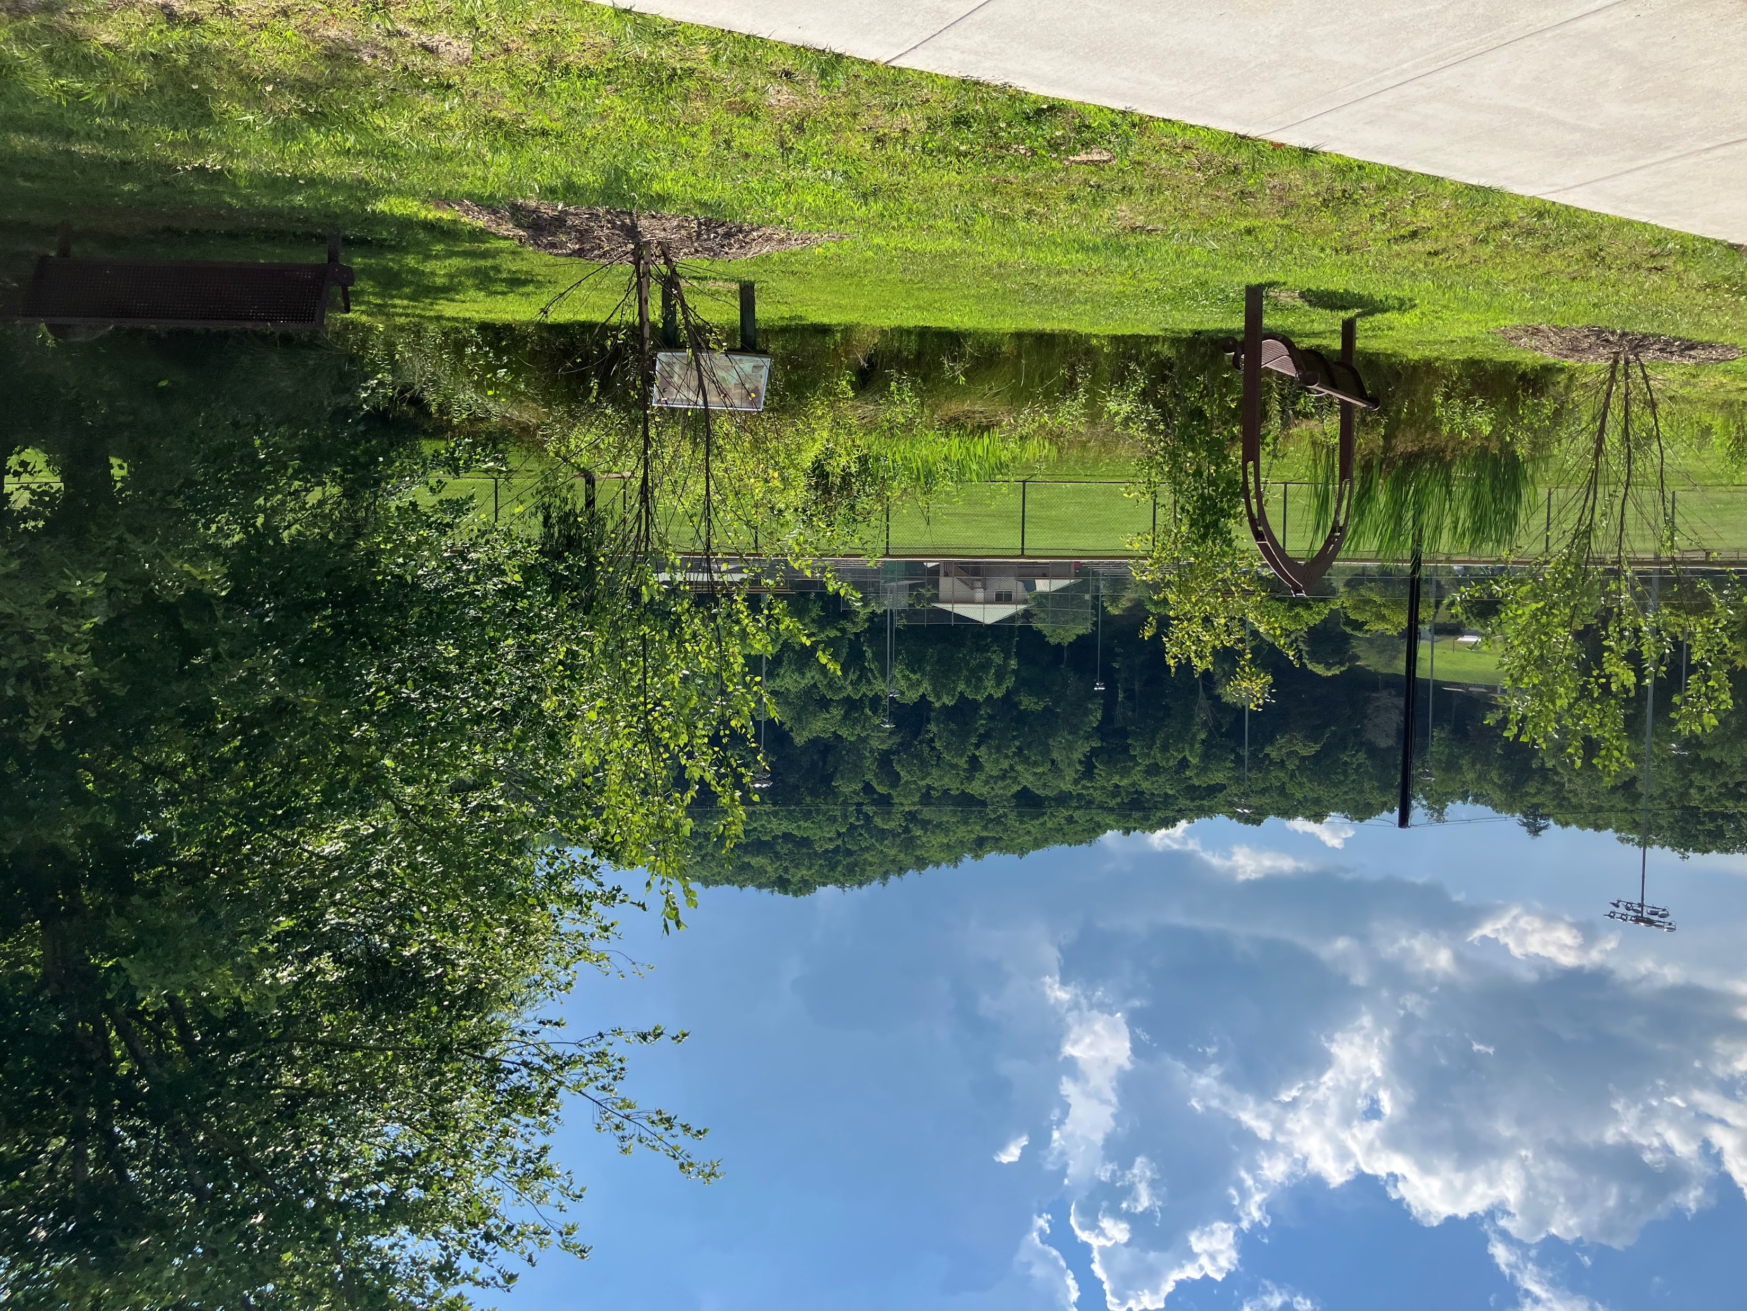
Questions?
Notes:
As we kick off this project, we’d like to get your thoughts! When the decision to move forward with an updated plan for the City was made, you probably had one or two key objectives of your own in mind. What were they? What are your expectations for the plan? What do you think it should do for the City?
And what does success look like? If you had to name one thing that should be true about the plan when it is done—or the City 10 years from now—to fully believe that this project was worth the effort, what would that be?

