Slide 1
Amanda Allen, Director
Jackson Co. Commissioners’ Working Session
June 3, 2024

Slide 2
mission
Conducting safe, secure, fair & impartial elections for the people of Jackson County.
Effective processes // Proactive planning
// Multi-partisan, community-led efforts

Slide 3
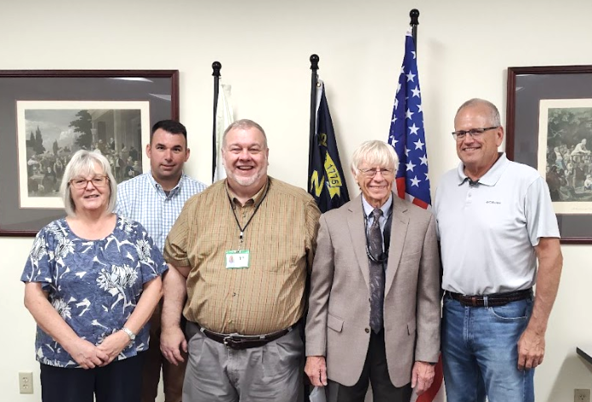
WHo we are & What we do
The Board of Elections (BOE) is a state-mandated county department
Governed by five appointed, multi-partisan Board members
Board-appointed Director oversees day-to-day operations and election administration
Bound by local, state and federal election laws and rules from the State Board of Elections (SBE)
County government’s role is largely budgetary
1 to 3 elections held every year, but election functions occur daily
Current Board: Ann Melton, Secretary; Michael Moore; Kirk Stephens, Chair; Roy Osborn; Ron Mau

Slide 4
Key Election Tasks
Candidacy
Program & test
Ballot processing
All candidate filing is done at the BOE, including petitions.
Voting equipment is tested and uniquely programmed prior to each election.
In-person (Early & Election Day), Absentee-By-Mail and Provisional
Campaign finance
Poll Workers
Administer Election
All campaigns must follow campaign finance law; often locally administered.
Recruit, train & deploy 150+ precinct workers; 50+ new workers in 2024!
Includes 1-5 Early Voting sites and 13 Election Day precincts. Plus, processing any challenges or protests.

Slide 5
Year-round tasks
Voter Registration
List Maintenance - Daily, weekly, monthly, annual & biennial functions for deaths, felonies, cancellations etc.
Mapping - Collaboration with local, Tribal & state GIS
Media & Public Engagement
Public Records Requests
Campaign Finance - Reports fall throughout the year + audits
Petition Processing - Local- & state-level
Training/Conferences - Mandated for Board & Director, at a minimum

Slide 6
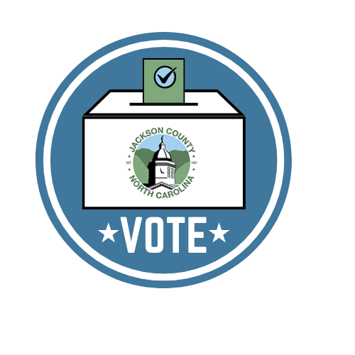
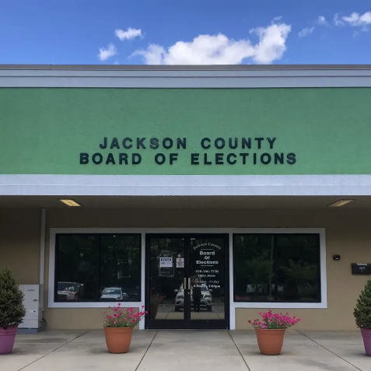
(always) Preparing for the next election
After Action Analysis - With precinct workers, staff, Board, stakeholders
Scheduling & Checklists
Jurisdictional Audits
Emergency & Security Planning - 2024 advances include cameras & access controls
Voting Equipment Maintenance - Performed annually by PrintElect
Coordinating Voting Sites
Supply inventory/ordering
Forecasting staffing - Recruitment & retention
Preparing for changes
…. and much more!

Slide 7
2024 Stat snapshot
3
30,403
44
35
5,321
125
Ballots cast
Days of in-person voting
Successful countywide elections
72.32% General Turnout
2.27% 2nd Primary Turnout
26.26% Primary Turnout
Plus, 160 days of Absentee by-mail voting, 27 days of processing results, and 29 days of candidate filing.
Primary, Second Republican Primary, General Election
Poll worker
training sessions
New registrations processed
Voter PHOTO IDS
At least two classes are required for every precinct worker before they serve in a polling place.
Voter registration changes happen daily - almost 39,000 transactions!
All voters are asked to provide valid photo ID when voting. County BOEs can provide FREE IDs to registered voters. Mobile voter ID clinics have been successful.

Slide 8
2020
2024
Presidential election comparison
Turnout
turnout
72.67%
21, 504 votes out of 29,593
72.32%
22,091 votes out of 30,547
Affiliation
9 NC options; Unaffiliated remains largest in Jackson
Absentee by-mail & Early voting
Absentee by-mail & Early voting
2800+ absentee accepted; 14,700+ EV
886 absentee accepted;
16,746 EV
NCSBE.gov // Results & Data

Slide 9
Challenges
Survived in 2024
Anticipated in 2025
SBE & BOE turnover
New administrative burdens & compressed deadlines (SB 382)
Increase in election administration legislation & litigation; quickness for immediate implementation of law or court decisions (like an unfunded statewide bond election)
Limited time between election cycles
Voter Photo ID implementation & vast changes to election law (SB747)
Employee & Board turnover
SBE Wellness Check
Ballot reconfiguration & absentee release delay
Hurricane Helene
“New Model” of election preference?
Six-month long statewide election protest

Slide 10
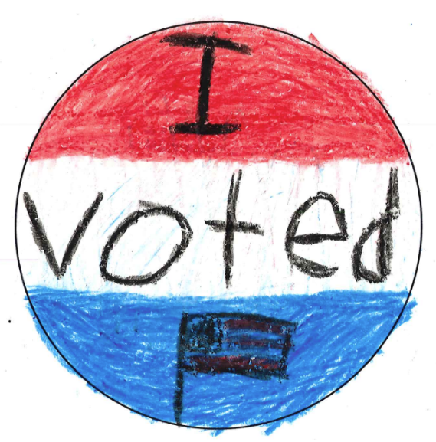
2025-26 FY Goals
Safe & Secure Voting
Community Partnerships
maintain election Standards
Emergencies & disasters
Voter trust & confidence
Diligence and high quality work
Build & maintain relationships
Reaching less engaged citizens
Invest in poll workers
Support office staff
Diversified workforce
Succession planning
Add Computer & GIS Support Tech
Professional development
Policies & procedures

Slide 11
2025 Election Dates
EVENT | DATE
Municipal Candidate Filing | Monday, July 7 (8am) - Friday, 18 (noon)
Voter Registration Deadline (for absentee and Election Day voting) | Friday, October 10 (5pm)*
Absentee Ballots Must be Available | Friday, October 3
Early Voting Begins (Same-Day Registration available) | Thursday, October 16
Election Day | Tuesday, November 4 (Polls open 6:30am- 7:30pm)
Deadline to Return Absentee Ballot | Tuesday, November 4 (7:30pm)*
Deadline to Provide HAVA ID, Photo ID and/or Absentee Cures | Friday, November 7 (noon)
County Canvass (certifying election) | Friday, November 14 (11am)
Statewide General Election Candidate Filing | Monday, December 1 (8am) - Friday, 19 (noon)
*Deadlines vary for UOCAVA voters (military and civilian overseas)

Slide 12
Questions?
contact:
876 Skyland Dr. - Suite 1
Sylva, NC 28779
828.586.7538
ElectionsInfo@JacksonNC.org
JCNCElections.org

